Slide 1
School & District Improvement Frameworks 2.0
Beth Brophy
Calhoun ISD
January 2015

Slide 2
School & District Improvement Frameworks 2.0
Wireless: cisd public
Username: guest
Password: 53dd0300

Slide 3


School & District Improvement Frameworks 2.0
The State Board of Education approved both the School Improvement Framework 2.0 and the District Improvement Framework 2.0 on
March 11, 2014
You asked: We listened!
  Updated and Streamlined
  Collaborative Input
  A Process, not just a Report
Notes:
Schools and districts have been working with version 1.0 since 2005. It became apparent over time that revisions were needed.
You requested streamlined; 40/90 becomes 26 and 19 becomes 10
The data strand has been integrated throughout the other strands meaning that 5 strands have become 4
The revision process including input from numerous agencies, organizations and educators.
The 2.0 version will allow educators to focus their time and energies on what is truly important in moving teaching and learning forward.

Slide 4
Supporting Documents
SIF 2.0
DIF 2.0
School Improvement Framework Overview
School System Review (SSR)
SIF Cards
District Improvement Framework Overview
District System Review (DSR)
DIF Cards
Glossary (covers both SIF and DIF)
Colored Chart for Observation Notes (both SIF and DIF)
Notes:
In version 2.0 attention was given to the fact that schools and districts operate differently and yet must work together as a system. SIF-DIF 2.0 works to specifically address the needs of each level.

Slide 5

Notes:
This short video clip (Cogs) helps reinforce the idea of “systems”.
FYI: This was actually a “one-take” video!

Slide 6
When you consider school and district improvement as a process, how is it also like a system?
Notes:
Allow participants to work in pairs or at tables for 2 minutes. Ask for 2-3 people to share out.

Slide 7
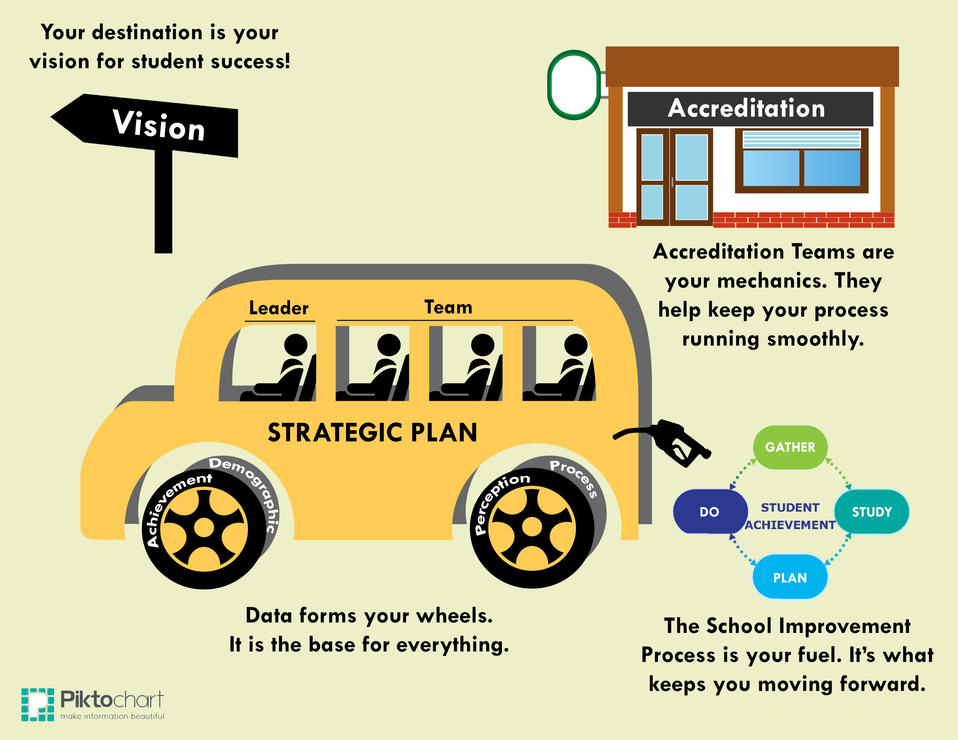
Notes:
Have one member of the team discuss how the MICSI team was asked that question, but also asked to consider a visual to represent their thinking. Describe the graphic component by component.

Slide 8
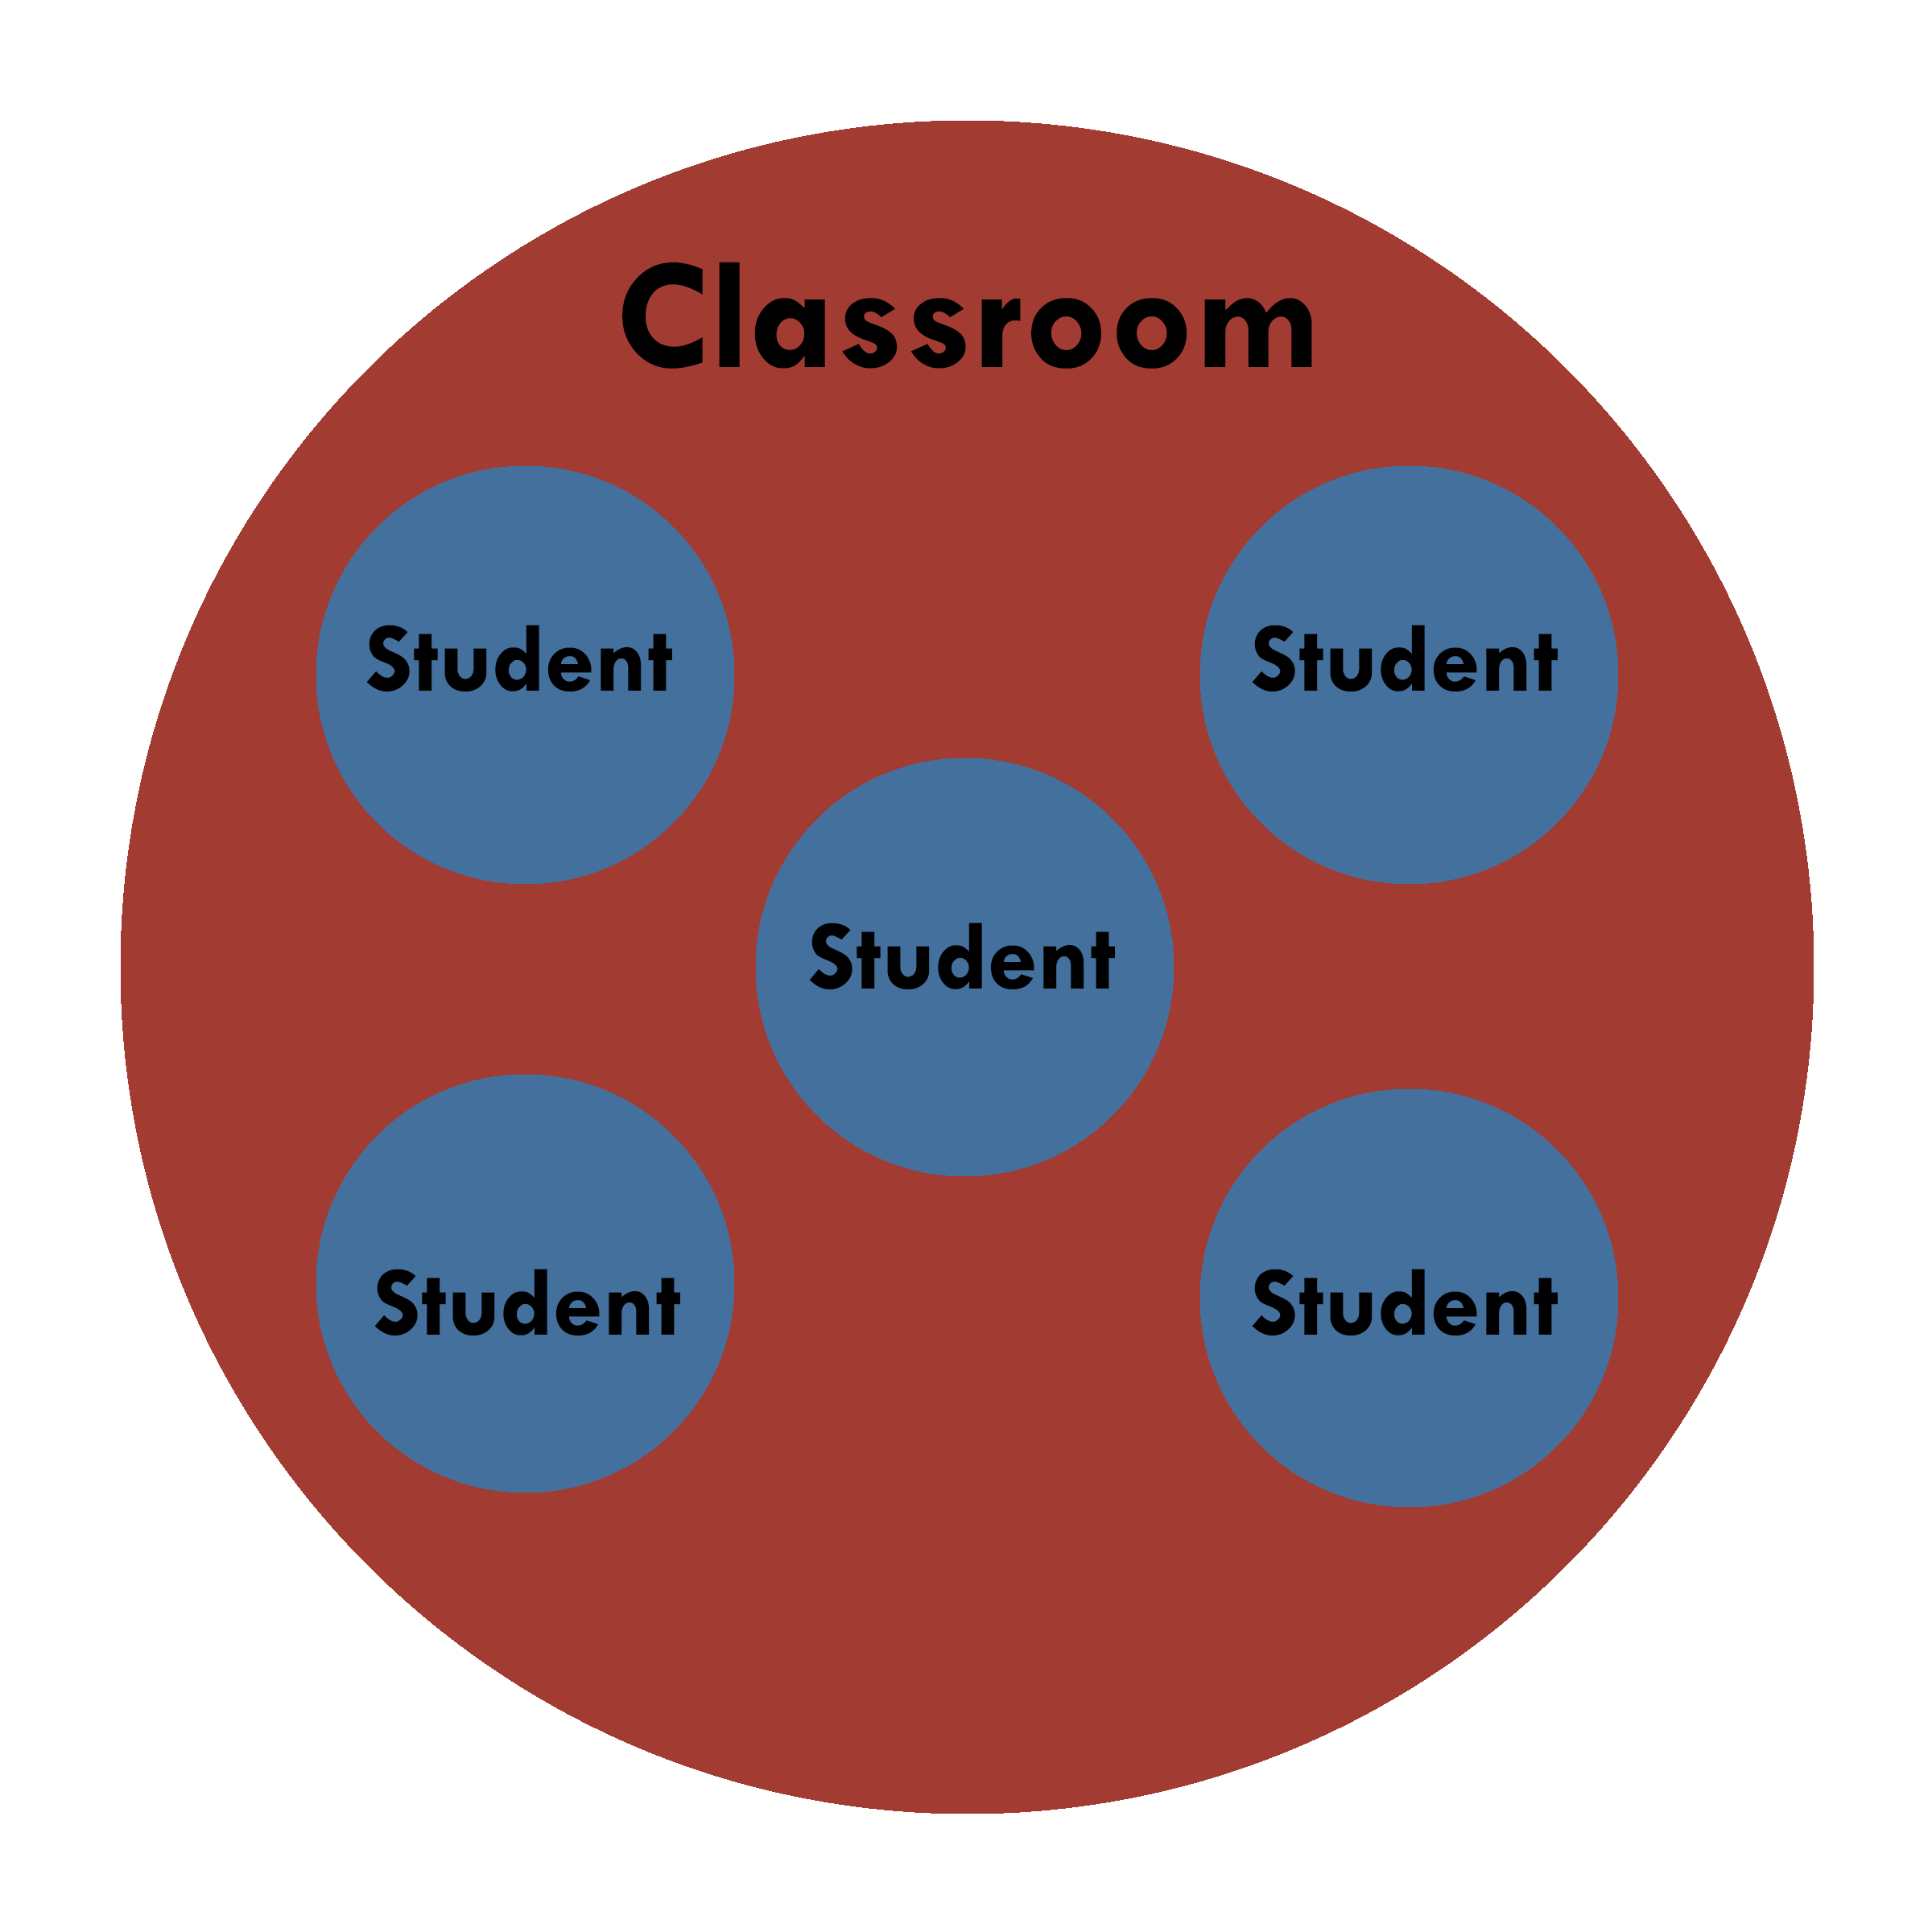
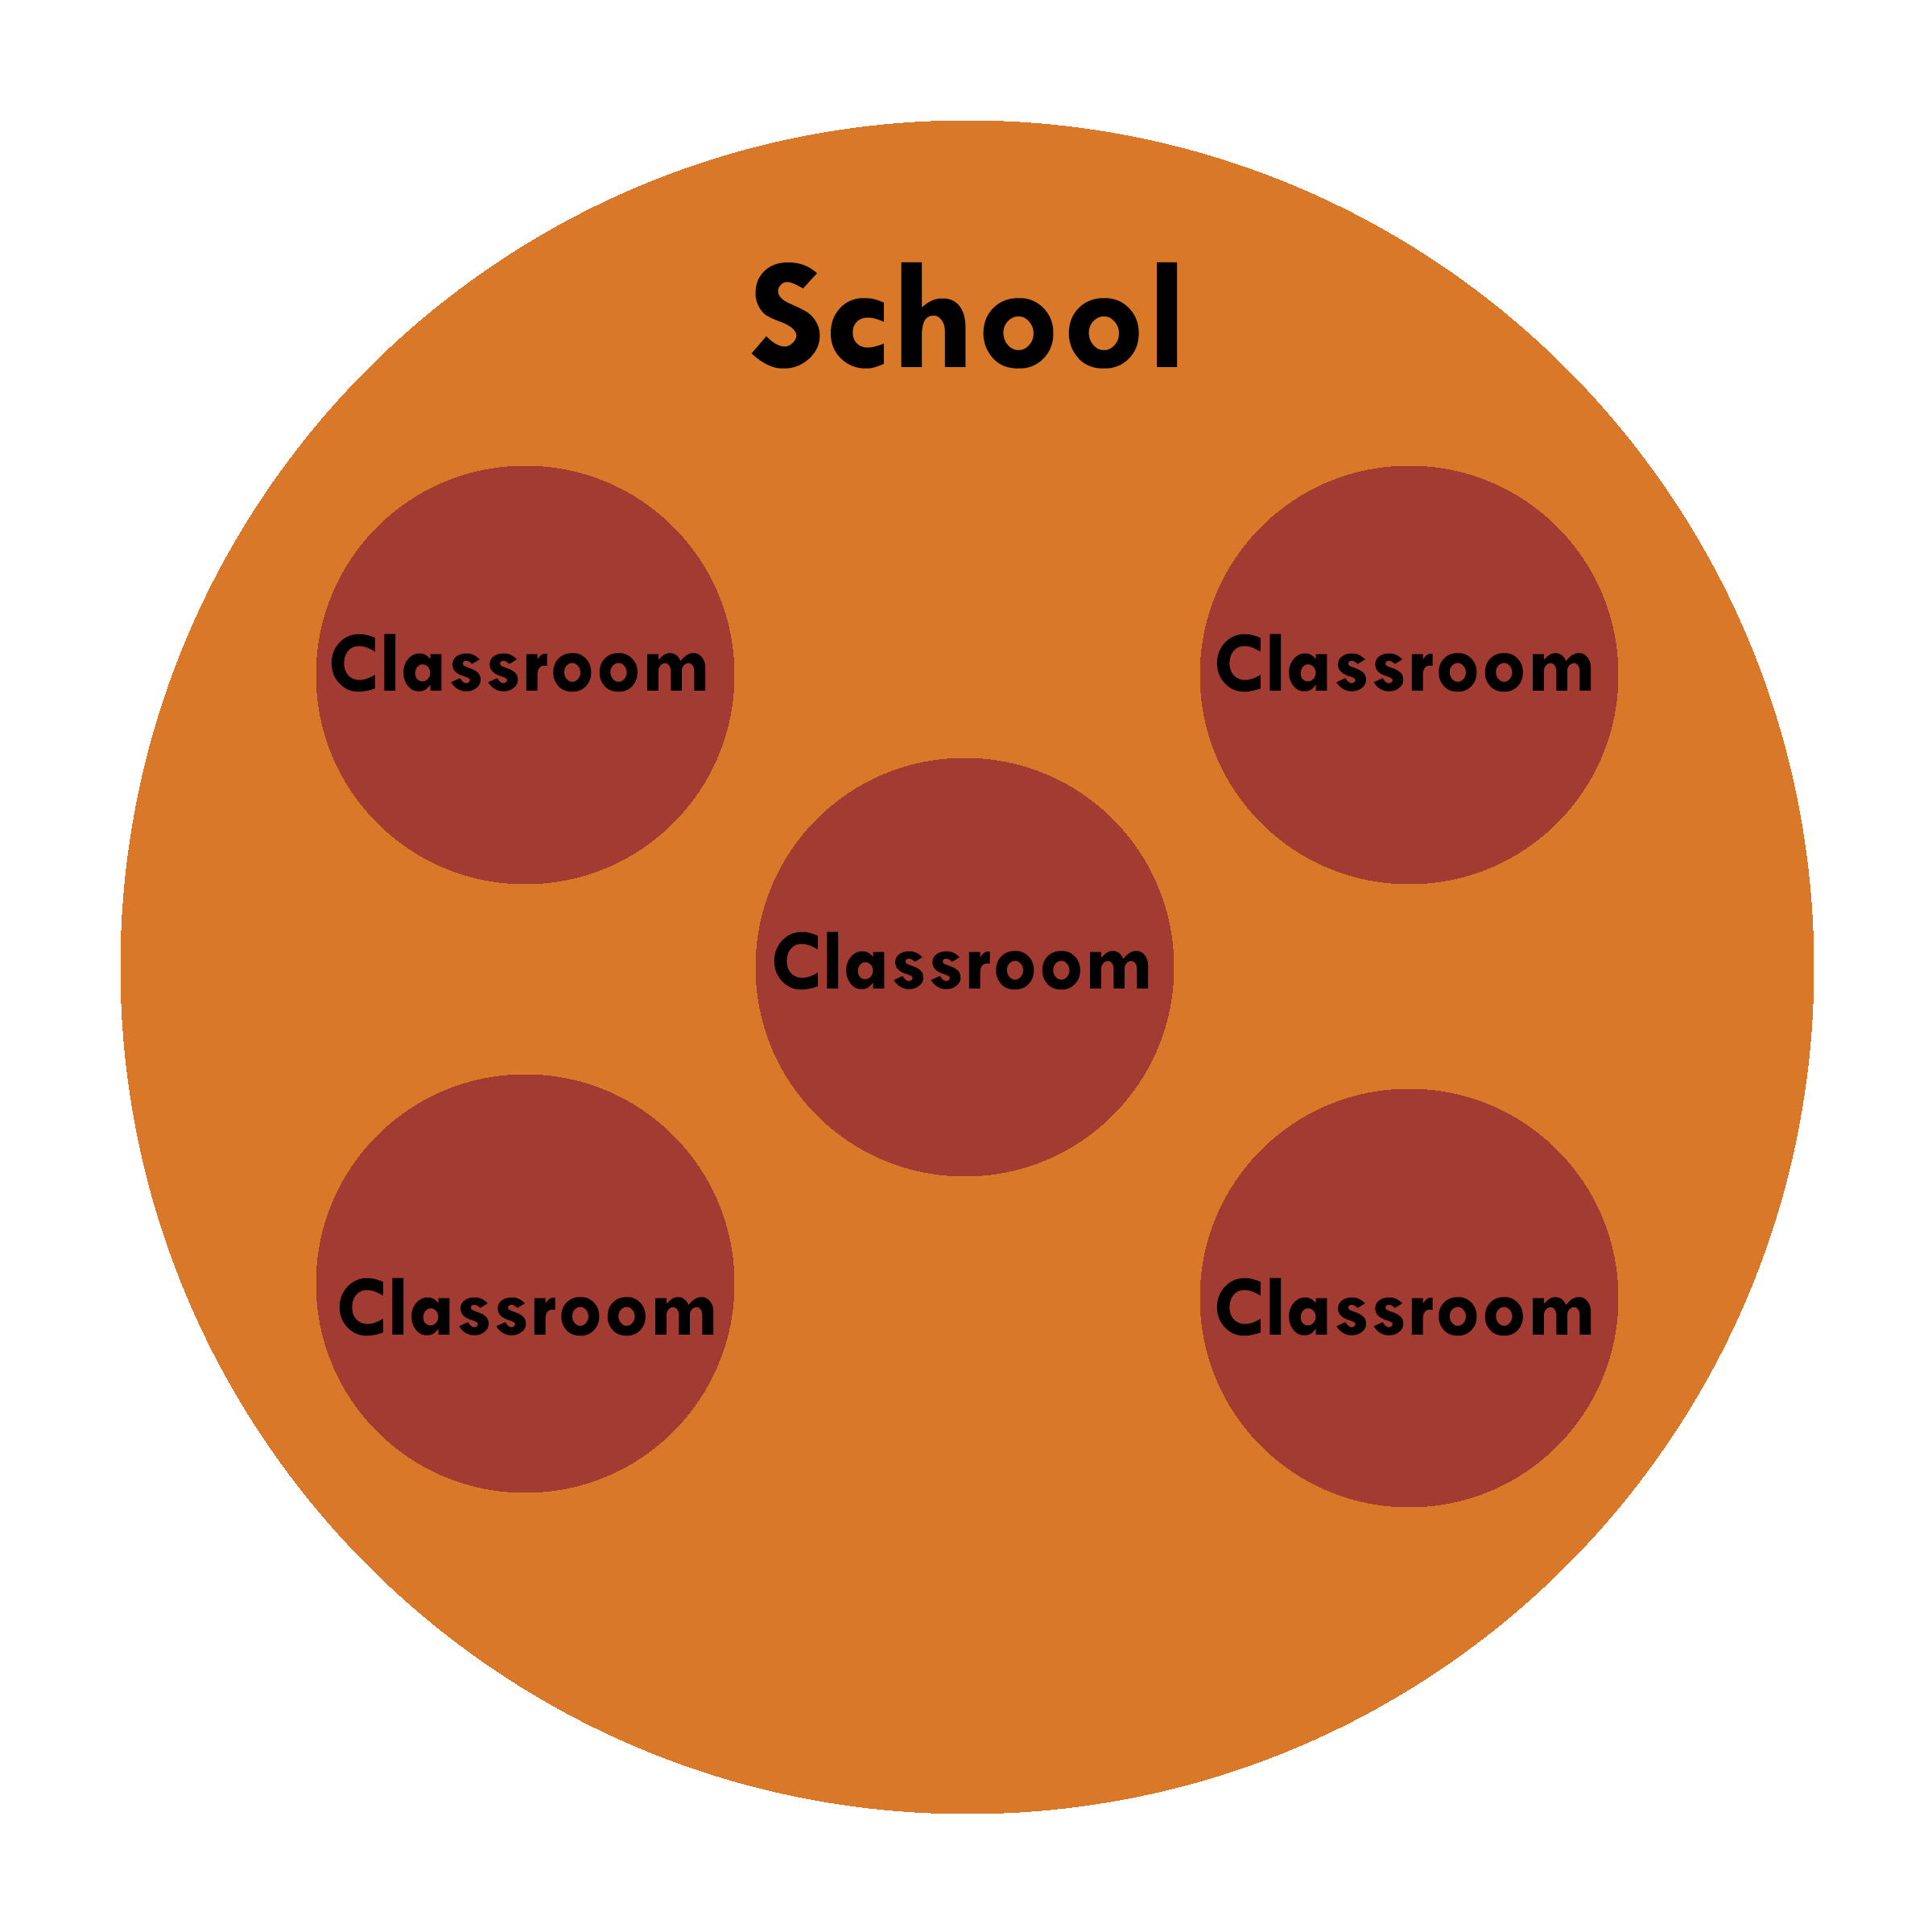
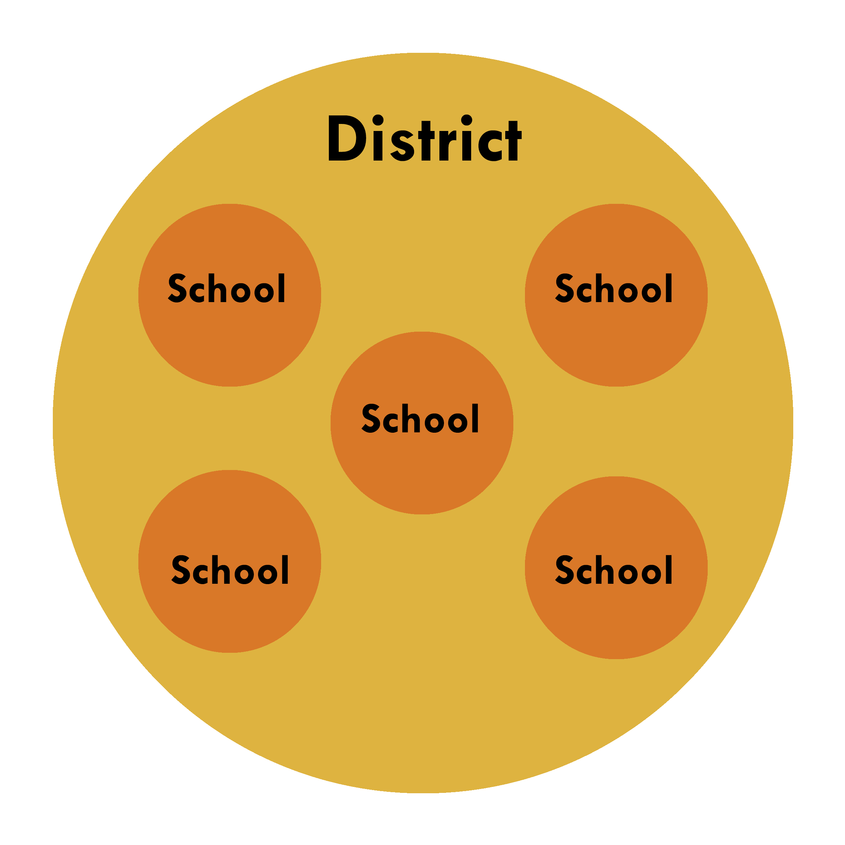
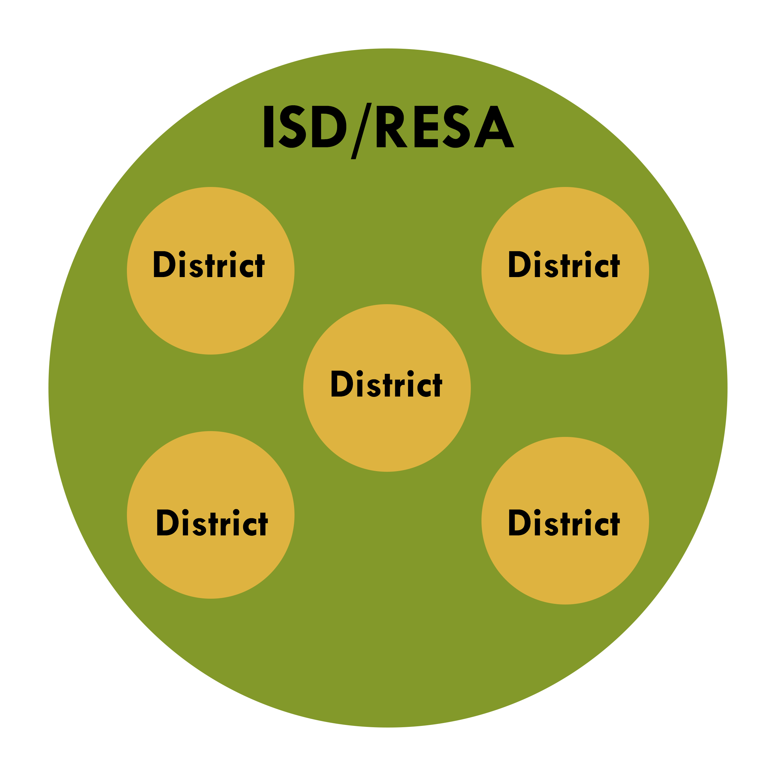

A System of Systems
Notes:
Where as the bus visual is one-dimensional, the reality for schools is that there are multiple layers or “systems within systems”. At each level, educators go through the gather – study – plan –do cycles as it is relevant to them using data points unique to them.

Slide 9
Notes:
Now, consider the bus visual again. This time reflect on how this applies to each level/system.

Slide 10
Continuous Improvement
What changes have you seen in education over the last five years?
How has your school or district sought to successfully address the evolving educational landscape?
Notes:
Since the release of SIF 1.0 in 2005, we have seen many changes within and surrounding education. Just think to yourself for a moment about two or three changes that have impacted you.
(*note, this will reappear in the interactive video)

Slide 11
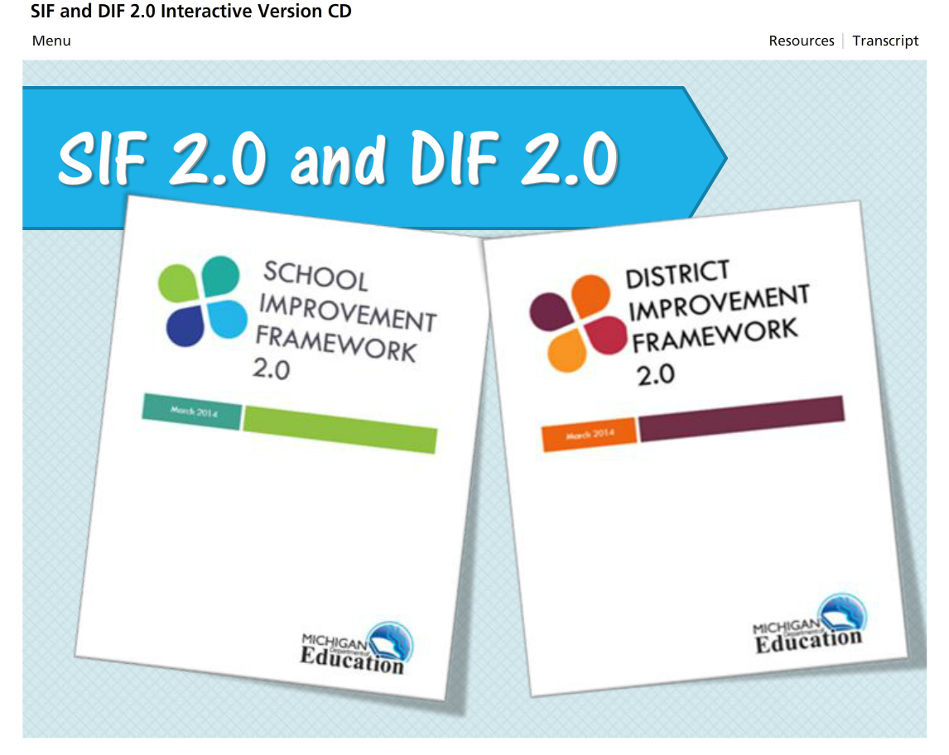
MVU Modules
SIF 2.0 and DIF 2.0
Notes:
Show Overview ONLY – Advanced Organizer. (handout)
We’re excited to share an engaging interactive video to introduce SIF-DIF 2.0. The video will be located on MVU

Slide 12


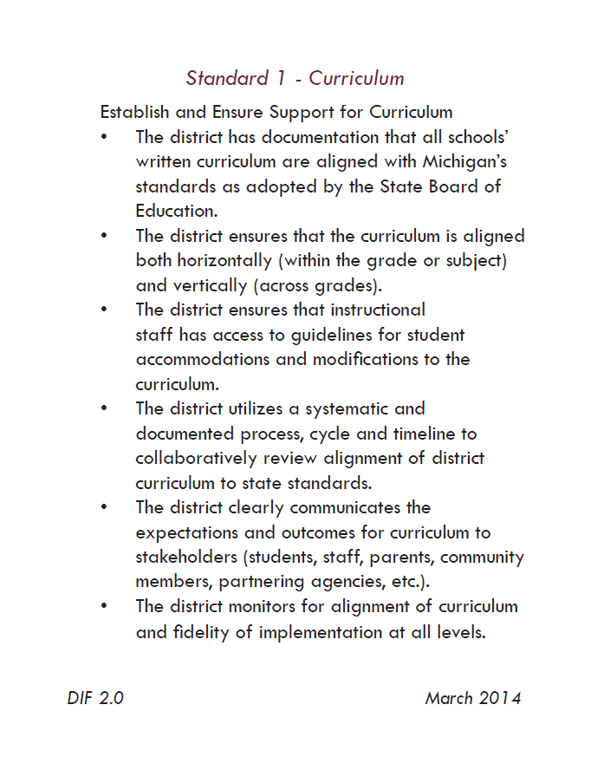
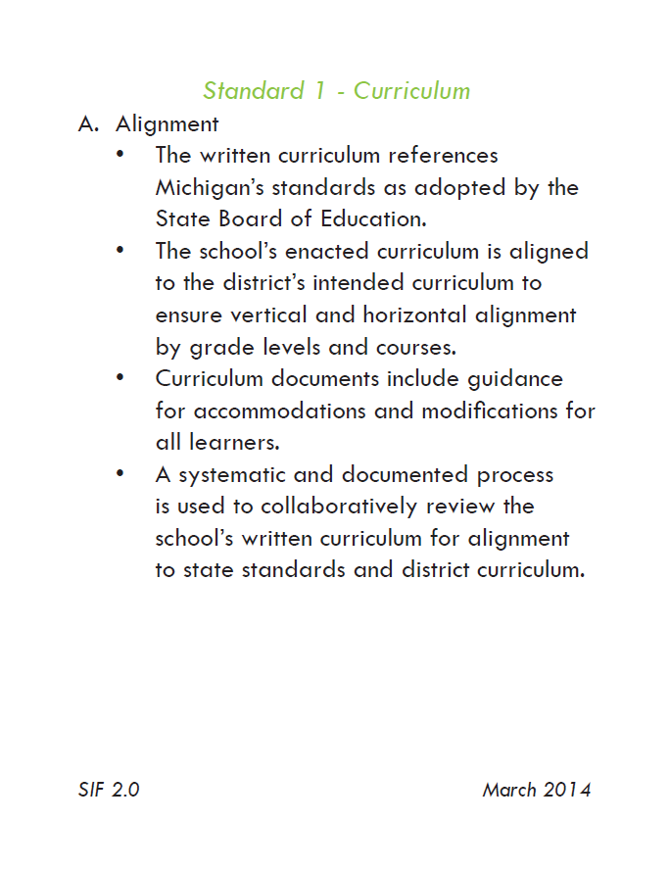
CARDS!
Notes:
A brief reference to the points and features on each card (front and back) to share!

Slide 13
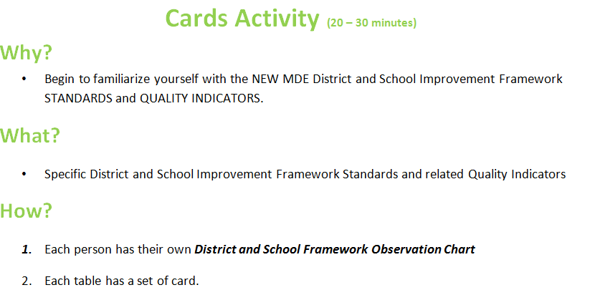
Be prepared to share Content and Connections with your tablemates.
Notes:
Each table will have one card deck and one set of 10 ledger-size activity sheets-
Have each person take at least one (Standard) district card and locate the corresponding (Standard) school cards.
Each person will locate the corresponding activity sheet page and begin (HANDOUT CARD ACTIVITY DIRECTIONS)

Slide 14
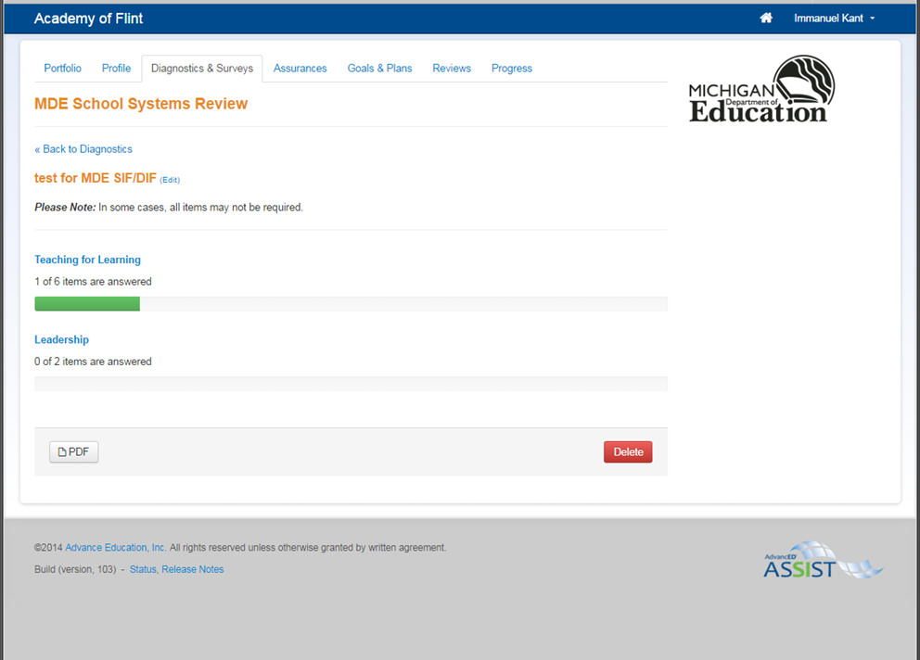

What to Expect
School Systems Review
Available in ASSIST by the end of January!
Notes:
With the advent of 2.0:
The School Systems Review will still be in ASSIST and replaces the School Process Rubrics (40/90 to 26)
The District Systems Review will still be in ASSIST and replaces the District Process Rubrics. (19 to 10)
Schools and Districts will still select level of performance/rating and select or insert evidence to support their choice
Schools and District will still be able to view a report summary showing each standard and the rating level selected.

Slide 15
MVU Modules
SIF 2.0 and DIF 2.0
Notes:
SIF 2.0 and DIF 2.0
Pull

Slide 16
School and District Systems Reviews
  Take a few minutes to examine the School or District Systems Review documents.
  What are your thoughts about using a guiding question to catalyze your discussions?
  What are your thoughts about starting with the Full Implementation column and moving left or right depending on your discussions?
  What do you like about the SSR or the DSR?
  What concerns do you have?

Slide 17
School and District Systems Reviews
  Questions?

Slide 18
School Improvement Timeline
School and District Systems Reviews
March 20 or…. 4 weeks prior to AdvancED External Review
  School Systems Review (SSR[26]), Interim Self-Assessment or Self-Assessment
    All of these meet the ED YES- Reporting Requirement
April 17 or…. 4 weeks prior to AdvancED External Review
  District Systems Review (DSR[10]), Interim Self-Assessment or Self-Assessment

Slide 19
School and District Systems Review
How might you gather input at your school or district?
  Introduce staff to the new SIF and/or DIF 2.0
  Review the School and/or District Systems Review
    Start with analysis the descriptions under Full Implementation
      Move left or right depending on analysis and evidence available
      Choose an implementation level and fill in evidence

Slide 20
School and District Systems Review
One Option
  Use the Google Forms provided to collect data from all staff
    Please copy the Google Form and rename it in your Google Drive
    Share the links with your staff
    Analyze results together with your staff
    Identify the evidence together with your staff

Slide 21
School Improvement Timeline
School and District Program Evaluation
  Don’t forget that the Program Evaluation Diagnostic is due June 30, 2015 for both schools and districts

Slide 22
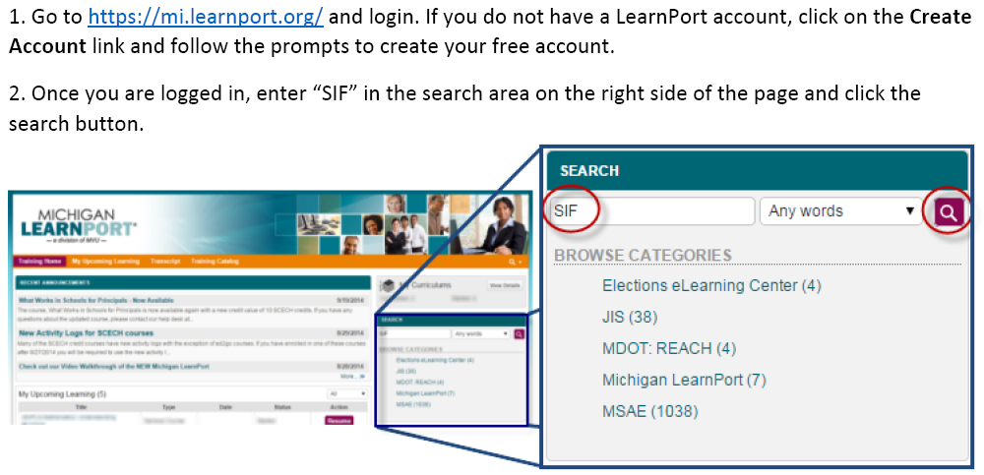
How to Access the MVU Training Course for SIF and DIF 2.0
Notes:
Handout

Slide 23
3 – 2 – 1 Reflection
– New points of learning
2 – Wonderings you may have
1 – Question still circling

Slide 24
MVU Link for use

