Slide 1
Demystifying Data
Mitch Fowler
School Data Consultant – Calhoun ISD
Email: fowlerm@calhounisd.org
Twitter: @fowlerm

Slide 2
Agenda
Defining Your Purpose
Using State Level Data to Look at the Big Picture
Developing Implementation Plans to Respond to Data
Identifying Assessment Tools and How Educators Will Use Them

Slide 3
Outcomes
Participants will:
identify their purpose for collecting data.
understand how to access and format state-level data to determine trends across time.
explore implementation plans as a tool to respond to data.
identify how tools like Google Docs can be used to collect and organize assessment data.

Slide 4
Today’s Plan
Purpose
State Data
Implementation Plan
Assessment Tools

Slide 5
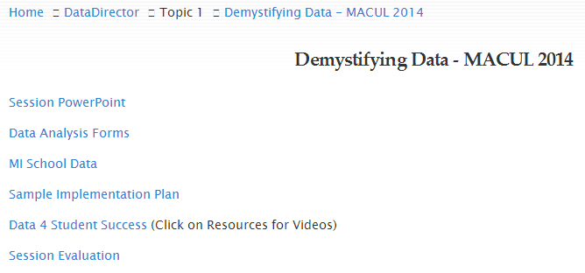
Today’s Resources
http://tinyurl.com/DemystifyingDataMACUL2014

Slide 6
Defining Your Purpose
Within your role, what are you expected to know about and do with data?
What do you expect teachers to know about and do with data?
What questions guide your work?
What are you hoping to walk away with today?

Slide 7
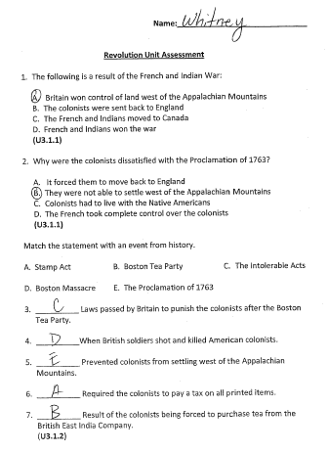
Analyze your data…

Slide 8
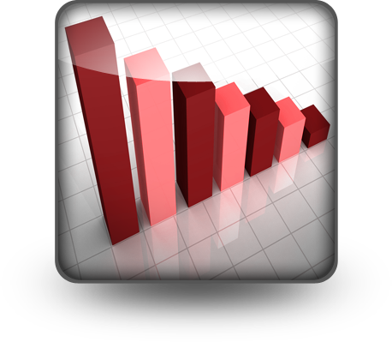
What was taught?
What went well?
What didn’t go well?
What are you going to do next?
Notes:
The classroom data analysis we will go through today will help to answer these four questions. I will provide you with templates to help answer these questions.

Slide 9
Analyze your data… using the following framework to answer the guiding questions.

Slide 10
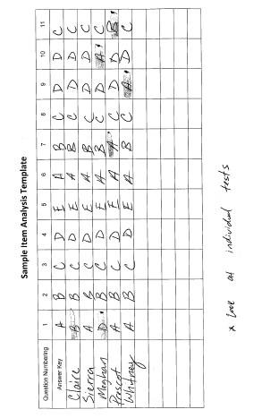
Notes:
Item Analysis:
Kids’ names along the left
Kids’ answers to each question

Slide 11
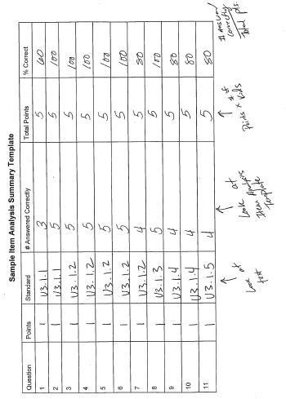
Notes:
Item Analysis Summary:
Each question’s point value
Each question’s standard (need to have the standard)
# of students answered correctly
Total Points = # of kids tested x’s Points column
% Correct = # Answered Correctly/Total Points

Slide 12
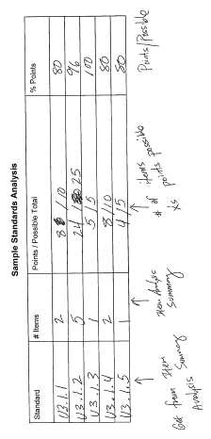
Notes:
Standards Analysis:
Write the Standards Assessed on the left
Write the # of items that are assessing the standard
Points = # of points earned by ALL students on the items assessed within the standard
Possible Total = # of points possible on ALL items assessed within the standard
% Possible = Points / Possible Total

Slide 13
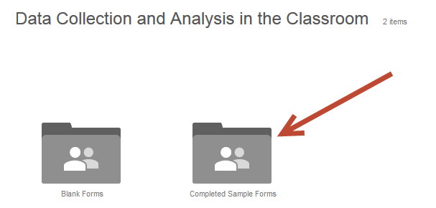

Slide 15
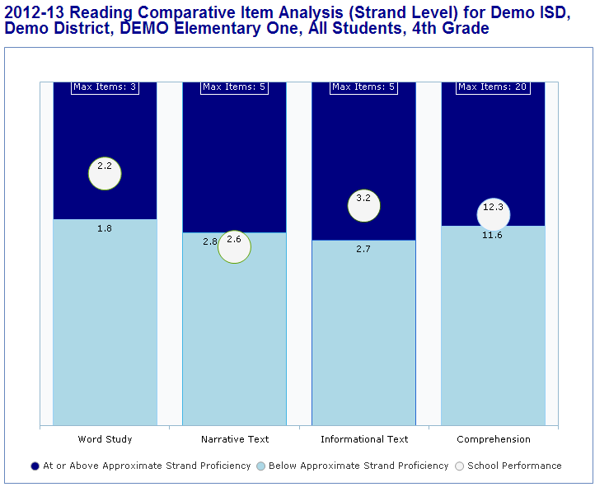
State Level Data
https://www.mischooldata.org
Student Count
Testing
College Readiness
Financial
Tools for School Improvement
And More!

Slide 16
Comparative Item Analysis
Over the last three years on the Reading MEAP:
What has the composition of the test been?
What has been our weakest strand?
What have been our weakest GLCEs?

Slide 17
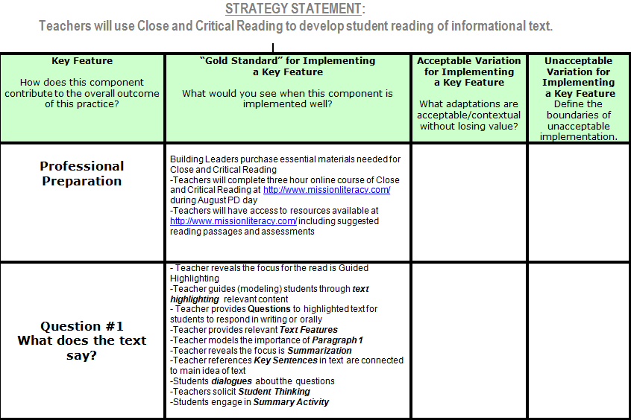
Implementation Planning
Key Features
PD
Key Components
Adult Implementation
Student Impact
Data Dialogue
Gold Standard
Acceptable Variation
Unacceptable Variation

Slide 18
Assessment Tools
A tool is a physical object that helps you achieve a goal. If you don’t know your goal, there isn’t a tool in the world that can help!

Slide 19
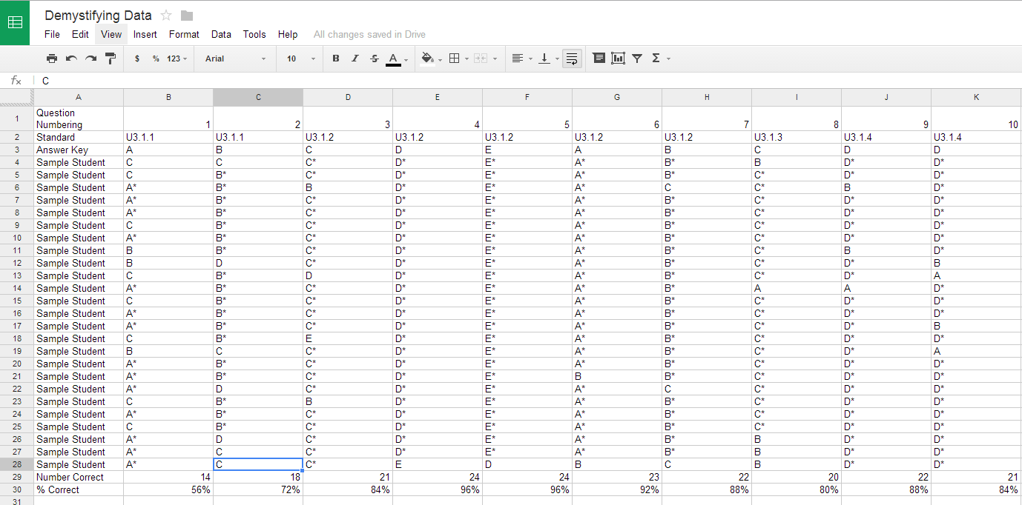

Slide 20
Notes:
The Data4SS website has tons of resources to enhance your understanding of data. Resources are found within the Professional Development section of the site.

Slide 21
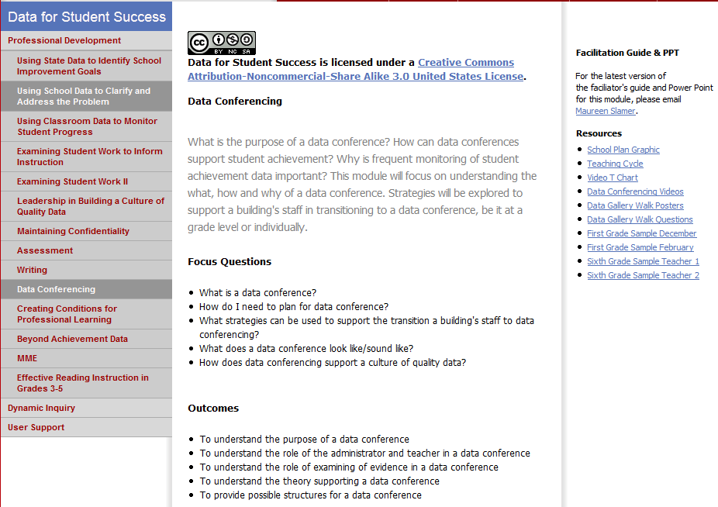
Notes:
I’ve tapped into the Data 4SS website for resources on data conferencing so that my colleagues and I can begin to develop and discuss common assessment data.

Slide 22
Session Evaluation

Slide 23
Thank you! Questions?
Mitch Fowler
School Data Consultant – Calhoun ISD
fowlerm@calhounisd.org

