Slide 1
Skyward Bound with RtI Data
Ryan Miller
millerr@calhounisd.org
Mitch Fowler
fowlerm@calhounisd.org
Twitter: @fowlerm
Session Resources:
http://tinyurl.com/SkywardRTIMACUL2014

Slide 2
Agenda
MTSS & Skyward; A Perfect Combination
Maximizing the Behavior Module
Identifying Students via Watch Lists
RtI in Skyward
Pitfalls to Avoid During Implementation

Slide 3
Outcomes
Participants will:
identify how the RtI Module within Skyward can help provide multi-tiered systems of support.
explore how the Watch List can be configured to identify students in need of support.
determine guiding questions to take back to their Skyward Implementation Team.

Slide 4
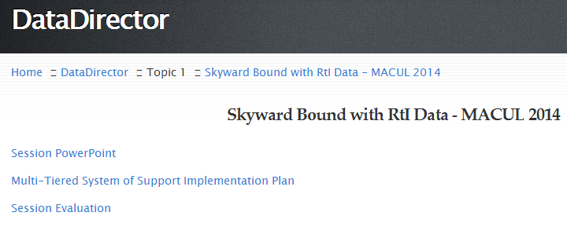
Session Resources
http://tinyurl.com/SkywardRTIMACUL2014

Slide 5
Essential Components of MTSS:
1. Implement effective instruction for all learners
2. Intervene early
3. Provide a multi-tiered model of instruction and intervention
4. Utilize a collaborative problem solving model
5. Assure a research-based Core Curriculum
6. Implement research/evidence-based instruction/interventions
7. Monitor student progress to inform instruction
8. Use data to make instructional decisions
9. Use assessment for universal screening, diagnostics, and progress monitoring
10. Implement with fidelity
11. Engage parents and community
"Michigan Department of Education Response to Intervention: A Multi ..." 2012. 23 Jan. 2014 <http://teachingforlearning.org/local/documents/rti-13.pdf>
Notes:
These 11 components come from the MDE’s recommendation for what constitutes a quality multi-tiered system of support. Those highlighted areas are place where Skyward can make things easier. Notice, Skyward is not a fix-all… some of these areas will need to be addressed separately.

Slide 6
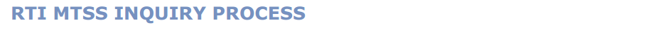
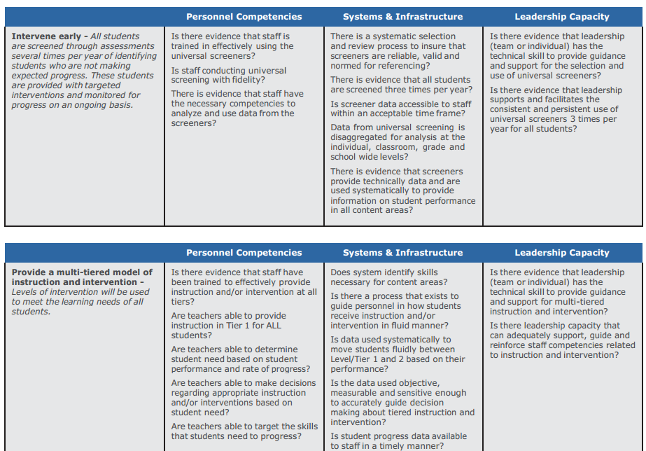
Notes:
MDE Self Evaluation Rubric for MTSS

Slide 7
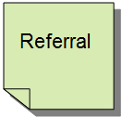





Sound Familiar?
Notes:
Do we have a system where we can collect and analyze referral data in a manner that allows us to create interventions based on the data. In other words, can we say over the last three months we’ve had a spike in bullying by Caucasian males in the cafeteria at the end of lunch? Or, are we just “processing” this information so that we can dole out consequences. Furthermore, which consequences are we doling out? Is there a trend?

Slide 8


Sound Familiar?
Notes:
Once we have our data, are we able to represent this data graphically? Can we assign interventions within the system? Do we have a systemic way of progress monitoring so that we know if the interventions worked or didn’t work?

Slide 9


Sound Familiar?
Notes:
Does our current system support the transfer of data amongst years, buildings, and stakeholders?

Slide 10
Sound Familiar?
?
Notes:
All in all, have you collected a TON of data only to be left with questions about what to do next?

Slide 11




Wouldn’t it Be Nice?
Referral
Time
Location
Gender
Offense
Notes:
However, wouldn’t it be nice to turn that old referral into a system that allows you to delineate time, location, gender, type of offense so that this data can be disaggregated in a visual format?

Slide 12
Wouldn’t it Be Nice?
Notes:
From there, wouldn’t it be great to get a quick visual of trends and then determine which areas need focus, but beyond that, identify which kids need help?

Slide 13





Wouldn’t it Be Nice?
Notes:
Finally, how awesome would it be to take those kids, assign interventions, and allow for all stakeholders (principal, teacher, counselor, interventionist) to progress monitor in real time?

Slide 14
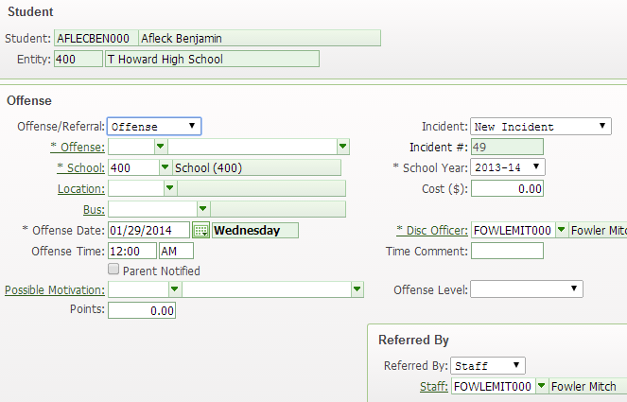
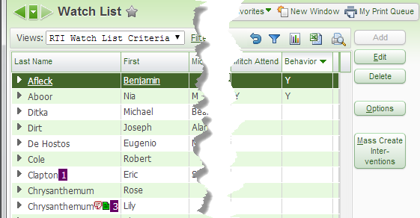
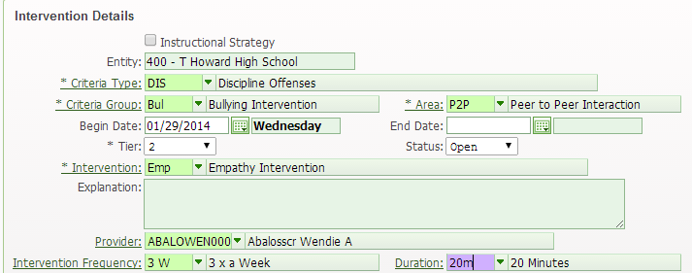
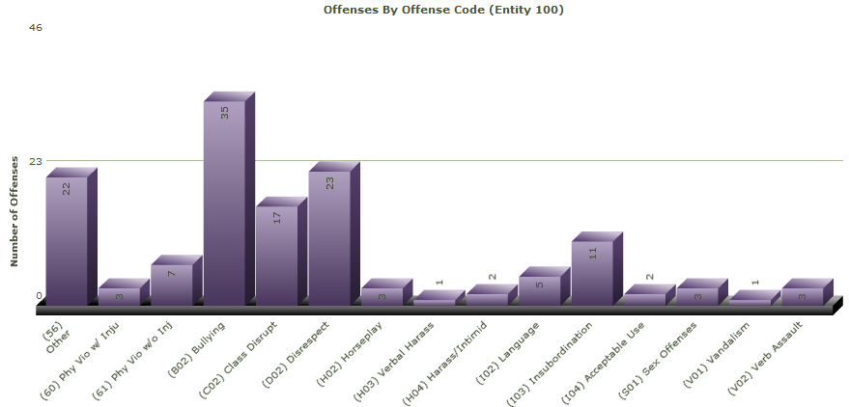
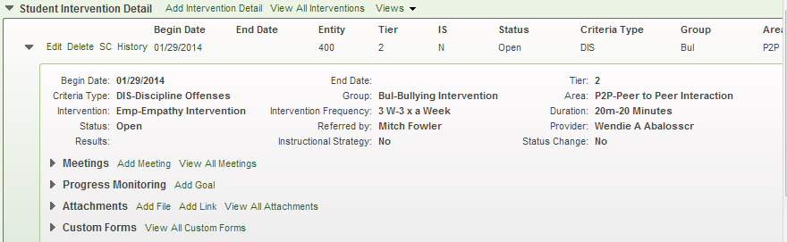
Skyward Can Help!
Notes:
Skyward can do this. By entering a referral into Skyward, educators can aggregate data into a visual format quickly, identify students at risk via a Watch List that is run automatically, mass assign interventions, and progress monitor at the student level. This is done via the Behavior Module, Watch List, and RtI Module.

Slide 15
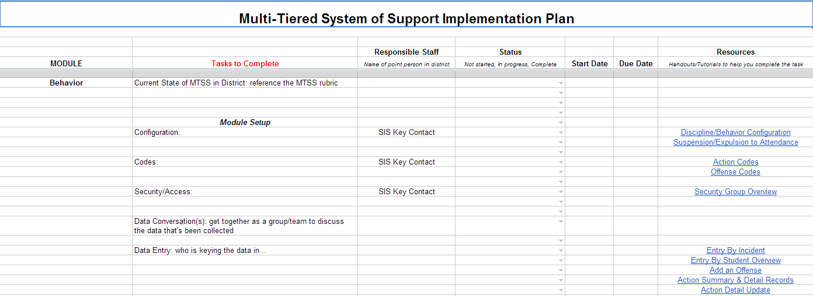
Implementation Planning
MTSS Implementation Plan
Notes:
Moving forward, Ryan has created a document that will help educators determine what tasks need to be completed, resources for those tasks, and other questions to consider. Above all, please know that we are here for you. How can we help?

Slide 16

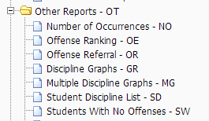


Maximizing the Behavior Module
Notes:
From there, it’s important to identify who will be responsible for configuring reports, who will be responsible for building them, when they will be run, and when conversations about this data will take place.

Slide 17
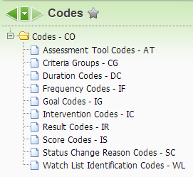
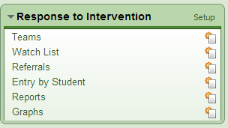
Identifying Kids via the Watchlist
Notes:
Within the watchlist, teams will need to meet to discuss what criteria they will use to identify students in need of intervention.

Slide 18
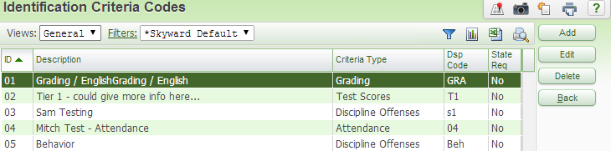
Identifying Kids via the Watchlist
Notes:
The screen here details what criteria an educator might use.

Slide 19
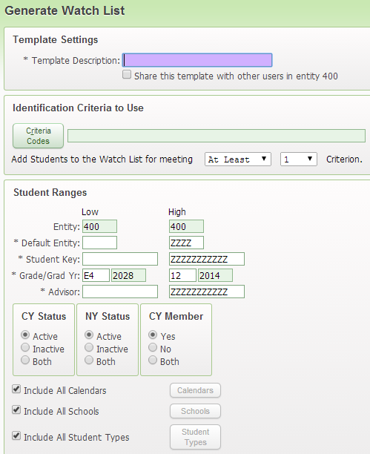

Identifying Kids via the Watchlist
Notes:
Once the criteria is identified, someone will need to create the Watch List Template, run it, and schedule it for future occurances.

Slide 20
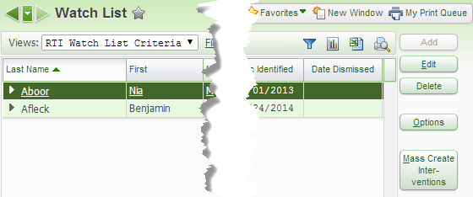
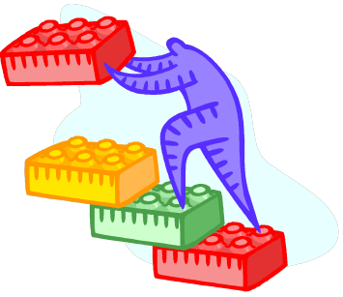



Identifying Kids via the Watchlist
Notes:
Above all, things to consider here are similar to the Behavior Module; who will configure the codes, who will build the watchlist template and set it to run, when will it be run, when will we discuss the data that is generated?

Slide 21
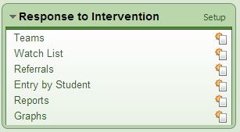
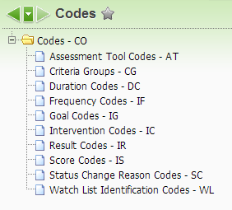
Implementing and Monitoring Interventions in the RtI Module
Notes:
As with the previous two modules, RtI works much the same way; a team will need to figure what interventions they will use as well as the details (frequency, progress monitoring, etc.) of those interventions.

Slide 22

Determining RtI Codes
Photo Credits: http://www.flickr.com/photos/mikeoliveri/

Slide 23
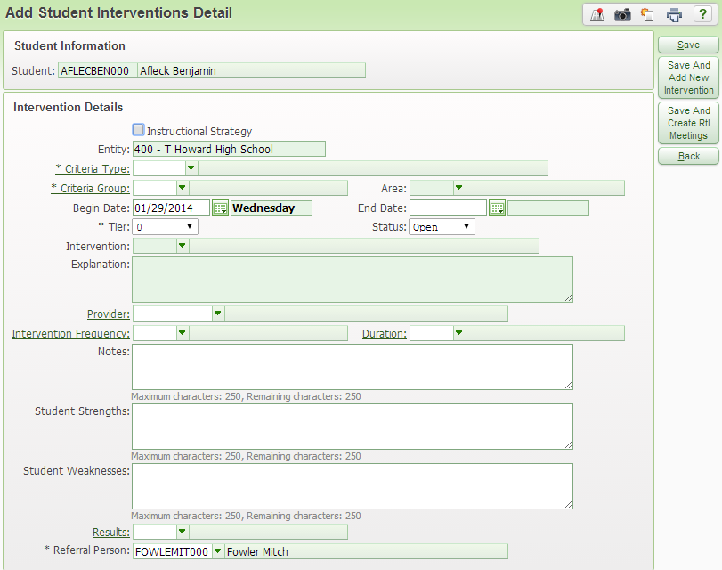
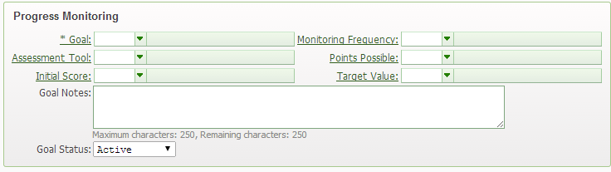
Implementing and Monitoring Interventions in the RtI Module
Notes:
From there, intervention details are entered. A good question here is “Who will do this?” and “What Tier will we monitor?”

Slide 24
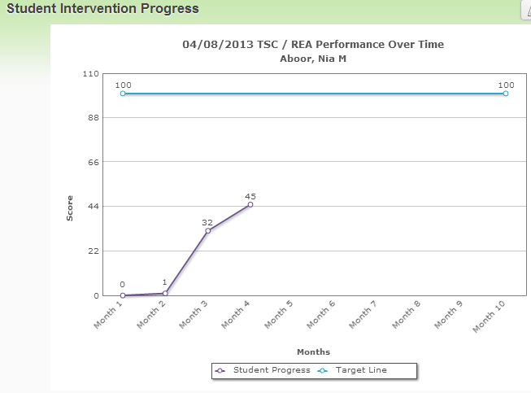
Implementing and Monitoring Interventions in the RtI Module
Notes:
From there, you’ll need to determine who will enter progress monitoring data and learn how to run these awesome reports that could be used for a CST.

Slide 25

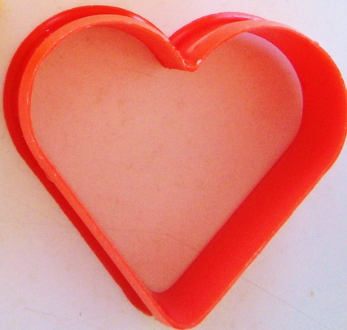
Staff Training
Photo Credits: http://www.flickr.com/photos/bluebakeblog//
Photo Credits: http://www.flickr.com/photos/amnesia/

Slide 26


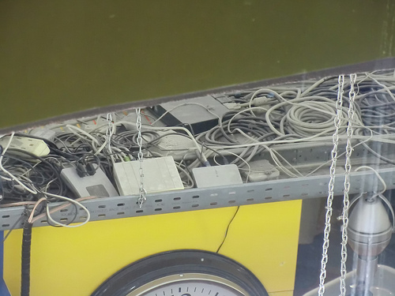
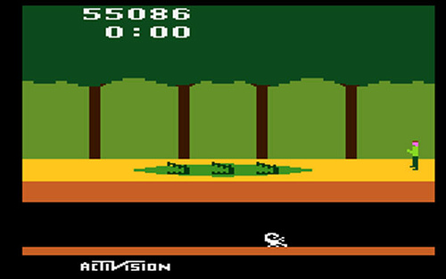
Pitfalls to Avoid
Photo Credits: http://www.flickr.com/photos/malkoff/
Photo Credits: http://www.flickr.com/photos/liloh/
Photo Credits: http://www.flickr.com/photos/38365223@N03/

Slide 27
Implementation Planning
Notes:
Moving forward, Ryan has created a document that will help educators determine what tasks need to be completed, resources for those tasks, and other questions to consider. Above all, please know that we are here for you. How can we help?

Slide 28
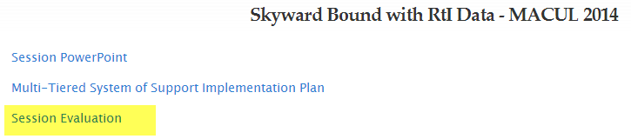
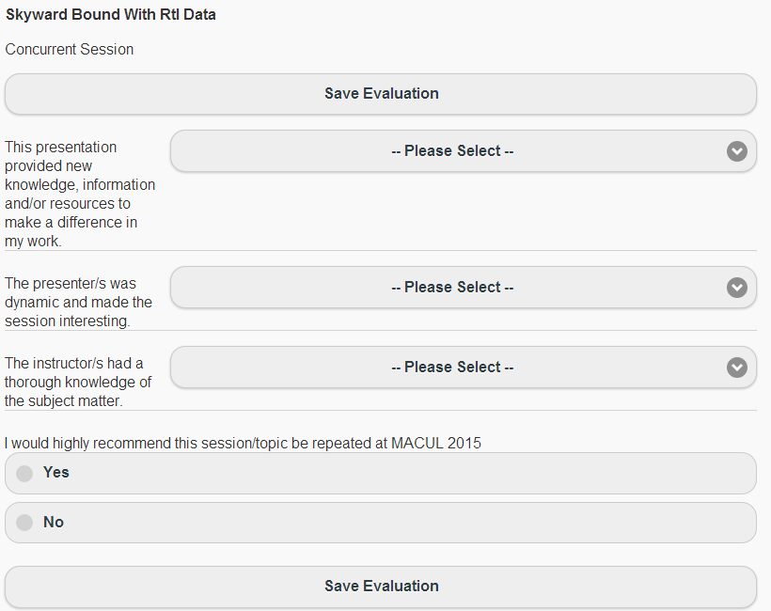
Session Evaluation

Slide 29
Thank You!
Questions?
Ryan Miller
millerr@calhounisd.org
Mitch Fowler
fowlerm@calhounisd.org
Twitter: @fowlerm
Session Resources:
http://tinyurl.com/SkywardRTIMACUL2014

