Slide 1
Revisiting DataDirector at BHS
Mitch Fowler
fowlerm@calhounisd.org

Slide 2
Agenda
Why DataDirector again?
Assessment Creation
Assessment Administration
Assessment Reporting
Importing Data into Skyward

Slide 3
Outcomes
Participants will:
identify purposes for using DataDirector in terms of student growth and consistency between grade levels and buildings.
understand how to create and administer assessments within DataDirector.
identify reports that will assist in demonstrating student growth and plan for instruction.
understand how to import data into Skyward.

Slide 4
Why DataDirector Again?
Changing Needs
Evaluation
Data Conferencing
Increased Technology
Consistency Between Buildings

Slide 5
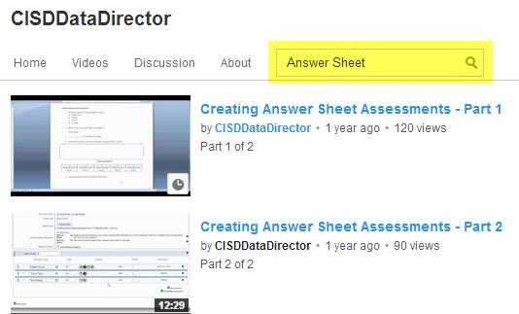
Assessment Creation
http://www.youtube.com/cisddatadirector

Slide 6
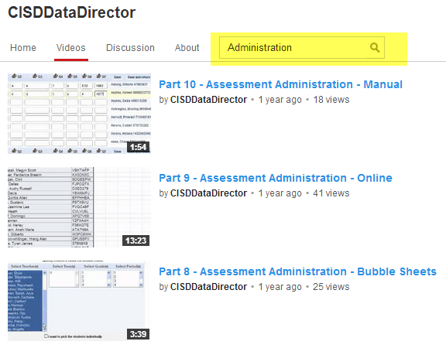
Assessment Administration

Slide 7
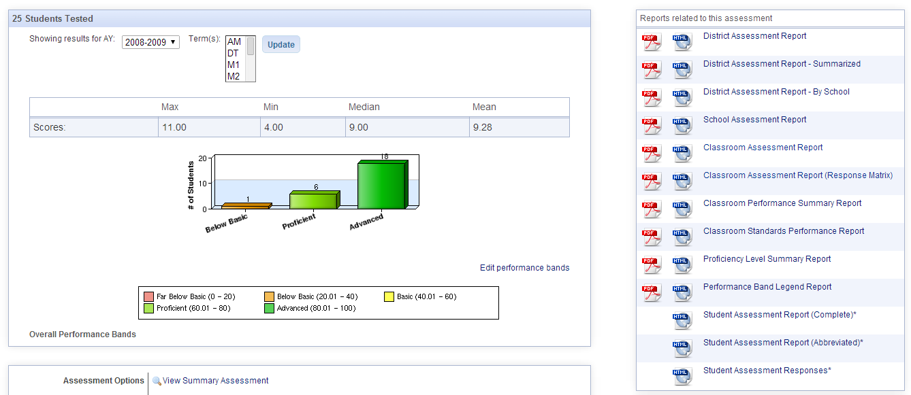
Assessment Reporting

Slide 8
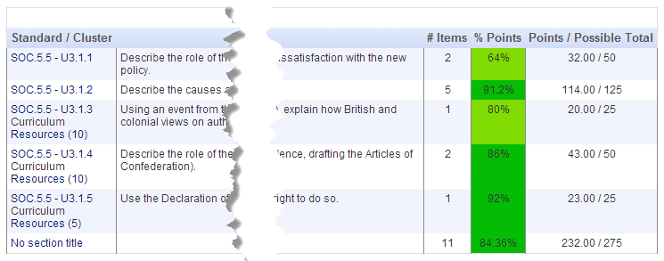
Existing DataDirector Reports

Slide 9
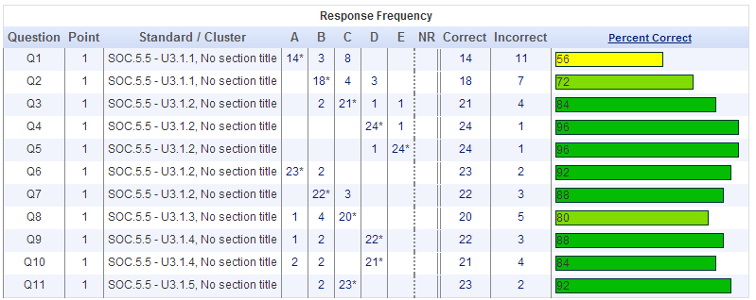
Existing DataDirector Reports

Slide 10
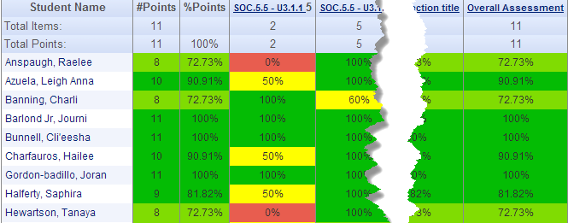
Existing DataDirector Reports

Slide 11
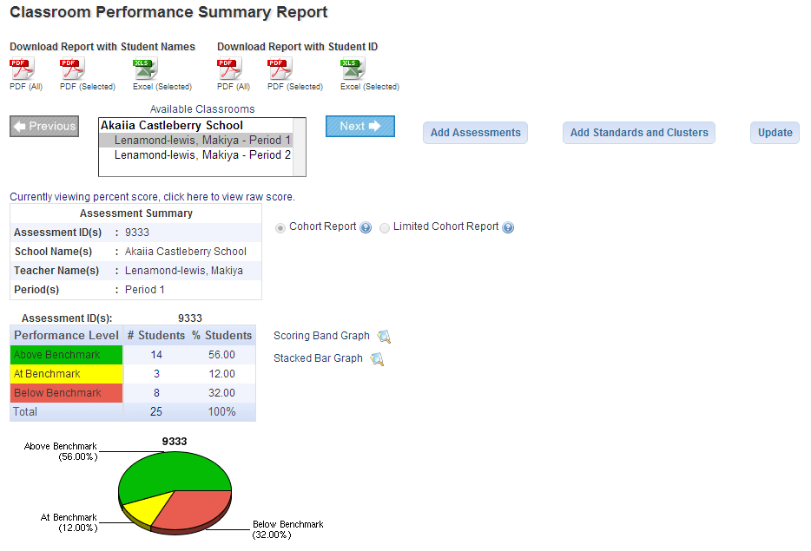
New DataDirector Features!

Slide 12
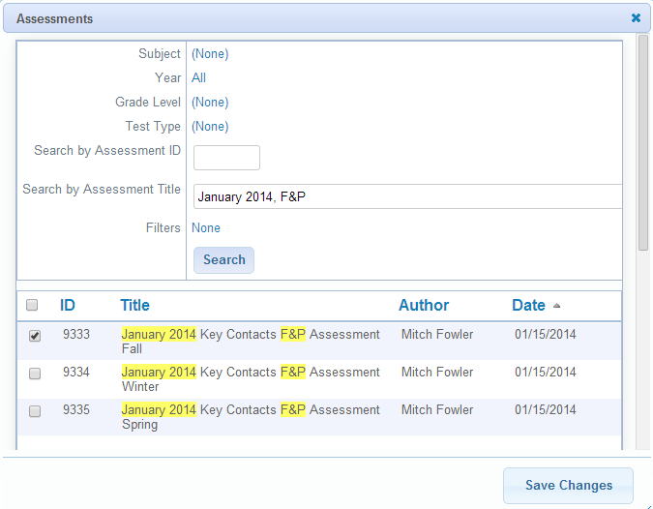
New DataDirector Features!

Slide 13
New DataDirector Features!

Slide 14
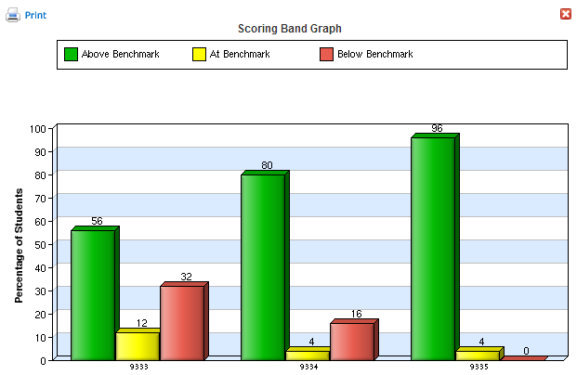
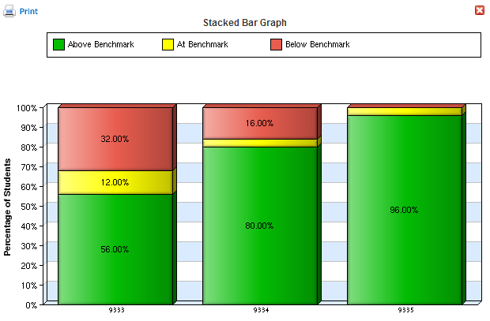
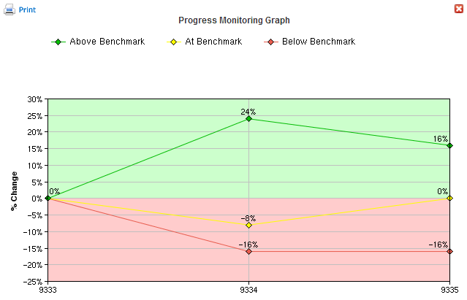
New DataDirector Features!

Slide 15
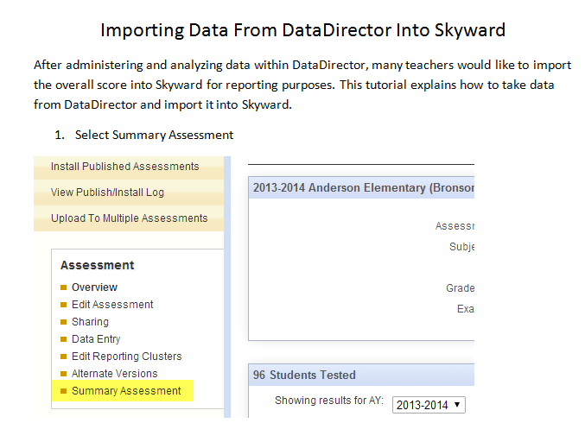
Transferring Data to Skyward

Slide 16
Transferring Data to Skyward
http://youtu.be/vqnDnuEp9PE?t=8m54s

Slide 17
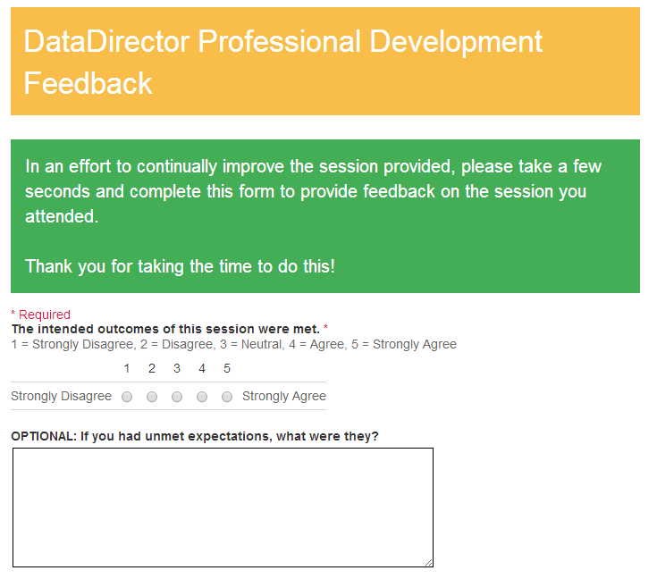
Evaluation and Next Steps

Slide 18
Thank You! Questions?
Mitch Fowler
fowlerm@calhounisd.org

