Slide 1
Sailing Through Your Tested Roster Window: Avoiding the Pitfalls of Accountable Students and Verification
Mitch Fowler
fowlerm@calhounisd.org
Tim Voskuil
voskuilt@calhounisd.org

Slide 2
Agenda
District Roles and Responsibilities
BAA Secure Site Permissions
Required Activities to Complete
How many of you are signed up for the BAA Listserv?

Slide 3
Outcomes
By the end of this session, you will be able to:
Describe district roles & responsibilities within the Accountability Timeline
Understand and obtain appropriate permissions
Complete:
Verification of Enrollment (Students Expected to Test)
Verification of Student Demographics
Verification of Answer Documents (Tested Roster)
Verification of Not Tested Students (Students Not Tested)

Slide 4
District Roles and Responsibilities
October 2 Fall Count data finalized by Wednesday, November 13
BAA pulls MSDS data Tuesday, November 19 & establishes baseline for district accountability
Districts able to submit Student Record Maintenance (SRM) to update enrollment, exit dates, and demographics for October 2 – 25
SRM deadline: Wednesday, November 27

Slide 5
District Roles and Responsibilities
Review period Wednesday, November 20 – Wednesday, November 27
In Secure Site, Districts must review & complete verification of:
Student Enrollment (Students Expected to Test)
Student Demographics
Answer Documents (Tested Roster)
Not Tested Students

Slide 6
District Roles and Responsibilities
Verification of Enrollment (Students Expected to Test)
Compares MSDS Fall Count data/enrollment (PEPE) to assessments taken
UIC issues
Tested but not enrolled (enrolled after Count Day)
Not tested but showing as enrolled (exited after Count Day but prior to testing)

Slide 7
District Roles and Responsibilities
Verification of Student Demographics
Indicates students for which your school will be held accountable
Special Education Students
Limited English Proficient Students
Economically Disadvantaged Students
Tested Out of Grade Level Students
Includes Full Enrollment list - sortable

Slide 8
District Roles and Responsibilities
Verification of Answer Documents (Tested Roster)
Data pulled from MSDS and all testing data
Verify Prohibitive Behavior
Verify Nonstandard Accommodations
Verify Missing Tests
Tested Roster Issues – list of all roster issues - sortable

Slide 9
District Roles and Responsibilities
Verification of Not Tested Students
List of students missing one or more content areas
Not Tested reasons entered as part of Verification of Answer Documents – ability to submit reason student did not test
Not Tested issues – list of all not tested issues - sortable

Slide 10
BAA Secure Site Permissions
The following roles will allow users to verify and appeal MEAP data:
Public School User Add/Modify
Public School Administrator
District User Add/Modify
District Administrator

Slide 11
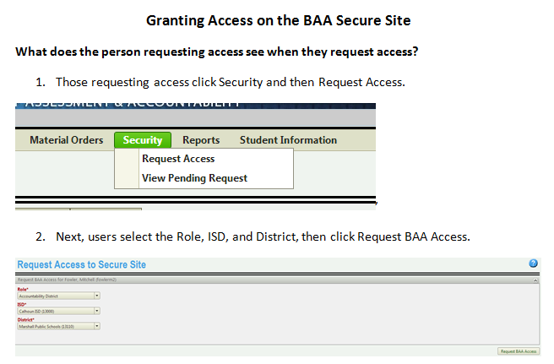
Requesting/Adding Permissions

Slide 12
Required Activities to Complete
BAA Secure Site Training

Slide 13
Questions? Stick around for technical assistance!

