Slide 1
Data Sherpa in Action:
The True Story of a Data Journey
Prepared for DataDirector User Conference – October 2013
Mitch Fowler
fowlerm@calhounisd.org

Slide 2
Agenda
Why?
Backwards Design
Course Details
Moodle Course Features
Marketing
Lessons Learned

Slide 3


Why Job Embedded PD?

Slide 4
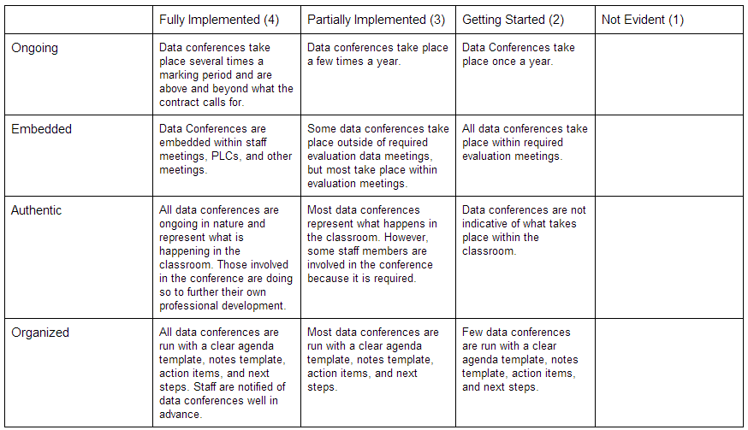
Backwards Design

Slide 5
Course Modules
Introduction
Trailhead
Face to Face
Action Plan
Data Conferencing
Journey Reflection

Slide 6
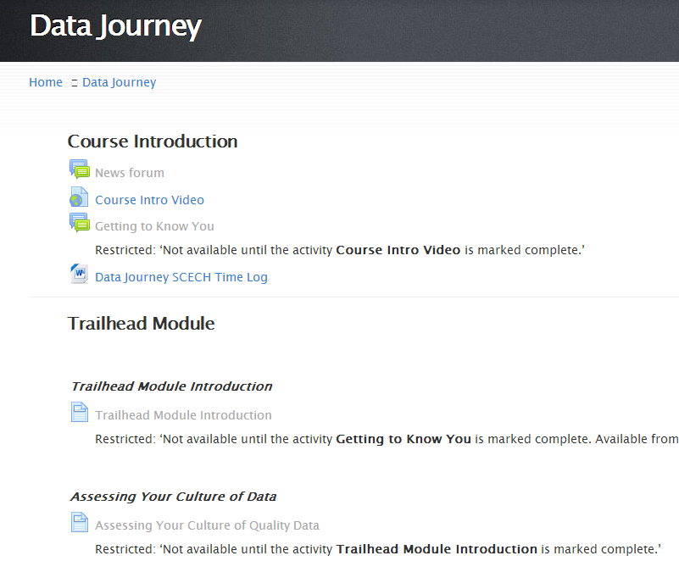
Moodle Course Features

Slide 7
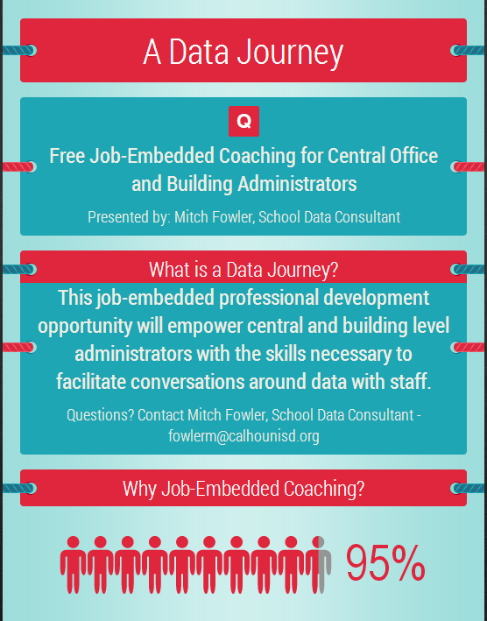
Marketing

Slide 8
Lessons Learned

Slide 9

Lessons Learned
Action
Plan

Slide 10
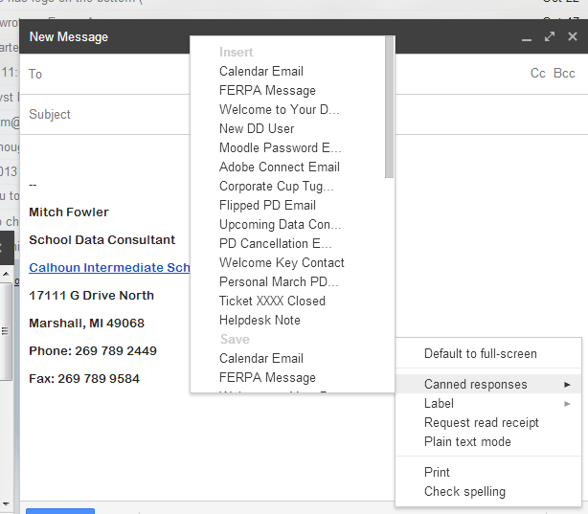
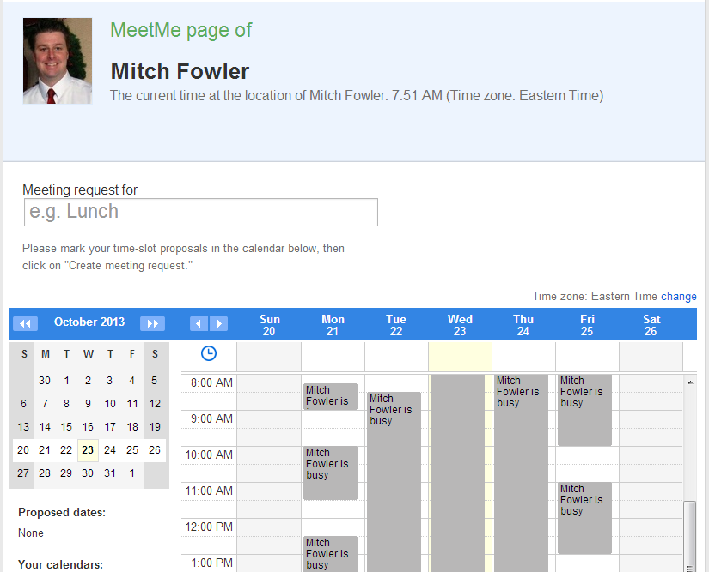
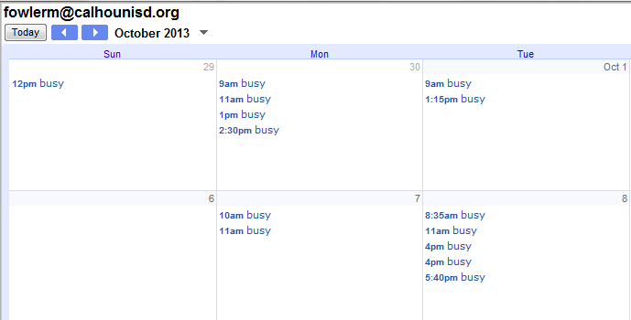

Lessons Learned

Slide 11
Questions?
Mitch Fowler
fowlerm@calhounisd.org

