Slide 1
Creating Smarter Balanced Aligned Assessments in DataDirector
Prepared for DataDirector User Conference – October 2013
Mitch Fowler
fowlerm@calhounisd.org

Slide 2
Agenda
Auto Test Generator Feature
Blueprint Organization
Combining the Auto Test Generator and the Blueprint

Slide 3
Outcomes
Participants will:
understand how to utilize the auto test generator.
understand how to utilize the Smarter Balanced Assessment Blueprints.
understand how to utilize the auto test generator to create item bank assessments based on the Smarter Balanced Assessment Blueprints.

Slide 4
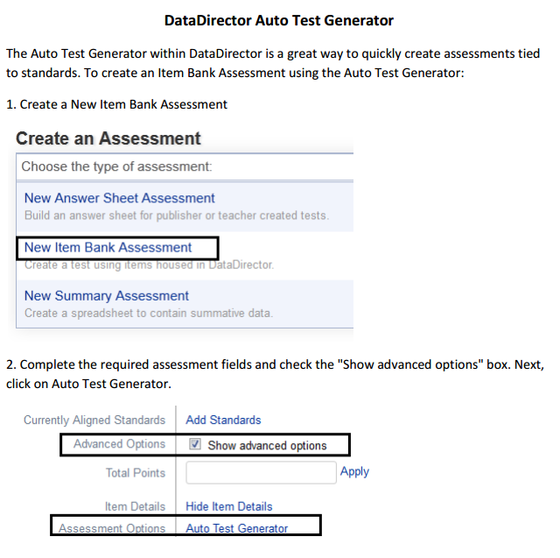
Auto Test Generator Feature

Slide 5
SBAC Preliminary Blueprint
SBAC Preliminary Blueprint
Blueprint Table
Target Sampling Table
Content Specifications Document

Slide 6
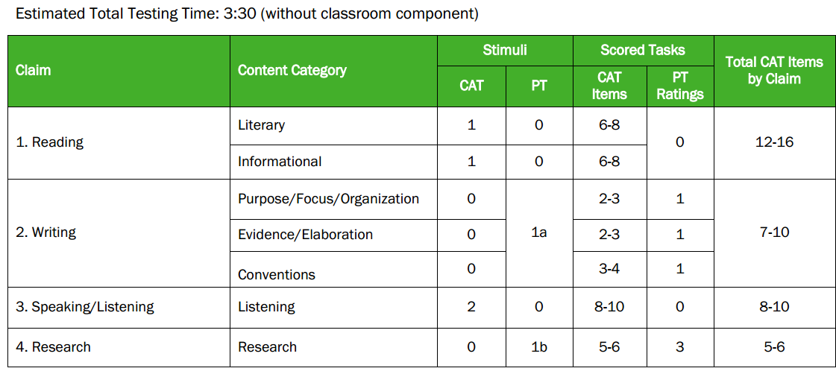
Blueprint Table
The ELA/literacy blueprints show:
the number of stimuli (e.g., reading passages, listening segments)
items/tasks associated with each content category
whether the content category is assessed using CAT items, performance tasks, or both

Slide 7
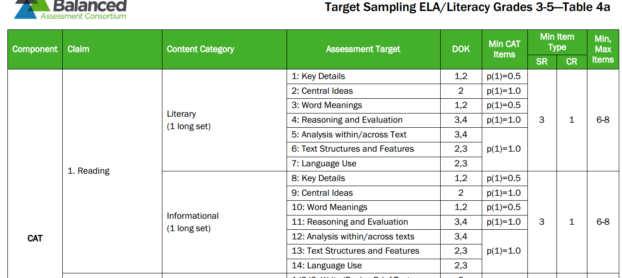
Target Sampling Table
Target sampling tables provide greater detail regarding the specific content within each claim.
The “targets” in these tables refer to the assessment targets defined in two documents: Content Specifications for ELA/Literacy and Content Specifications for Mathematics.

Slide 8
Content Specifications
3rd Grade - RL-2 Recount stories, including fables, folktales, and myths from diverse cultures; determine the central message, lesson, or moral and explain how it is conveyed through key details in the text.
4th Grade - RL-2 Determine a theme of a story, drama, or poem from details in the text; summarize the text.
5th Grade - RL-2 Determine a theme of a story, drama, or poem from details in the text, including how characters in a story or drama respond to challenges or how the speaker in a poem reflects up a topic; summarize the text

Slide 9
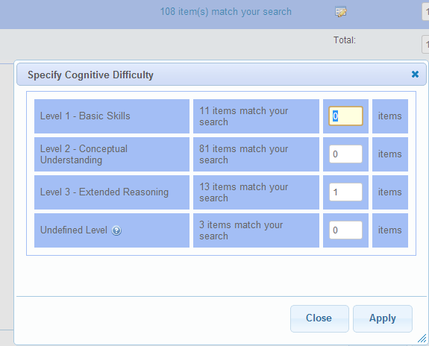
Blueprint + Auto Test Generator
3rd Grade - RL-2 Recount stories, including fables, folktales, and myths from diverse cultures; determine the central message, lesson, or moral and explain how it is conveyed through key details in the text.

Slide 10
Questions?
Mitch Fowler
fowlerm@calhounisd.org

