Slide 1
MTSS & Formative Assessment
Mitch Fowler
August 2013
fowlerm@calhounisd.org

Slide 2
Today’s Information
Research (Stiggins and Marzano)
– 10 Days
Formative Assessment PD – 3 Days
DataDirector Training – 1 Day
90 Minutes

Slide 3
Today’s Outcomes
Participants will:
understand how to access previous year’s data to identify potential areas of need.
understand how to create student friendly learning targets from standards.
understand how to identify the types of learning targets (knowledge, reasoning, performance skill, product).
understand how to identify appropriate assessment methods for student learning targets.
identify specific DataDirector reports to assist in remediation based on learning targets.

Slide 4
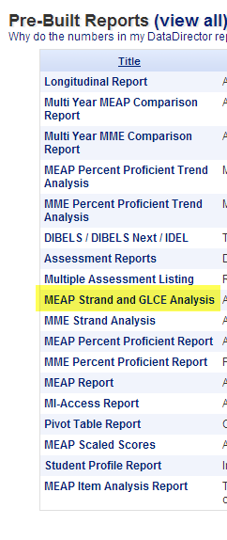
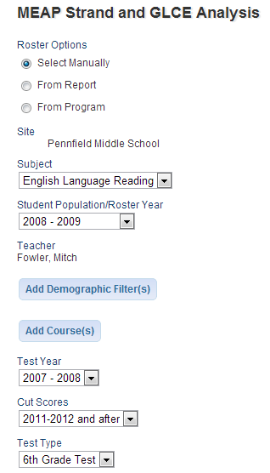
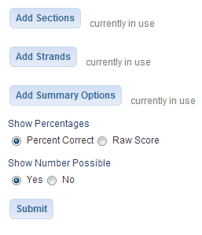
Previous Year’s Data (MEAP)

Slide 5
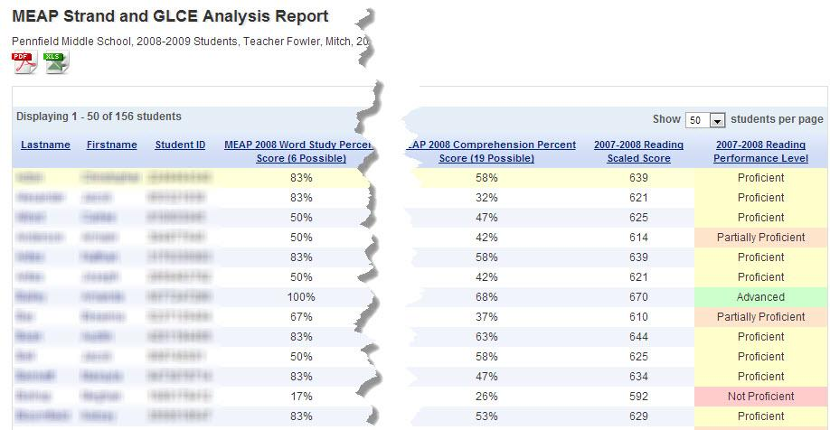
Previous Year’s Data (MEAP)

Slide 6
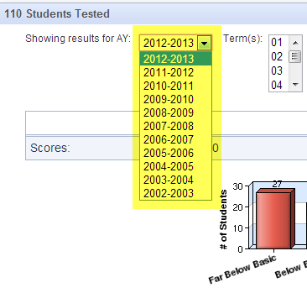
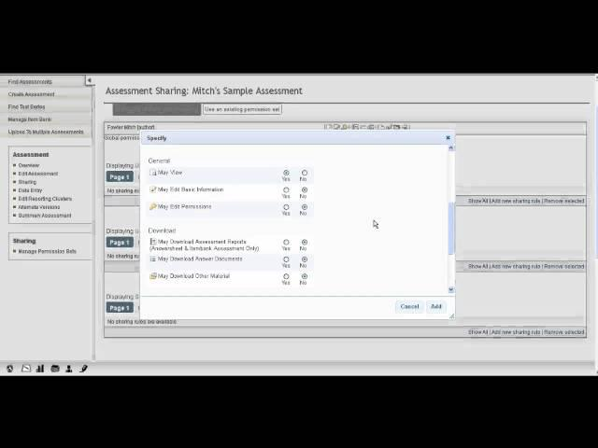
Previous Year’s Data (Local)
Previous year’s assessments must be shared in DataDirector.

Slide 7
Clear and appropriate learning targets
Based on the work by Rick Stiggins

Slide 8
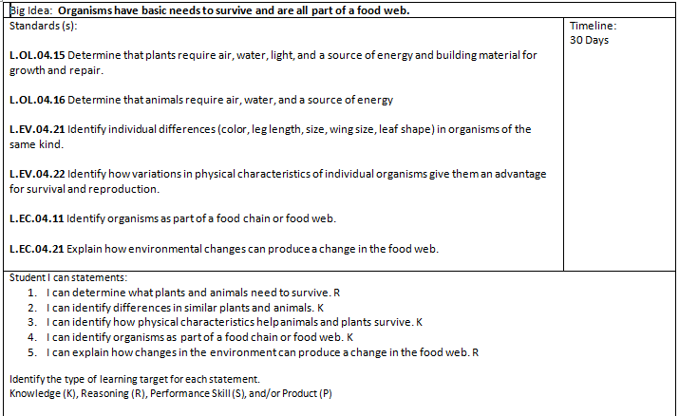
Assessment Maps
Big Ideas
Standards Assessed
Student Friendly Learning Targets
Learning Target Types
Timeline for Assessment, Remediation, and Extension
This work is based on the professional develoment entitled Formative Assessment for Secondary Social Studies Teachers by John Vail, Doug Flynn, and Heather Reid. Presented August 2009 at the Kalamazoo RESA.

Slide 9
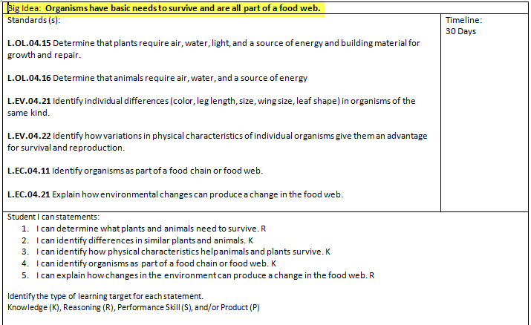
Assessment Map - Big Idea
What do you want students to remember 10 years from now?
This work is based on the professional develoment entitled Formative Assessment for Secondary Social Studies Teachers by John Vail, Doug Flynn, and Heather Reid. Presented August 2009 at the Kalamazoo RESA.

Slide 10
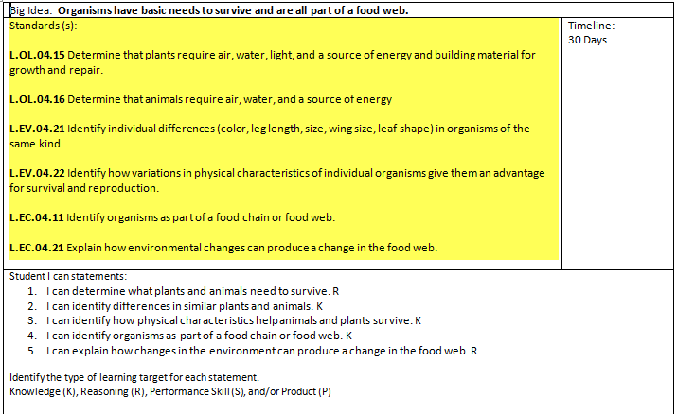
Assessment Map - Standards Assessed
What standards must kids master by the time the unit is over?
This work is based on the professional develoment entitled Formative Assessment for Secondary Social Studies Teachers by John Vail, Doug Flynn, and Heather Reid. Presented August 2009 at the Kalamazoo RESA.

Slide 11
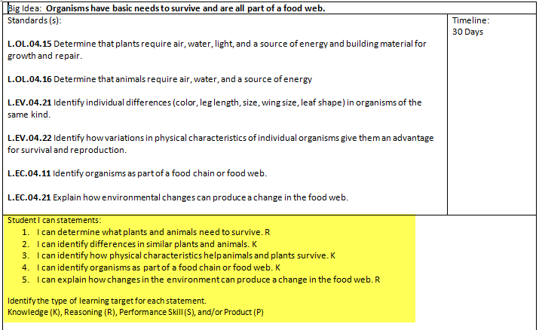
Assessment Map - I can Statements
This work is based on the professional develoment entitled Formative Assessment for Secondary Social Studies Teachers by John Vail, Doug Flynn, and Heather Reid. Presented August 2009 at the Kalamazoo RESA.

Slide 12
Creating Clear Learning Targets
Know what kinds of targets are represented in the curriculum.
Know which targets each assessment measures.
Communicate the learning targets in advance in language students can understand.
This work is based on the professional develoment entitled Formative Assessment for Secondary Social Studies Teachers by John Vail, Doug Flynn, and Heather Reid. Presented August 2009 at the Kalamazoo RESA.

Slide 13
Kinds of Targets
Master content knowledge
Use knowledge to reason and solve problems
Demonstrate performance skills
Create quality products
This work is based on the professional develoment entitled Formative Assessment for Secondary Social Studies Teachers by John Vail, Doug Flynn, and Heather Reid. Presented August 2009 at the Kalamazoo RESA.

Slide 14
Clear Targets: Benefits to Students
Students who could identify their learning scored 27 percentile points higher than those who could not (Marzano, 2005).
This work is based on the professional develoment entitled Formative Assessment for Secondary Social Studies Teachers by John Vail, Doug Flynn, and Heather Reid. Presented August 2009 at the Kalamazoo RESA.

Slide 15
Learning Targets
Any achievement expectations we hold for students.
Statement of what we want students to learn.
This work is based on the professional develoment entitled Formative Assessment for Secondary Social Studies Teachers by John Vail, Doug Flynn, and Heather Reid. Presented August 2009 at the Kalamazoo RESA.

Slide 16
Which of these are actually learning targets?
Senior Project
Model of a Fort
Present a Persuasive Argument
State Report
Diorama
This work is based on the professional develoment entitled Formative Assessment for Secondary Social Studies Teachers by John Vail, Doug Flynn, and Heather Reid. Presented August 2009 at the Kalamazoo RESA.

Slide 17
A Social Studies Example
World History | Subject
Korean War | Topic
Chapter 10 | Resource
Create a Timeline | Activity
Understand recurring conflicts that lead to war | Learning Target
This work is based on the professional develoment entitled Formative Assessment for Secondary Social Studies Teachers by John Vail, Doug Flynn, and Heather Reid. Presented August 2009 at the Kalamazoo RESA.

Slide 18
Kinds of Learning Targets
Knowledge
Reasoning
Skill
Product
This work is based on the professional develoment entitled Formative Assessment for Secondary Social Studies Teachers by John Vail, Doug Flynn, and Heather Reid. Presented August 2009 at the Kalamazoo RESA.

Slide 19
Kinds of Learning Targets - Knowledge
Master factual and procedural knowedge to be learned outright or retrieved.
Recognizes and describes patterns
Understands long-term physiological benefits of regular participation in physical activity
Explains the important characteristics of U.S. citizenship
Knows that energy can be transformed between various forms
This work is based on the professional develoment entitled Formative Assessment for Secondary Social Studies Teachers by John Vail, Doug Flynn, and Heather Reid. Presented August 2009 at the Kalamazoo RESA.

Slide 20
Kinds of Learning Targets - Reasoning
Use knowledge to reason and solve problems
Uses statistical methods to describe, analyze, evaluate, and make decisions.
Analyzes fitness assessments to set personal fitness goals, strategizes ways to reach goals, evaluate acvities.
Examines data/results and proposes meaningful interpretation.
This work is based on the professional develoment entitled Formative Assessment for Secondary Social Studies Teachers by John Vail, Doug Flynn, and Heather Reid. Presented August 2009 at the Kalamazoo RESA.

Slide 21
Kinds of Learning Targets – Skill
Demonstrate mastery of specific performance skills
Measures length in metric and US units.
Reads aloud with fluency and expression
Dribbles to keep the ball away from an opponent
Participates in civic discussion with the aim of solving current problems
Uses simple equipment and tools to gather data
This work is based on the professional develoment entitled Formative Assessment for Secondary Social Studies Teachers by John Vail, Doug Flynn, and Heather Reid. Presented August 2009 at the Kalamazoo RESA.

Slide 22
Kinds of Learning Targets – Product
Create quality products
Constructs bar graphs
Develops a personal health-related fitness plan
Constructs physical models of familiar objects
Creates a scripted scene based on improvised work
This work is based on the professional develoment entitled Formative Assessment for Secondary Social Studies Teachers by John Vail, Doug Flynn, and Heather Reid. Presented August 2009 at the Kalamazoo RESA.

Slide 23
Converting Learning Targets to Student Friendly Language (I Can statements)
Identify important or difficult learning goal.
Identify words(s) needing clarification.
Define the word(s).
Rewrite the definition as an “I can” statement in terms that students can understand.
Try it out and refine as needed.
Have students try this process.
This work is based on the professional develoment entitled Formative Assessment for Secondary Social Studies Teachers by John Vail, Doug Flynn, and Heather Reid. Presented August 2009 at the Kalamazoo RESA.

Slide 24
Student Friendly Language
Word to be defined: SUMMARIZE
to give brief statement of the main points, main, events, or important ideas.
Students Friendly Language:
I can summarize text.
This means I can make a short statement of the main points of the big ideas of what I read.
This work is based on the professional develoment entitled Formative Assessment for Secondary Social Studies Teachers by John Vail, Doug Flynn, and Heather Reid. Presented August 2009 at the Kalamazoo RESA.

Slide 25
Student Friendly Language
Word to be defined: PREDICTION
A statement saying something will happen in the future.
Students Friendly Language:
I can make predictions.
This means I can use information from what I read to guess at what will happen next.
This work is based on the professional develoment entitled Formative Assessment for Secondary Social Studies Teachers by John Vail, Doug Flynn, and Heather Reid. Presented August 2009 at the Kalamazoo RESA.

Slide 26
Student Friendly Language
Learning Target: “Deeply examine policy issues…”
Word to be defined: EXAMINE
A process by which problems, alternate views and reasons for differing views for a given situation are understood.
Students Friendly Language:
I can examine.
This means I can state the problems, describe alternative views, and understand the reasons for these different views.
This work is based on the professional develoment entitled Formative Assessment for Secondary Social Studies Teachers by John Vail, Doug Flynn, and Heather Reid. Presented August 2009 at the Kalamazoo RESA.

Slide 27
Your Turn…
Choose either “analyze” or “describe” and convert it into student friendly terms:
Definition:
Student Friendly Language:
This work is based on the professional develoment entitled Formative Assessment for Secondary Social Studies Teachers by John Vail, Doug Flynn, and Heather Reid. Presented August 2009 at the Kalamazoo RESA.

Slide 28
Clear and Appropriate Learning Targets Summary
Things to remember:
Convert complex or unfamilar targets to student friendly language
Post targets or have students keep them
Connect learning targets to activities
This work is based on the professional develoment entitled Formative Assessment for Secondary Social Studies Teachers by John Vail, Doug Flynn, and Heather Reid. Presented August 2009 at the Kalamazoo RESA.

Slide 29
Effective assessment design
Based on the work by Rick Stiggins

Slide 30
Sound Assessment Design
Select a proper assessment method
Select or create quality items, tasks, and rubrics
Sample – gather enough evidence
Control for bias
Design assessments so students can self-assess and set goals
This work is based on the professional develoment entitled Formative Assessment for Secondary Social Studies Teachers by John Vail, Doug Flynn, and Heather Reid. Presented August 2009 at the Kalamazoo RESA.

Slide 31
Possible Assessment Methods
Selected Response
Multiple Choice
True/False
Matching
Fill In
Extended Written Response
Performance Assessment
Personal Communication
Questions
Conferences
Interviews
This work is based on the professional develoment entitled Formative Assessment for Secondary Social Studies Teachers by John Vail, Doug Flynn, and Heather Reid. Presented August 2009 at the Kalamazoo RESA.

Slide 32
Target – Method Match Activity
 | SR | EWR | PA | PC
Know
Reason
Skills
Product
This work is based on the professional develoment entitled Formative Assessment for Secondary Social Studies Teachers by John Vail, Doug Flynn, and Heather Reid. Presented August 2009 at the Kalamazoo RESA.

Slide 33
Target – Method Match Activity
 | SR | EWR | PA | PC
Know | + | + | ? | +
Reason | + | + | + | +
Skills |  |  | + | +
Product |  |  | +
This work is based on the professional develoment entitled Formative Assessment for Secondary Social Studies Teachers by John Vail, Doug Flynn, and Heather Reid. Presented August 2009 at the Kalamazoo RESA.

Slide 34
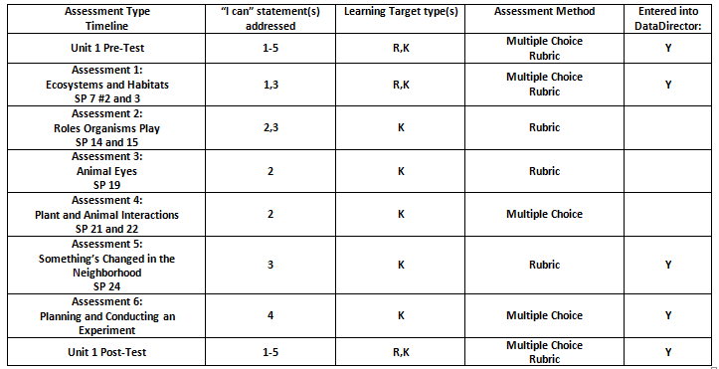
Assessment Map – Putting it All Together

Slide 35
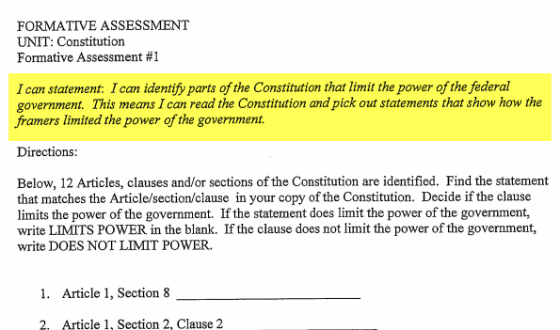
Assessments & Targets
This work is based on the professional develoment entitled Formative Assessment for Secondary Social Studies Teachers by John Vail, Doug Flynn, and Heather Reid. Presented August 2009 at the Kalamazoo RESA.

Slide 36
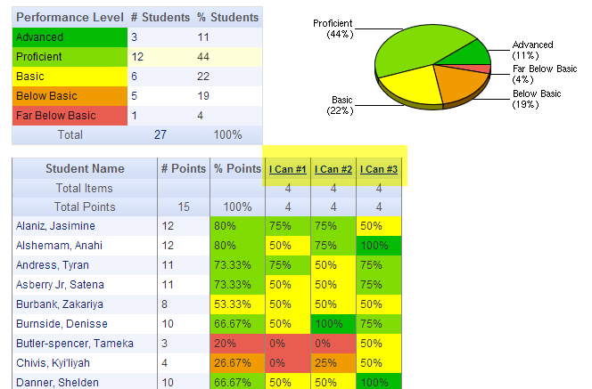
Using Assessment Data

Slide 37
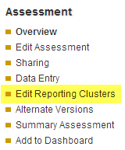
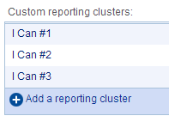
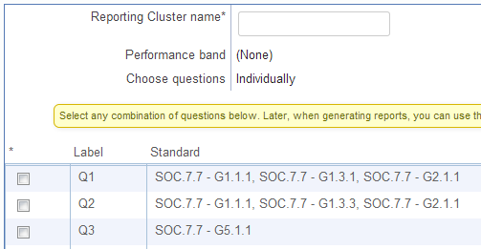
Using Assessment Data

Slide 38
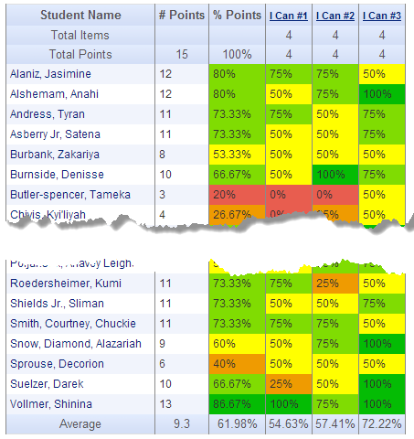
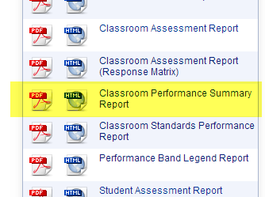
Using Assessment Data

Slide 39
Using Assessment Data - Remediation
 | I Can #1 |  | I Can #2 |  | I Can #3
 | Yes (>75%) | No | Yes (>85%) | No | Yes (>75%) | No
 | John Paul Ringo | Scary Sporty Posh | John | Scary Sporty Posh Paul Ringo | Ringo | Scary Sporty Posh John Paul
Next Steps | Extension | Remediation | Extension | Remediation | Extension | Remediation
When? | 9/31 | 9/31 | 10/1 | 10/1 | 10/2 | 10/2
What?

Slide 40
Questions?
fowlerm@calhounisd.org

