Slide 1
Common Core: Are we ready?
Michelle Tatrow, Joe Liberato, Tammy Schiller
May 10, 2013

Slide 2
Bell work
A triangle has a perimeter of 13 cm. The two shorter sides have integer lengths equal to x and x+1. What could be the lengths of the three sides of the triangle?
Notes:
The solution is 3,4,6 cm. Any other combination will not work for this scenario.
If they say 1, 2, 10 or 2, 3, 8….Ask: How would you draw that?
If they say 4, 5, 4……….Ask: Which 2 side is x and which is x+1? Which sides are the shortest? (ie….This combination does not meet the requirement that the 2 shorter sides are x and x+1.)
Have participants answer:
What strategies did you try?
What did you do that didn’t work and how did you know it didn’t work?
How do you know there’s only 1 right answer?
What if you could have a triangle with fractional side lengths?

Slide 3
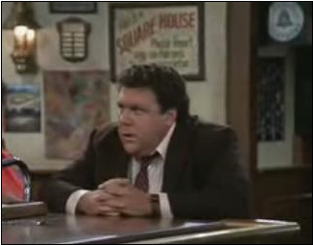
Norms
Participate positively
Share the air time
Silence phones
Seek clarification

Slide 4
Outcomes
Develop an understanding of the CCSS math practices in the context of teaching Geometry and Measurement.
Identify student misconceptions and strategies for support.

Slide 5

Homework Reflection Time
Form Trios
Share using Tuning Protocol
What do the students know and what are their next steps?
Notes:
Trios - share task, share student work
Focus Questions – What do the students know and what are next steps?
Those without work join a group of 3 with work

Slide 6
How did it go?
What were some of the benefits of reflecting on your lesson in this way?
What are some things you learned from this activity?
How might you incorporate a tuning protocol at your school?
Notes:
Have participants discuss these questions in their trios.
Return to tables
Discuss the same questions at your tables(?)
BREAK TIME!!!

Slide 7

Break
Notes:
15 minutes

Slide 8

Reading Activity (3 – 2 – 1)
3 – Ideas or connections you already teach in your class(es)
2 – New ideas or concepts you could incorporate into your teaching.
1 – Question you want to ask regarding measurement
Notes:
CCSS Progressions document K-5 Geometric Measurement
K-5 Teachers:
Read Pg 1-5
Your grade and the grade below and above
Principles and Standards for School Mathematics
6-12 Teachers:
Read Measurement Standard for your grade band.
Have participants mix and mingle to share their 3-2-1 from their reading.

Slide 9
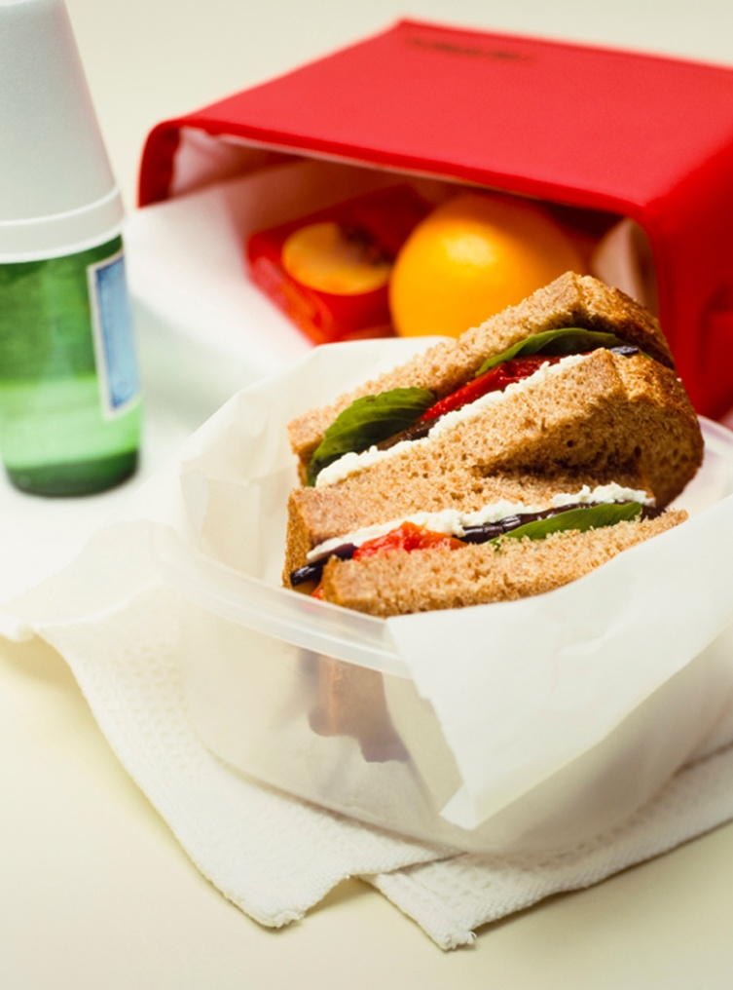
Lunch
Notes:
Joe

Slide 10
Most Important Point
What would you say was the most important point from this morning?
Notes:
Tammy

Slide 11

Always, Sometimes, Never
Check the appropriate box indicating if each statement is always, sometimes or never true
Be prepared to discuss your answers with other participants.

Slide 12
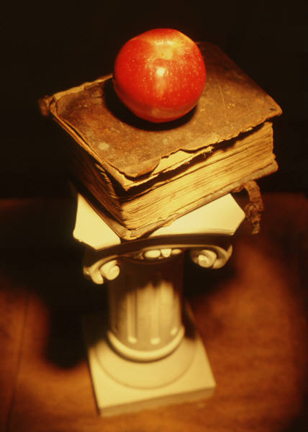
Area and Perimeter Activity
Do the math.
What math does a student need to understand to be successful on this task?
Notes:
Noyce Foundation Task:

Slide 13
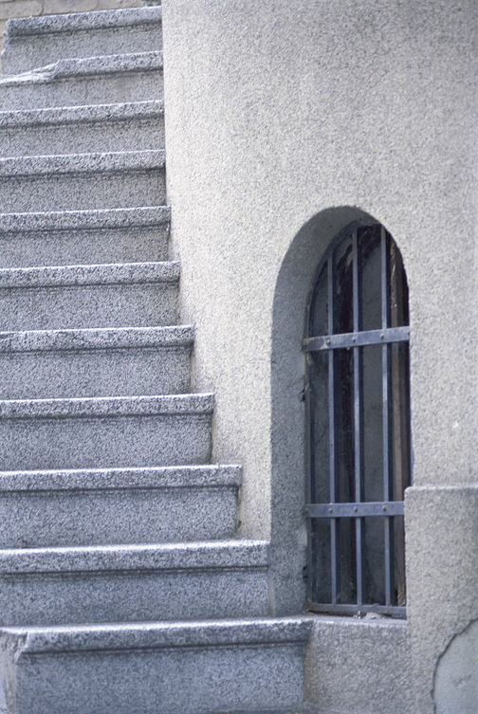
Area and Perimeter (cont...)
Look at Student work for #1.
What misconceptions did you notice in Student work on Question #1?
What are some possible next steps for students with the misconceptions you noticed on #1?

Slide 14

Area and Perimeter (cont….)
Look at Student work for #2
What errors did you notice in student thinking?
What do the students know and what are their possible next learning steps?

Slide 15

Area and Perimeter (cont….)
Which of the CCSS Mathematical Practices most strongly connect to this task and why?

Slide 16

Break

Slide 17
More Misconceptions….
Brainstorm misconceptions
Form grade alike groups
Discuss strategies for overcoming misconceptions
Chart ideas
Carousel and review ideas
Notes:
Sample Misconceptions:
Area and perimeter are mixed up.
Cannot locate base and height on a triangle
Larger space means larger angle (rather than measuring the OPENING for an angle)
Students fail to understand the hierarchy of shapes (ie….every square is also a rectangle, kite, parallelogram, rhombus and a trapezoid)
Lines of symmetry cut a figure in half……a rectangle has only 2 lines of symmetry
The diagonal of a square is the same length as the side.
Using a protractor errors as a result of not estimating the size of the angle

Slide 18
Reflection Time
What are some of your take-away’s from the math CCSS PD you’ve attended this year?
How have you applied your learning?
What might be some CCSS challenges for you next year?
How will you sustain the growth you’ve made into 2013-14 school year?

Slide 19

Planning Time
Use your ideas from reflection time to do some planning for 2013-14.

