Slide 1
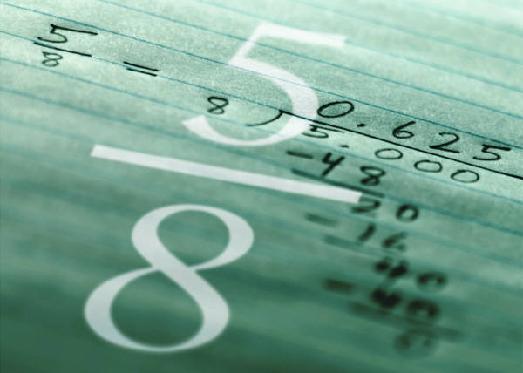
Fractions
Multiplying Fractions
Fear
Fractions

Slide 2
Is multiplication repeated addition?
1/2 ∙ 5 =
1/2 ∙ 5/1 =
1 ∙ 5 = 5/
2 ∙ 1 = 2
So 1/2 ∙ 5/1 = 5/2
Now let’s make that a mixed number!
1/2
1/2
1/2
1/2
1/2

Slide 3
Making a mixed number
If it takes 2 halves to make a whole
1 2 3 4 5
Then 5/2 equals 2 1/2
This is fairly easy to draw when you multiply a fraction by a whole number.
1/2
1/2
1/2
1/2
1/2

Slide 4
What about this?
1/3 ∙ 1/2 =
We can multiply top and bottom and get
1 ∙ 1 = 1 and 3 ∙ 2 = 6
Therefore 1/3 ∙1/2 = 1/6
But can we draw it?
Remember that in word problems “of” is times (∙)

Slide 5
Rewording
1/3 of 1/2 =
Can we draw it now?
Now there are 6 parts and the shading overlaps in one part. Is the shaded part 1/6?
1/3
1/2

Slide 6
Let’s practice
Draw fraction rectangles to show the following multiplication problems.
1/4 of 1/2 =
1/2 of 2/3 =
3/4 of 2/3 =
Remember to shade the parts that are common to both fractions.

