Slide 1
Organizing PLC Conversations April 2013
Mitch Fowler
School Data Consultant
fowlerm@calhounisd.org

Slide 2
Face to Face Outcomes
Participants will:
create a protocol for identifying PLC goals.
develop a PLC agenda format.
identify PLC data points.
create a PLC roadmap for the remainder of the year and next year.

Slide 3
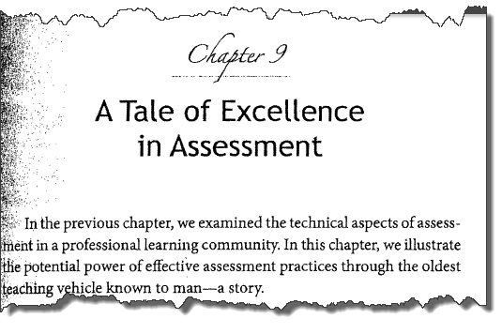
Something to Consider…

Slide 4
Identifying PLC Goals
80% of 4th grade students will demonstrate reading proficiency in comprehension by 6/15/2014 as measured by the MEAP assessment.
Utilize Reading Comprehension Strategies at least four times per week in order to increase reading comprehension as measured by PLC common assessment.

Slide 5
PLC Goal Work Time
Take some time and consider:
based on what you’ve learned thus far, how might you approach developing PLC goals in your district?
what supports might you need to gather the data for this stage?

Slide 6
Assessments to Measure Goals
Implementation Data
Monitor
How and when will we collect the adult data?
Evaluate
How and when will we discuss the adult data?
Impact Data
Monitor
How and when will we collect the student data?
Evaluate
How and when will we discuss the student data?

Slide 7
Assessments to Measure Goals - Sample
Implementation Data
Monitor
How and when will we collect the adult data?
Teacher Checklist
Evaluate
How and when will we discuss the adult data?
Grade Level PLC
Impact Data
Monitor
How and when will we collect the student data?
District Reading Assessment
Evaluate
How and when will we discuss the student data?
Grade Level PLC

Slide 8
Assessments to Measure Goals – Sample (Number of Times Comprehension Strategy is Used)
Week # | Teacher A | Teacher B
1 | 3 | 4
2 | 0 | 5
3 | 2 | 4
4 | 1 | 6
(Student Proficiency Levels)
Week # | Teacher A | Teacher B
1 | 62 | 81
2 | 65 | 79
3 | 67 | 83
4 | 71 | 84

Slide 9
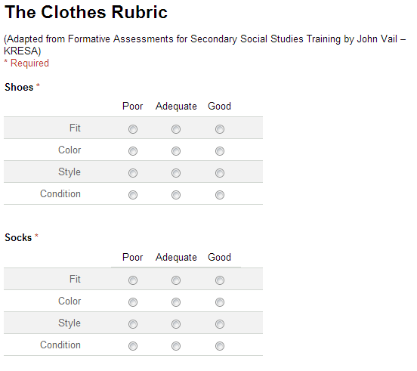
Analyzing Common Assessments for Reliability

Slide 10
Analyzing Common Assessments for Reliability
What considerations might need to be made about assessments before data is collected?
Grading Philosophies
Grading Approaches
Understanding of Rubric Value

Slide 11
PLC Guiding Questions

Slide 12
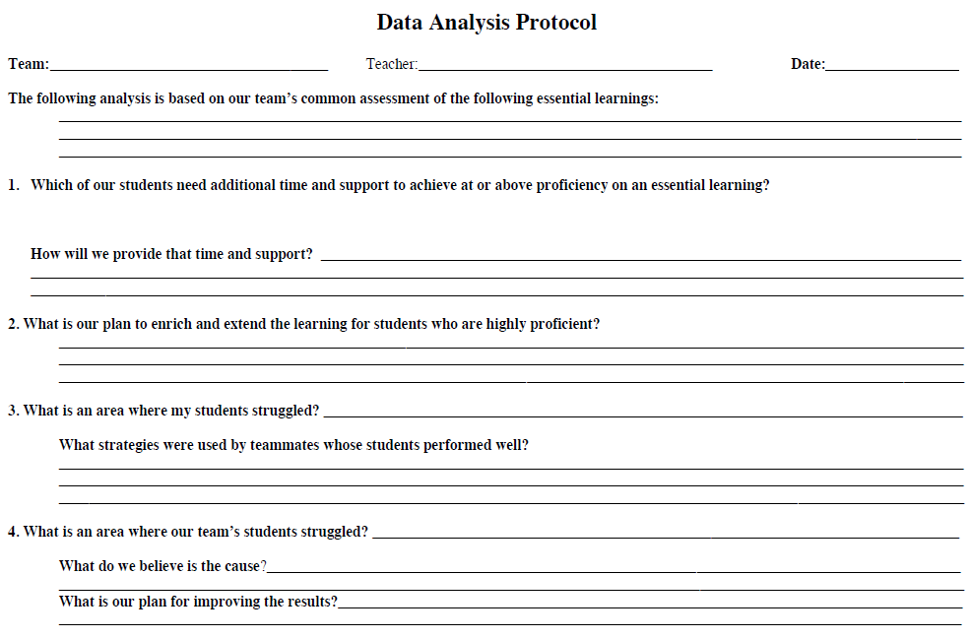
PLC Guiding Questions

Slide 13
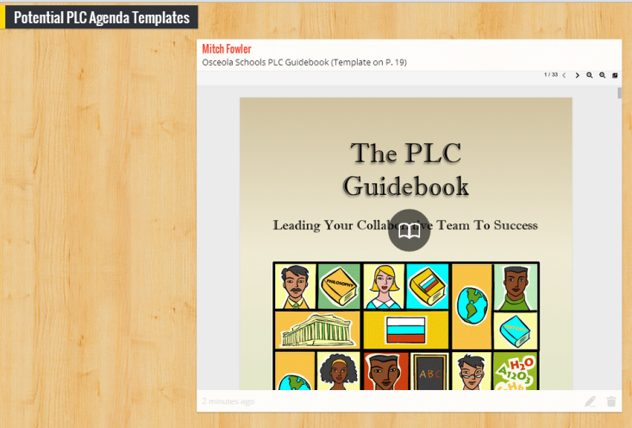
PLC Agendas
Format
Expectations for Receiving Agendas
Administrator’s Role in PLC Agendas
Share the Wealth, Avoid Burn Out

Slide 14
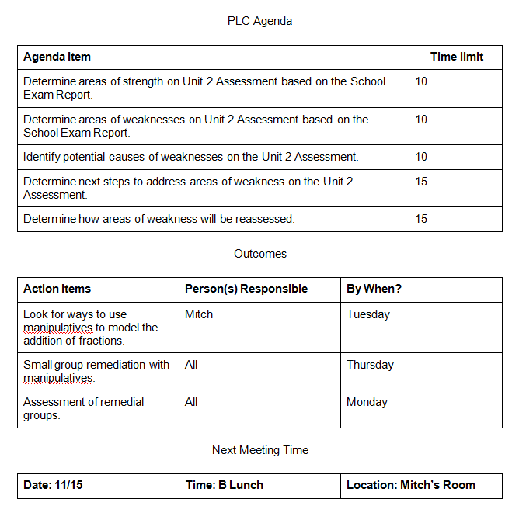
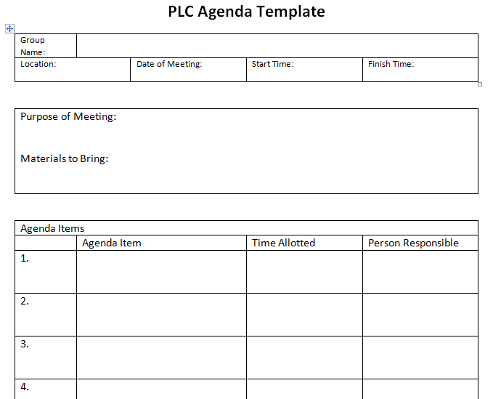
PLC Agenda Format

Slide 15
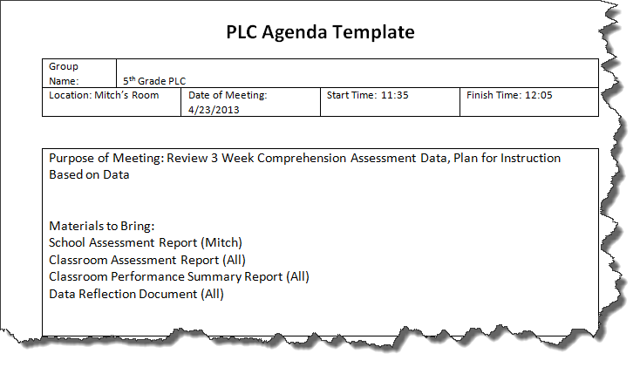
Assessment Data / Reports
Complete Data Review Before or During?

Slide 16
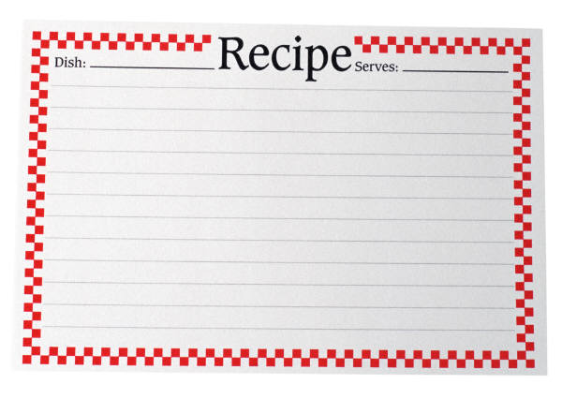
PLC Recipe Card
PLC Agenda
Data Analysis Questions Completed
Assessment Reports
Agenda Action Items

Slide 17
PLC Roadmap
August | September | January | May
Identify PLC Leads Determine PLC Goals Identify Assessments Create Agenda Template | Hold initial PLC Get Agenda out 1 Week ahead of time Reports Training | Progress monitor for goal Adjust goal if necessary | Determine status of goal Record take-aways for following year

