Slide 1
Elements of Quality Instruction & Data Use in Physical Education
Angela M^{c}Donald
SPLASH Coordinator for Nutrition & Physical Activity Education
9th Grade CTE Academy Physical Education & Health

Slide 2
Housekeeping
Drinks/Food
Restrooms
Cell phones
Lunch
SB-CEUs – October Session Only

Slide 3
Ground Rules
Everyone participates
Listen actively and respect when others are talking
Be conscious of body language and non-verbals
Different opinions welcome
Speak from your own experience
Limit side bar conversations
Start on time: end on time
Assume positive intent
Have fun!

Slide 4
Introductions
StandUp-HandUp-PairUp
  Stand up and high five someone not from your table
  Tell them the following information:
    Name
    School at which you teach
    What do you hope to gain from this training?
      tallest partner will share first
  Repeat process with 3 total people and find your seat

Slide 5
Training Objectives
By the end of the Elements of Quality Instruction & Data Use in Physical Education Training, participants will be able to:
  Name the seven habits of highly effective physical educators and relate the habits to their own teaching
  Explain the top 10 reasons for quality physical education
  Understand how the “best practices” incentives impacts their teaching
  Discuss the characteristics of a quality lesson
  Name the essential elements of instruction
  Practice using meaningful feedback statements to enhance learning
  Understand how skill progressions can be used as formative assessment to collect data
  Create their own formative assessment based on their skill performance analysis of a specific skill

Slide 6
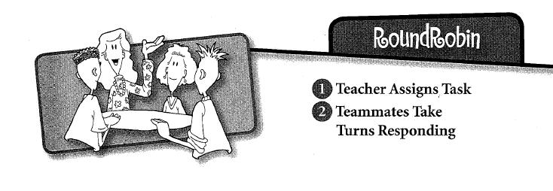
RoundRobin

Slide 7
RoundRobin
All About Me

Slide 8

The Seven Habits of Highly Effective Physical Educators
RallyTable
The teacher provides a task to which there are multiple possible responses, and provides think time.
Students take turns passing a paper and pencil, each writing one answer or making a contribution.

Slide 9
The Seven Habits of Highly Effective Physical Educators
RallyTable
What are some characteristics of an effective physical education teacher?

Slide 10
The Seven Habits of Highly Effective Physical Educators
RoundRobin – share out characteristics with team
Stand while sharing – team sits when finished

Slide 11
The Seven Habits of Highly Effective Physical Educators
Stephen Covey The 7 Habits of Highly Effective People
  Explains habits that assist people in becoming more effective and successful in their professional and personal lives
  Habit = “as the intersection of knowledge, skill, and desire”, they are learned and developed
For physical educators these habits can applied to working with students or colleagues.

Slide 12
The Seven Habits of Highly Effective Physical Educators
Jigsaw
  For each assigned habit, highlight three points that you thought were most important
  Why is this habit important in becoming an effective physical educator?
1’s = Habit 7 and Conclusion
2’s = Habits 5 & 6
3’s = Habits 3 & 4
4’s = Habits 1 & 2

Slide 13
The Seven Habits of Highly Effective Physical Educators
RoundRobin
Each person will have 2 minutes to share their information about their habits to their teammates

Slide 14
The Seven Habits of Highly Effective Physical Educators
Be Proactive
  Understanding your behaviors are products of your own choices
Begin with the End in Mind
  “How do I want to be remembered as a teacher or colleague?”
  Everything you do is a reflection of who you are
Put First Things First
  Effective self-management

Slide 15
The Seven Habits of Highly Effective Physical Educators
Think Win/Win
  Working positively with others to find solutions that are mutually satisfying
Seek First to Understand, Then to Be Understood
  Empathy
Synergize
  Joining forces to become a more powerful whole
Sharpen the Saw
  Taking care of oneself = more effective & productive

Slide 16
The Seven Habits of Highly Effective Physical Educators
Write down which habit you feel is your strongest and why.
Write down which habit you need to make a habit or improve upon. How can you achieve this?
RallyRobin your answer with shoulder partner – 30 seconds

Slide 17

Brain Break
Balloon Bounce

Slide 18
Top 10 Reasons for Quality Physical Education
Mix-Pair-Share
  Students mix around the room
  Teacher stops music
  Students pair up with the person closest to them and give a high five. Students who haven’t found a partner raise their hands to find each other.
  Teacher asks a question and gives think time

Slide 19
Top 10 Reasons for Quality Physical Education
Mix-Pair-Share
RallyRobin: Why do we teach physical education?
Timed-Pair Share: How does quality physical education differ from “gym”?
Timed-Pair Share: On a scale from 1 to 10 (1 being low and 10 being high), how would you rate your teaching in terms of being considered quality physical education? Explain why.

Slide 20
Top 10 Reasons for Quality Physical Education
Regular physical activity helps prevent disease.
Regular physical activity promotes lifetime wellness.
Quality Physical Education can help fight obesity.
Quality Physical Education can help promote lifelong physical fitness.
Quality Physical Education provides unique opportunities for activity.

Slide 21
Top 10 Reasons for Quality Physical Education
Quality Physical Education teaches self-management and motor skills.
Physical Activity and Physical Education promote learning.
Regular physical activity participation makes economic sense.
Physical Education is widely endorsed.
Quality Physical Education helps to educate the total child.

Slide 22
Top 10 Reasons for Quality Physical Education
On the worksheet please rank the 10 reasons from least important reason why all youth need quality physical education (#1) to most important (#10).
RoundRobin – Timed-Pair-Share – 1 minute each to show ranking and explain the reasoning behind your ranking.

Slide 23
Brain Break
Gotcha!

Slide 24
Characteristics of Quality Physical Education
State Board of Education Policy on Quality Physical Education (9/25/2003) *currently being amended by State Board
A Quality physical education program addresses three critical issues:
  Curriculum
  Instruction & Assessment
  Opportunity to Learn

Slide 25
Characteristics of Quality Physical Education
Curriculum
  Has a curriculum aligned with the Michigan K-12 Physical Education Content Standards and Benchmarks
Instruction and Assessment
  Taught by a certified physical education teacher trained in best practice physical education methods
  Includes students of all abilities

Slide 26
Characteristics of Quality Physical Education
Opportunity to Learn
  Offers instructional periods totaling 150 minutes per week (elementary) and 225 minutes per week (middle and high school)
  Has a teacher to student ratio consistent with those of other subject areas and/or classrooms
  Has enough functional equipment for each student to actively participate

Slide 27
“Best Practices” Incentives
Sec. 22f of the School Aid Act
  The only new money school districts will receive (outside of their Retirement subsidy) is for Best Practices
Best Practices (as defined by Legislature for 2012-13) include:
  Board is Policy Holder
  Districts is Schools of Choice under Sec. 105 and/or Sec. 105c (as PSA is defined to meet this “best practice”)
  Districts use data to monitor student growth
  Districts offer dual enrollment, AP courses, etc.
  Districts offer on-line learning
  Districts have a link to the MiSchoolData dashboard
  Districts seek competitive bids for non-instructional services
  Districts offer PE or Health to meet MDE standards

Slide 28
“Best Practices” Incentives
How does my district stack up?
With your fellow school colleagues, complete the following checklist to determine your “best practices” eligibility
Create an action plan for your district to implement quality physical education

Slide 29

BREAK!

Slide 30
Quality Instruction
Characteristics of a Quality Lesson
Essential Elements of Instruction
Instructional Feedback
Using Skill Performance Analysis as Formative Assessment to collect data

Slide 31
Characteristics of a Quality Lesson
Regardless of the teaching style used, an effective learning environment is characterized by a set of instructional behaviors that occur regularly
RallyTable with shoulder partner:
  What elements make a physical education lesson an effective learning environment?

Slide 32
Characteristics of a Quality Lesson
Students are engaged in appropriate learning activities for a large percentage of class time.
The learning atmosphere is success oriented, with a positive, caring climate.
Students are given clear objectives and receive high rates of information feedback from the teacher and the environment.
Student progress is monitored regularly and students are held accountable for learning in physical education.

Slide 33
Characteristics of a Quality Lesson
Low rates of management time and smooth transitions from one activity to another characterize the environment.
Students spend a limited amount of time waiting in line or in other unproductive behaviors.
Teachers are organized and have high but realistic expectations for student achievement.
Teachers are enthusiastic about what they are doing and are actively involved in the instructional process.

Slide 34
Characteristics of a Quality Lesson
Based on the 8 elements of a quality lesson, rank your teaching effectiveness for each quality
RoundRobin: What element do you need to improve upon the most and name one way to improve that quality?

Slide 35
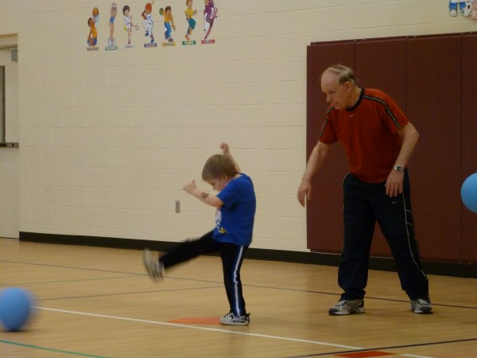
Essential Elements of Instruction
Objectives
Anticipatory Set (hook)
Standards/Expectations
Teaching
  Input
  Modeling/demo
  Direction giving
  Checking for understanding
Guided Practice
Independent Practice
Closure

Slide 36
Instructional Feedback
Mix-Pair-Share
Timed-Pair-Share: Why is it important to provide instructional feedback?
RallyRobin: List all the ways you give feedback when teaching
Timed-Pair-Share: What’s the difference between effective and ineffective feedback?

Slide 37
Instructional Feedback
Delivering Meaningful Effective Feedback
  Positive – corrective not negative
  Specific – “Nice Job” “Way to Hustle” are general statements that don’t give students much information
  Immediate - give feedback as soon as possible and if using corrective feedback allow for student to practice again and reinforce with more feedback

Slide 38
Instructional Feedback
For the following skill assigned to your number, create an inappropriate feedback statement and an effective feedback statement
1’s = instep kick soccer
2’s = forehand swing tennis
3’s = locomotor skill of skipping
4’s = object control skill of catching

Slide 39
Instructional Feedback
RoundRobin – Share your inappropriate and effective feedback statements with your team

Slide 40
Brain Break
Shoe Scramble!
  1. Shoe Circle – players form a circle. Everyone takes off one shoe and tosses it in the center.
  2. Hands Joined – everyone joins hands.
  3. Helping Hands – each person must pick up one shoe, locate the owner of the shoe, and return it to the owner without letting go of the hands on either side!

Slide 41
Skill Performance Analysis
What is an SPA?
  Break down of a skill into its’ critical elements for demonstration, instruction, and assessment
5 parts of a SPA
  List all the steps of the skill – preparation to follow-through
  List 3-4 MOST CRITICAL steps – create cues
  Write psychomotor objective for skill
  Assessment plan
  Common skill errors and strategies

Slide 42
Skill Performance Analysis
SPA Example: Heading a Soccer Ball
Skip – EPEC Assessment

Slide 43
Using a Skill Performance Analysis for Data Collection
With your shoulder partner discuss the following questions:
  How could you use an SPA to collect data?
  How might you use an SPA to provide data for your teacher evaluation?

Slide 44
Designing your own SPA’s
With the remainder of the time before lunch:
  Select one skill that you will be teaching at the beginning of the school year and design an SPA for that skill.
  In terms of assessment, determine how you will assess this skill with data collection in mind.
  After lunch…you’ll see the connection between your SPA and Data Collection

