Slide 1
February 2013 BCPS Visual Arts PLC Data Training
Mitch Fowler
fowlerm@calhounisd.org

Slide 2
What would you like to do with your data once you’ve collected it?

Slide 3
Outcomes
Participants will:
identify their purpose for collecting and analyzing assessment data.
understand how to access the 12-13 BCPS Visual Arts Assessment on DataDirector.
understand how to enter student assessment data into the 12-13 BCPS V.A. Assessment.
determine which assessment reports will best fit their needs in order to make adjustments based on data.

Slide 4
Accessing the BCPS Visual Arts Assessment

Slide 5
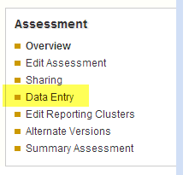
Data Entry
To break kids down by grade, teacher, period, view the tutorial video at:
http://youtu.be/IWIHaq8-fqM

Slide 6
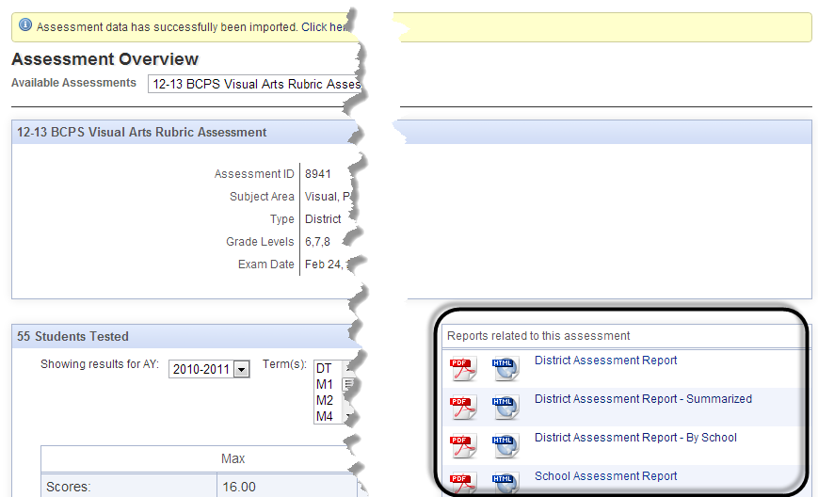
Available Assessment Reports

Slide 7
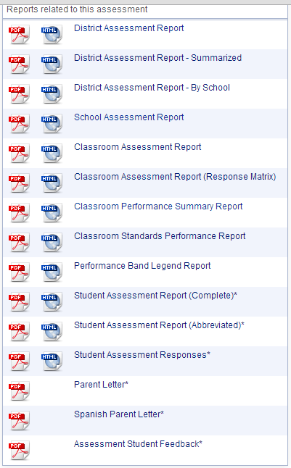
Available Assessment Reports (Cont.)
What
Who

Slide 8
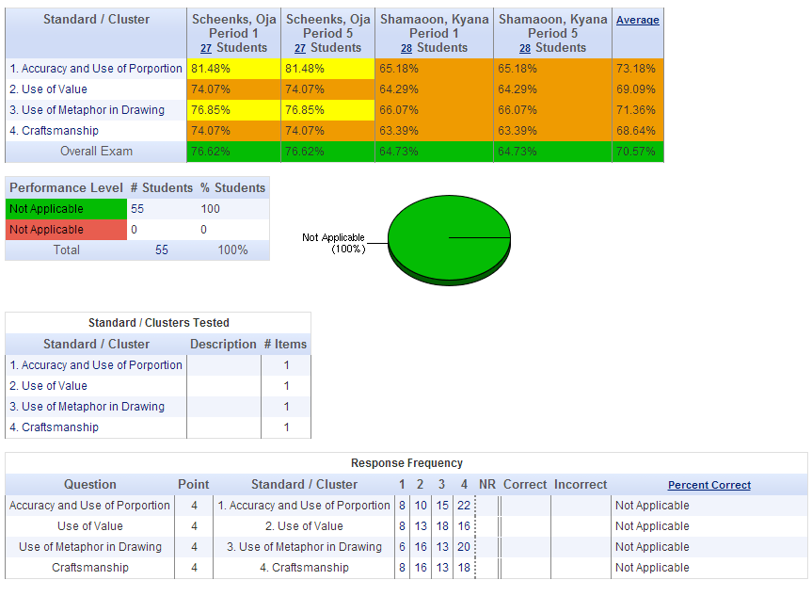
Available Assessment Reports (Cont.)
!
School Assessment Report
!

Slide 9
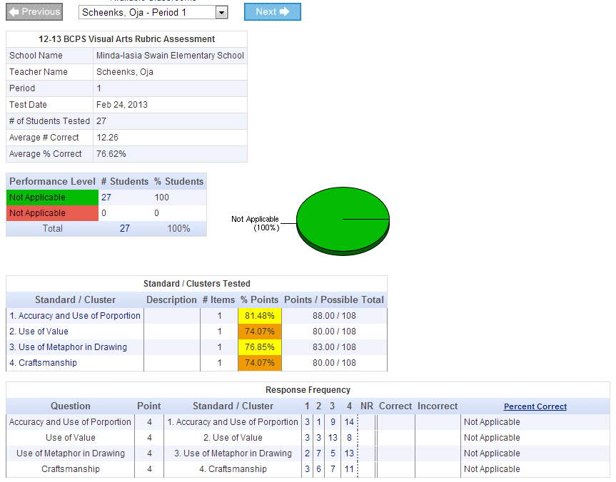
Available Assessment Reports (Cont.)
Classroom Assessment Report
!
!

Slide 10
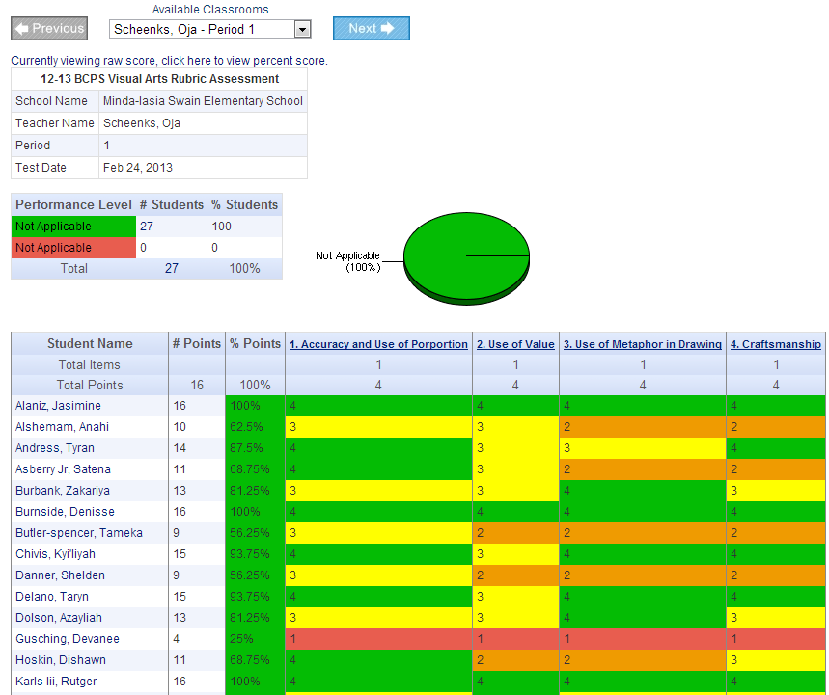
Available Assessment Reports (Cont.)
Classroom Performance Summary Report
!

Slide 11
Acting on the Data
PLC Time
Evaluations
Other times?

Slide 12
Reflection on Learning
PD Training Survey

