Slide 1
Elements of Quality Instruction and Data Usage in Physical Education – October Session

Slide 2
What was taught?
What went well?
What didn’t go well?
What’s next?

Slide 3
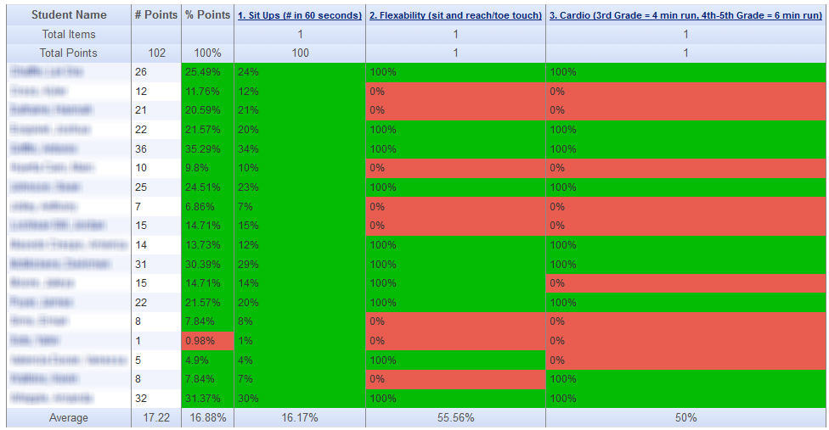
Who got it?
Who didn’t?
What do we do with the kids who didn’t get it?

