Slide 1
Common Core: Are we ready?
November 9, 2012

Slide 2
Bell Work
Write 3 equivalent fractions for each:
4/5
5/4
2.8
9/15
Be ready to use math language to explain your thinking.
Notes:
Michelle facilitate and Tammy will chart.
What strategies did you use for these questions?
Elicit responses of different strategies.
This warm-up can bring out student misconceptions that can be addressed prior to the beginning of a lesson.
Share at tables then share out.

Slide 3
Norms
Participate positively
Share the air time
Silence phones
Seek clarification
Notes:
Tammy

Slide 4
Outcomes
Examine our conceptual understandings of operations with rational numbers and what that means for instruction at multiple grade levels
Explore Smarter Balanced Assessment Consortium rational number items
Develop an understanding of the CCSS Mathematical Practices in the context of teaching operations with rational numbers
Identify student misconceptions and strategies for support.
Notes:
Tammy

Slide 5
Importance of Equivalence
Why is equivalence of fractions important?
What are some common misconceptions kids have when making equivalent fractions?
How can we support learning for students who hold these misconceptions?
Notes:
Michelle facilitate, Tammy Chart
Individually, write and then Stand and Pair up with someone not at your table.
Elicit and chart group responses.
Same numerator makes them equal.
Adding same # to numerator and denominator makes equivalent fractions
¾ and 5/6 are equivalent because both are 1 away from the whole
Michelle facilitate and Tammy will chart.
What strategies did you use for these questions?
Elicit responses of different strategies.
This warm-up can bring out student misconceptions that can be addressed prior to the beginning of a lesson.
Share at tables then share out.

Slide 6
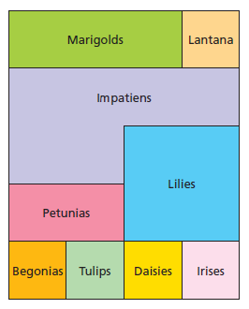
Planting Flowers (Addition and Subtraction)
Notes:
Michelle
Introduce problems
10 min individual time
Collaborate with table group
What are some similarities and differences you notice in the work at your table?
Are different answers you have correct?

Slide 7
Reflecting on Planting Flowers
What will students need to understand to make sense of part a?
What if a student says that impatiens are 1/9 of the garden?
How does the idea of equivalent fractions come into this problem?
Which of the CCSS math practices would best support this problem?
Notes:
Michelle
A kid who says 1/9 may not understand area……May not understand the need for equal sized pieces.
1/9: What is the biggest piece, how do you know? What is the smallest piece, and how do you know? How much bigger is ____ than ____?
Give a cut-out model.
Final group Processing: What might be some ways we need to plan to identify student understanding and support their learning of fraction operations? (Plan for student “math talk”)

Slide 8
Break

Slide 9
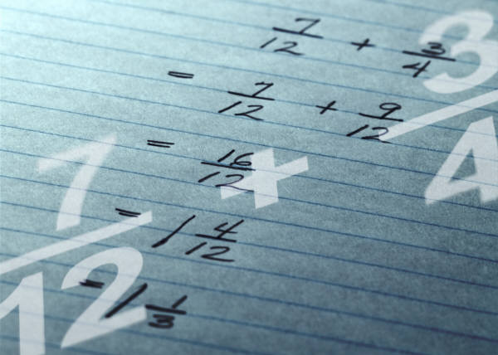
Visualizing Addition and Subtraction
Notes:
Tammy
(Adding, Subtracting, and Misconceptions Wksheet)
Do the Math:
Adding and Subtracting Visual Models:
Complete with a partner or OYO
Whole group discuss #4

Slide 10
Reflection
How could having students make drawings to justify addition and subtraction with fractions help students with common misconceptions?
How is this activity connected to the “Planting Flowers” problem?
Which of the CCSS math practices would best support this problem?
Notes:
Tammy
(Grade level dissection Groups of 4 – corners) PROMSE Activity 1c: Adding, Subtracting, and Misconceptions
In grade band groups discuss the questions.
Create cross grade groups and:
Cross Grade Groups………….Same questions but use talking chips/fingers: Talking Chips!
Be sure “equal parts” and “what is the whole” are ideas that come out in this discussion
Whole group: What were some of the big ideas you discussed?

Slide 11
Article: The Power of Problem Choice
Sentence
Word
Phrase
Notes:
Michelle

Slide 12
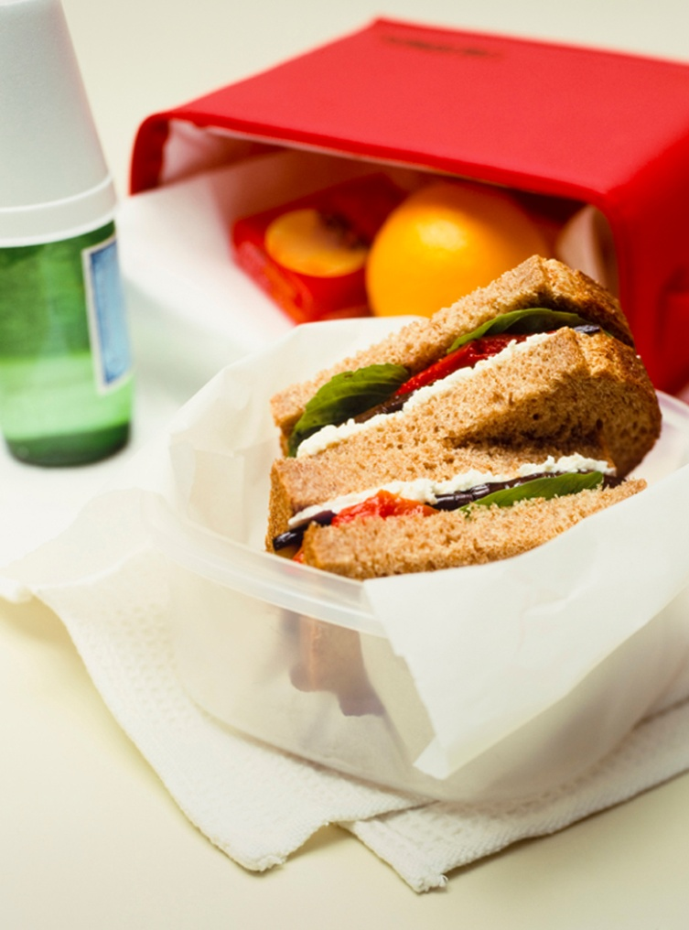
Lunch
Notes:
What do you know about 3 5/8?
What do you know about 5/8?
If students solve using estimation, how does that set them up for math success later on?
If students solve using an exact calculation, how does that set them up for math success later on?

Slide 13
Most Important Point
Notes:
Tammy
Jot down your “Most Important Point” from this morning. Be prepared to share with a partner.
SU,HU,PU

Slide 14
Teaching Multiplication of Fractions
Individually, answer the questions on the handout.
What do students first need to understand about fractions in order to make sense of multiplying fractions
Why do we say that “of” means “times” when we think about multiplying fractions?
Notes:
Joe
Activity 2a wksht
Thinking about teaching multiplication with fractions (Activity 2a)
What do students first need to understand about fractions in order to make sense of multiplying (and eventually dividing) of fractions? (Either ½ of ¾ is cutting each ¼ in half, or taking half of the 3 pieces : 1& ½ fourths)
Why do we say that “of” means “times” when we think about multiplying fractions? ½ x ¾ = half a group of ¾

Slide 15
True/False Activity
Decide if each statement is true or false.
If it is true, justify your answer.
If it is false, show why it’s false and revise the statement so it is true.
Notes:
Michelle
Connecting Multiplication of Fractions to Multiplication of Whole Numbers (Activity 2b- 4 pages – not page 1)
How did these exercises help you think about the concept of multiplying fractions?
The intention of these exercises was to begin to develop students’ strategies to reason about multiplication of fractions. How does this support the ideas on the Common Core regarding learning fraction multiplication?

Slide 16
Reflection
How did these exercises help you think about the concept of multiplying fractions?
The intention was to begin to develop students’ strategies to reason about multiplication for fractions. How does this activity support the ideas in the CCSS regarding learning fraction multiplication?
Notes:
Michelle/ All

Slide 17
Break

Slide 18
Multiplication Models
Independently answer #1-4
Discuss answers in group.
Which was least challenging?
Which was most challenging?
What was the impact of having to estimate, draw a visual and write a number sentence?
Notes:
Tammy

Slide 19
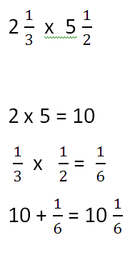
Student work analysis
What error has the student made?
What would be your next steps with this student?
Notes:
Michelle

Slide 20
Team Thinking Time
Where do your students tend to struggle with fraction concepts?
What fraction operation concept might be most important to address in your district?

Slide 21
K-12 Connections
Concept
K – 2
3 - 5
9 - 12
6 - 8
How does each grade band support students in understanding this concept?
Notes:
Joe
Have participants identify big concepts they want to focus on in their district and What they might do at their grade level to support that focus area.
Multiplication of fractions needs a strong base in lower el with repeated addition and whole number multiplication with visual models and equations.
HS when we see kids struggling with fractions seek out their misconceptions and support them where they are so that the misconception is addressed.

Slide 22
SBAC sample items
3-5 Fractions 2a & Fractions 2b
6-8 Expressions and Equations 2
HS: Rationals and Radicals

Slide 23
Please Provide Feedback
Click the feedback link on the Moodle to provide us with feedback on today’s PD.
If you are getting SCECH’s (formerly known as SB-CEU’s) you will receive a separate email from MDE to complete a survey.

