Slide 1
Assessment Design for All Educators
Mitch Fowler
fowlerm@calhounisd.org

Slide 2
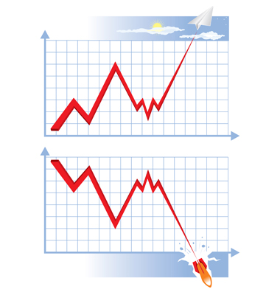
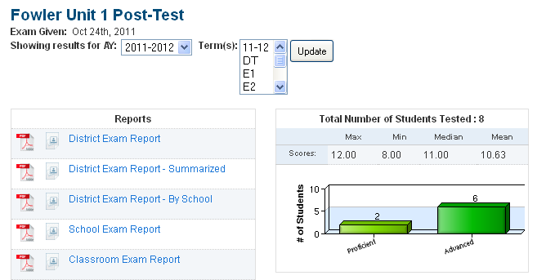
My Experiences
?

Slide 3
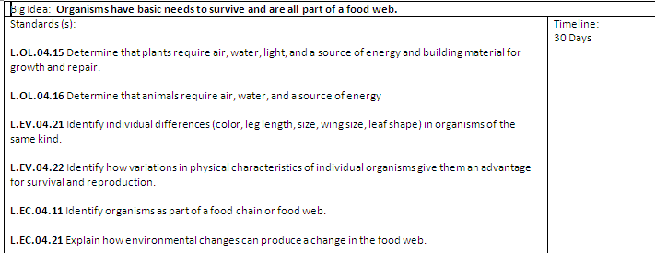
Assessment Map

Slide 4
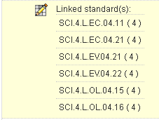
Merging Assessment Maps and DataDirector
Pre-Test / Post-Test Linked Standards
Formative Assessment 1 Linked Standards

Slide 5
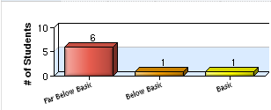
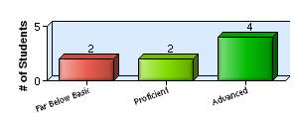
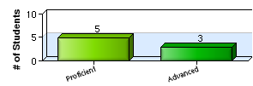
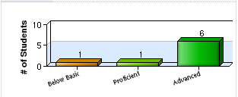
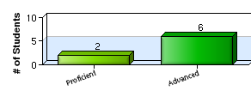
Formative Data Analysis
Pre-Test
Formative 1
Formative 2
Formative 3
Post-Test

Slide 6
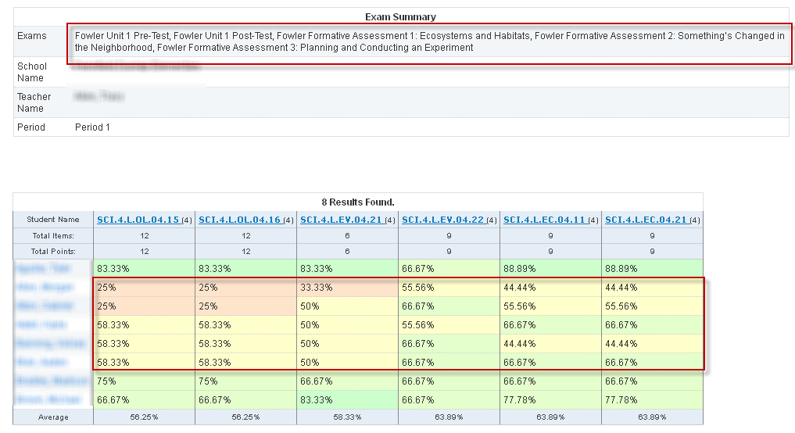
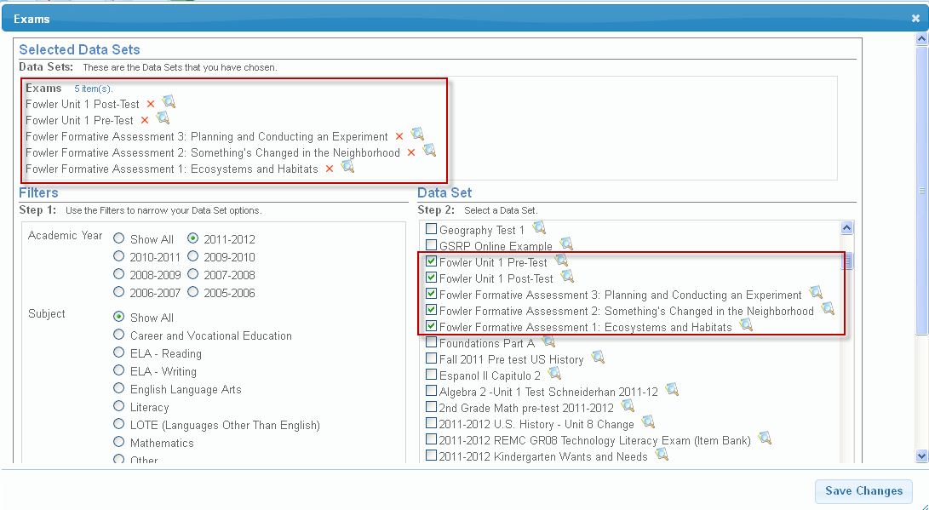
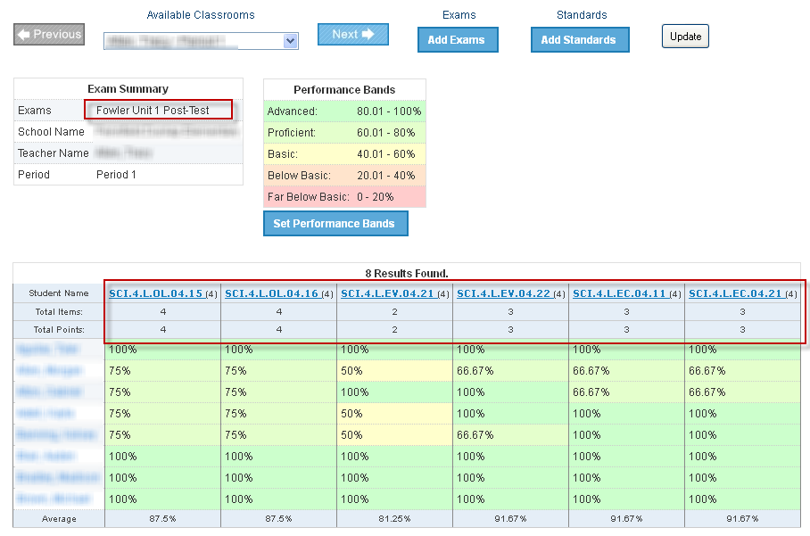
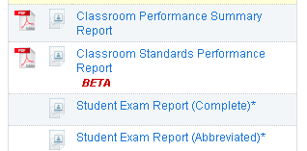
Formative Data Analysis
!

Slide 7
Review and Wrap Up
Assessment Mapping
Build Exams and Link to Standards
Classroom Standards Performance Report
Impact on consultants?
Other reports to show growth?

