Slide 1
Common Core: Are We Ready?
October 12, 2012

Slide 2
Bell work:
What do you know about ?

Slide 3
Norms
Participate positively
Share the air time
Silence phones
Seek clarification

Slide 4
Structure of CCSS Math Sessions
Each session will focus on:
One strand of mathematics across grade levels
CCSS Mathematical Practices
Planning time for implementation of new learning

Slide 5
Outcomes
Examine our conceptual understandings of fractions
Explore Smarter Balanced Assessment Consortium fraction items
Develop an understanding of the CCSS Mathematical Practices in the context of teaching fractions
Identify student misconceptions of fractions

Slide 6
Introductions
We believe:
Students need to dialogue about and make sense of the mathematics they are learning.
Students learn best with an approach that exposes them to rich mathematics tasks with a balance between procedural and conceptual understanding.
The quality of teacher decision-making has the greatest impact on student learning.
Notes:
The why!

Slide 7
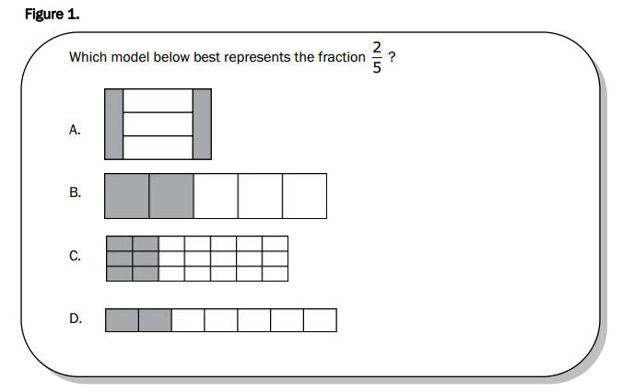
MEAP-like fraction item

Slide 8
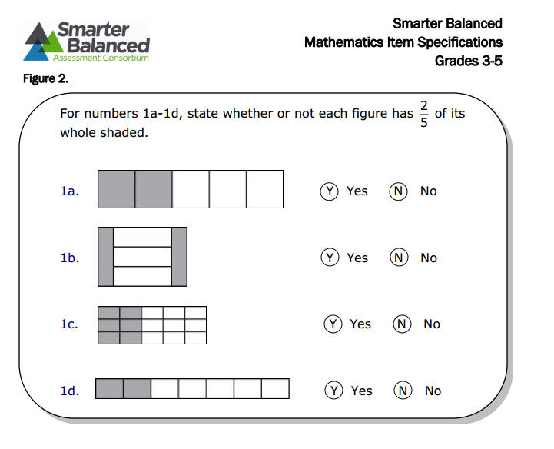
SBAC-like fraction item

Slide 9
Beans Problems
Do A-D individually
Form grade-level groups
Discuss A-D
Regroup into cross grade-level groups
Develop a poster to demonstrate E
Share out

Slide 10
Definition of Fraction

Slide 11
Break

Slide 12
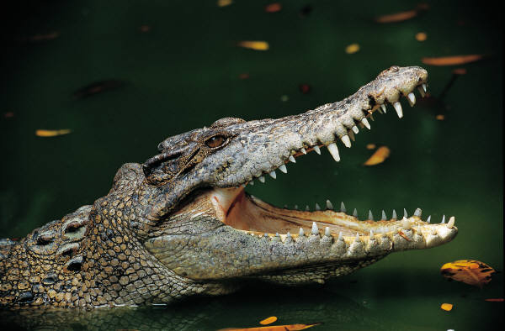
Which is Greater?

Slide 13
CCSS Math Practices “Chalk Talk” (Marker Talk ☺)
Notes:
Individual time first!!!

Slide 14
Focus on the CCSS-MP
What are some commonalities you see across multiple practices?
What are some things a teacher might do to engage and support students around the CCSS-MP?

Slide 15
Lunch

Slide 16
M. I. P.
What was the most important point for you from this morning?

Slide 17
Fraction Misconceptions
Where are fractions taught or used in my grade-level?
What misconceptions have I seen from kids?

Slide 18
Expert Group Jigsaw
What is the misconception?
What might be some strategies to overcome this?
Notes:
Form groups of 5 (home group).
# off 1-5 in your groups
Each person read: Intro (136- top of 138)
1’s Rational # error pattern 1
2’s Rational # error pattern 2, and so on.
Discuss/summarize in expert group to help your home group understand
Go back to home groups and share

Slide 19
Home Groups
Summarize your error patterns
How can the instructional strategies (pg 165 to 171) support students with the different error patterns?

Slide 20
Planning Time
Fraction Misconception
What are we doing at grade levels to support fraction concepts?
How are we identifying students misconception of fractions?
What supports can we put in place to address student misconceptions?
Notes:
We need some type of menu of potions for planning time.

Slide 21
Planning Time
Fraction Misconception
What concepts in my grade support fraction understanding?
How can I identify misconceptions in students that may inhibit their understanding of fractions?
What supports can I put in place to address student misconceptions?
Notes:
We need some type of menu of potions for planning time.

Slide 22
Planning Time
Common Core Implementation
What do teachers/administrators need to know in my building?
How are we going to align our curriculum documents?
What are we going to do with the math practices?
How are we going to align our assessments?
Notes:
We need some type of menu of potions for planning time.

Slide 23
Planning Time
Math Practices
What areas in our program do we have successes or are things in place?
What areas do we need to improve?
What supports do teachers need?
How are we going to monitor implementation?
How are we going to measure change in student performance?

Slide 24
Planning
Common Core
Fraction Identification and Support
Math Talk/Math Practices

Slide 25
Evaluation
Please fill out an Evaluation (link on the Moodle site).
Record your thoughts for the day.

