Slide 1
At Risk Data: Identify, Collect, Analyze, and Act Today!
Mitch Fowler
School Data Consultant – Calhoun ISD
fowlerm@calhounisd.org

Slide 2



Our story…
5 Miles

Slide 3
Identify - 31-A Legislation
Section 31a of the State School Aid Act
Provides supplementary instructional and pupil support services for pupils who meet the at-risk criteria specified in the legislation.
Criteria include
  low achievement on MEAP tests in mathematics, reading or science;
  OR failure to meet core academic curricular objectives in English language arts or mathematics (applies to grade K-3 pupils only);
  OR the presence of two or more identified at-risk factors.

Slide 4
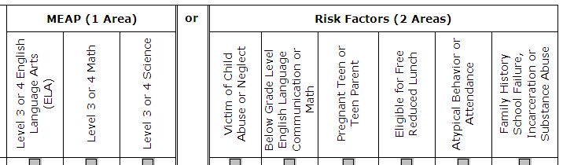
Identify - 31-A Workbooks

Slide 5
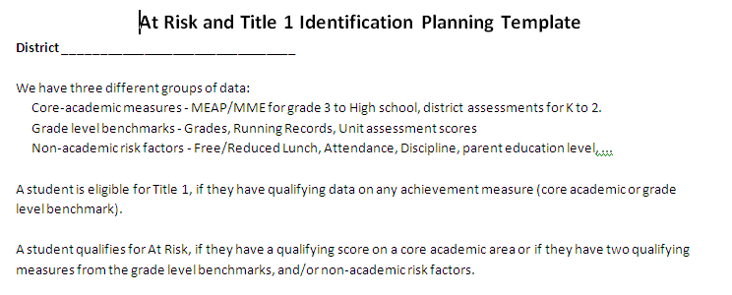
Identify Activity –
What Data Should You Use?

Slide 6
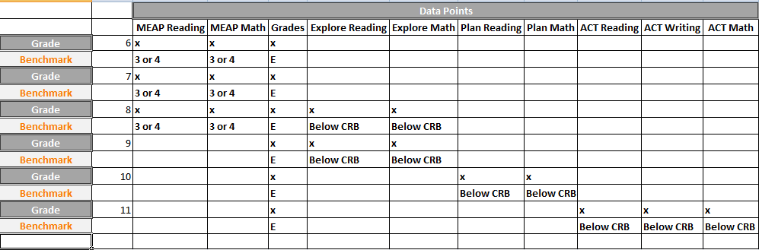
Identify Activity –
Data Collection Template

Slide 7
Collecting At Risk Data
31 A Risk Factors Assessment
Victim of Childhood Abuse and Neglect
Teen Parent
Family History

Slide 8

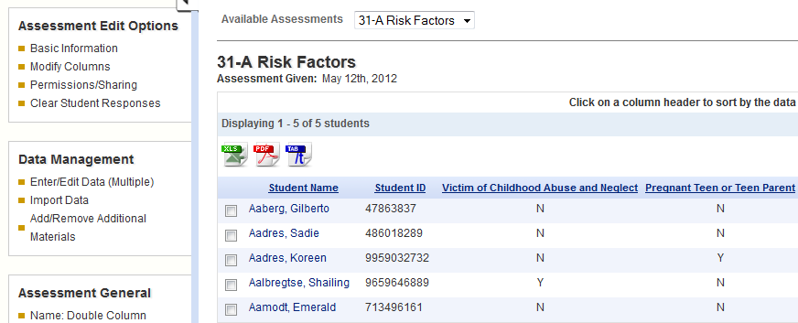
Collecting At Risk Data –
DataDirector View
Notes:
31-A Risk Factors Summary Assessment in the Demo Site.

Slide 9
Collecting At Risk Data
At-Risk Data Report
MEAP Data
31-A Risk Factors Assessment Data
Behavior
Attendance
Local Data

Slide 10
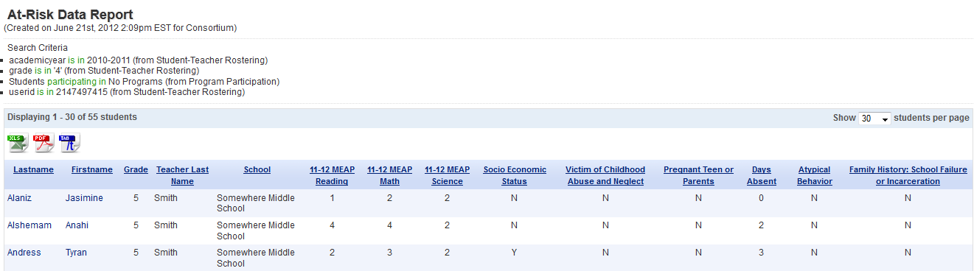
Collecting At Risk Data –
DataDirector View
Data from MEAP Assessment
Data from 31-A Assessment
Data from NSLP and Attendance Demographic
Notes:
At Risk Data Report in the Demo Site

Slide 11
Collecting At Risk Data
At-Risk Data Report
CISD At-Risk Data Tool
At-Risk Demographics

Slide 12
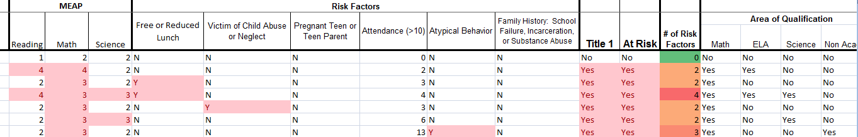
Analyzing At Risk Data
Notes:
Sample At Risk Report copied and pasted into the Sample CISD At Risk Data Tool

Slide 13
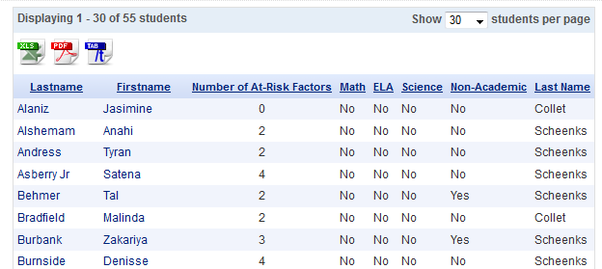
Collecting At Risk Data –
DataDirector View

Slide 14
Acting on At Risk Data

Slide 15
Lessons Learned
Protocols, protocols, protocols…
Data Entry
Storage
Access
Frequency
Lots of assistance during the first year!
Tutorials = helpful

