Slide 1
General Education First!
BLURRING THE LINES
Notes:
Lynne – Welcome. Introduction of Mitch
Warm up activity – Introductions: Role in ISD; greatest strength in role, what skill you would like to improve. Pair off and discuss and share. Write down answers fro future sessions.

Slide 2

Background
Consultant Leadership Series
Purpose:
  Train Teacher Consultants to effectively work in classrooms
    Cognitive Coaching
    Data Collection and Analysis
    Organization Skills
    Common Core Curriculum
    Communication Skills
    Transition Skills
    Tier I
Notes:
(Lynne)
Research based knowledge
Broaden skill level to build capacity of teachers in best practice
Data driven decision making
Student success in the general education curriculum

Slide 3
AGENDA
Special Education History, In Brief
Why Data?
3WiN Data Portrait
MI School Data Portal
Data Director
Exploring Special Education Data
What This Data Means For Programming
Notes:
(Lynne)

Slide 4
Individuals with Disabilities Education Act (IDEA)
The Individuals with Disabilities Education Act (IDEA) is a law ensuring services to children with disabilities throughout the nation.
IDEA governs how states and public agencies provide early intervention, special education and related services to more than 6.5 million eligible infants, toddlers, children and youth with disabilities.
Two Parts: Part B and Part C
Notes:
(Lynne)
Activity – At tables: Sticky notes. Two minutes to write one word or phrase depicting IDEA regulations and how you see it daily. Charts: FAPE, General Education, Services,

Slide 5
Why Data?
Student
Progress
Analyze
Data
Program from data
Teach
Assess
Special Education Then
  Early 1970’s
  FAPE
  Individualized Education
  Special Education Now
    Inclusion Model
    Data Driven
    FAPE
    Individualized Education
Notes:
(Lynne) -began and grew rapidly. Categorical classrooms were everywhere for students with academic and behavioral issues.
LD became a new eligibility in the late 70’s
OHI followed shortly thereafter
RR
SE teachers were trained in modifying curriculum
SE teachers were trained to teach a different curriculum
Dummy downed
NCLB – closer look at how special education services were delivered and the results. Movement to including SE in GE first. MDE collects data annually on students with IEPs and their time in GE. Expectation for MEAP and graduation. SE - data driven

Slide 6

Rigorous Expectations
No Child Left Behind
AYP
School Improvement
Common Core
MMC
CIMS
Notes:
(Lynne)
Describe all of the above - Handouts

Slide 7

Rigorous Expectations For All Students
Expectations
Identification: SIDR, REED and RtI
Least Restrictive Environment
The extent possible
Progress in General Education
AYP
MEAP
Suspension/Expulsion
Graduation Rates/Drop Out Rates
Notes:
Lynne -Raised the ceiling
Special Education students not receiving a diploma
4,000+ students in SE in our county/ How many receive a diploma with MMC?

Slide 8
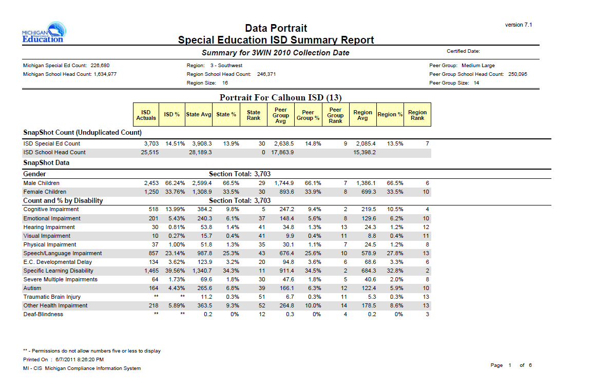
3WiN Data Portrait
Notes:
(Lynne) - Add data portrait here. Describe the areas of information from yearly data that could drive programming in each district. Good data for school improvement planning also.
TC info: How accommodations/modifications provide the tools for success in school.

Slide 9
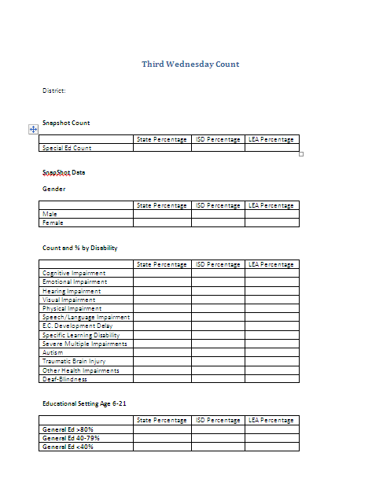
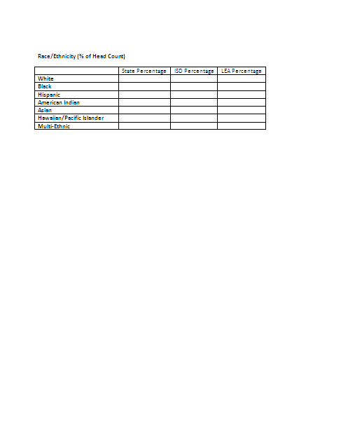
Use Template To Complete State And ISD Data
Notes:
(Lynne)
Exercise to compare data state, ISD and district

Slide 10
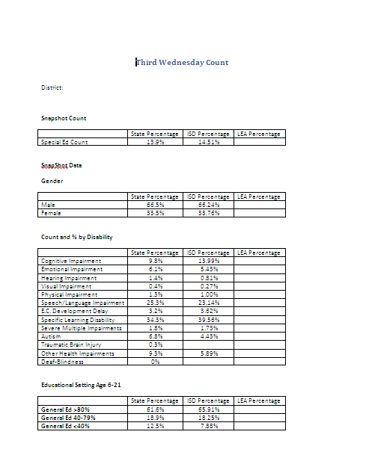
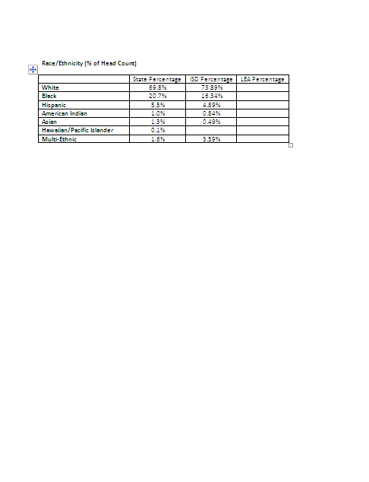
Check Your Work
Notes:
(Lynne)After table time, ask groups what they observed with this information.

Slide 11
Your LEA Portrait
Review your district’s data
Review Disability Data
Review LRE Data

Slide 12

Group Activity
Review District Disability
Data:
What information did you find?
What might the district have control over?
What changes can the district make to improve outcomes?
What other data do you need to access to hypothesize?
Notes:
(Lynne)
Group Activity
Cluster to own district or district of choice. Work in groups to find data. Discuss.

Slide 13

Least Restrictive Environment
Data
Implications
MEAP Scores
AYP
Graduation
Drop Out
CIMS
Notes:
(Lynne)-On-line activity – website to December 1 count – districts. Review LRE information at tables. Discuss as whole group implications for graduation/MEAP scores/drop outs

Slide 14
Group Activity
Review District LRE Data:
What information did you find?
What might the district have control over?
What changes can the district make to improve outcomes?
Any other questions?

Slide 15

State Performance Plan Indicators
Performance Indicators
Graduation
Drop Out
Assessment
Suspension/Expulsion
Child Find
LRE
Notes:
(Lynne) Graduation Rate, Drop Out, LRE, Child Find, Suspension/Expulsion

Slide 16
BREAK

Slide 17
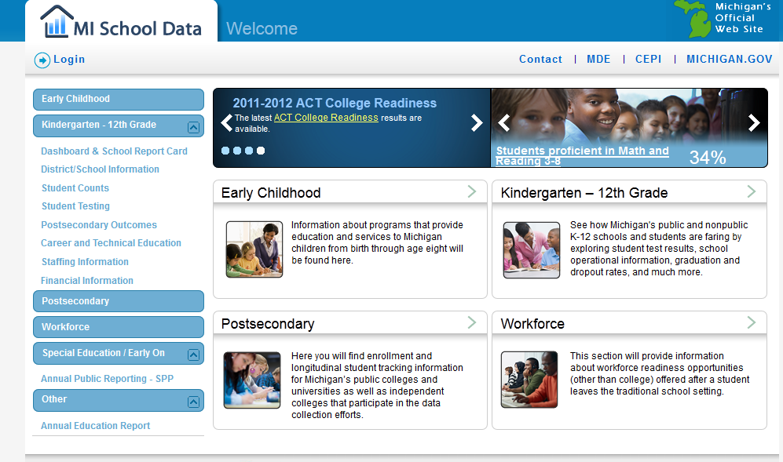
Exploring the MI School Data Portal
www.mischooldata.org
Special Education Inquiries
Proficiency Inquiry
Disability Groups
Notes:
(Mitch)

Slide 18
Group Activity
Exploring
MI School Data
Portal
Review district disability
data:
Does each disability group share the same trend?
Should more attention be focused on certain disability groups?
Which subgroups performed the best on this test? Worst?

Slide 19
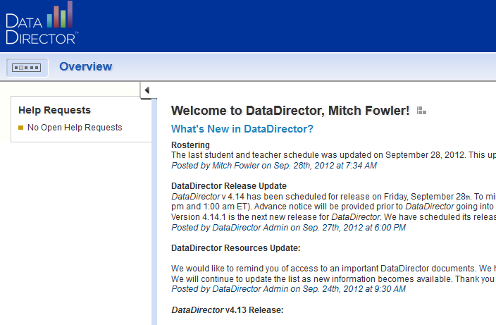
Exploring DataDirector
www.datadirector.com/calhoun
Strand Analysis
Custom Reporting
Greater Disaggregation

Slide 20
Group Activity
Exploring
DataDirector
Review district disability
data:
Which strand appears to cause SWD the most trouble?
Are all disability types performing at the same level among the strands?
Which disability types are struggling? Which are succeeding?
Notes:
Angela Pass out BCPS data portrait:10 minutes

Slide 21
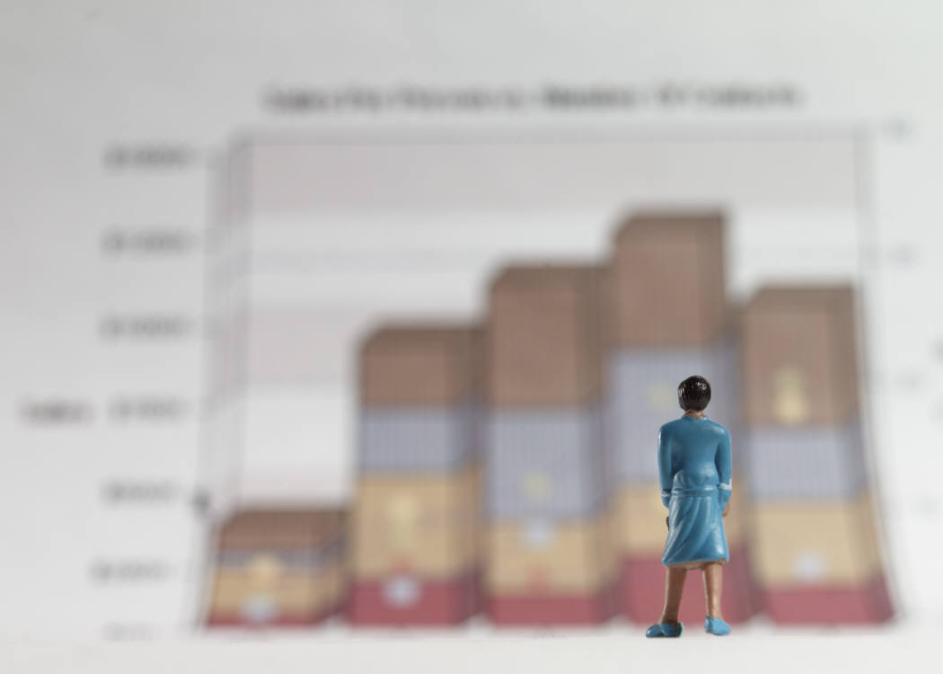
Illuminate
Progress Reports

Slide 22

School Improvement Planning
MEAP
MEAP-Access
Mi-Access
CIMS
School Improvement
IEPs
Student Outcomes
Notes:
(Lynne)

Slide 23

DATA and Programming
Notes:
Small group activity – How can this data be used to drive your school improvement and programming?

Slide 24

Share Ideas
Notes:
(Mitch)

Slide 25

Where Do We Go From Here?
Notes:
(Mitch)

