Slide 1
DataDirector: It’s Just a Tool
Urbandale Elementary Sept. 2012
Mitch Fowler
fowlerm@calhounisd.org

Slide 2
Today’s Outcomes
Participants will:
  understand how to use DataDirector to input data.
  retrieve data reports to support teaching and learning.
  use data to communicate student progress with colleagues and parents.

Slide 3
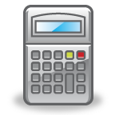
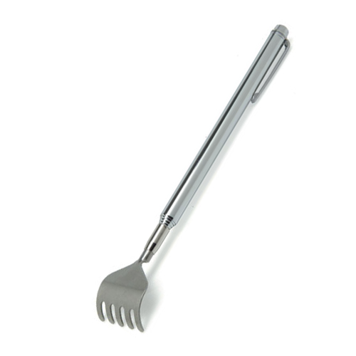


Just a Tool…
“A tool is any physical item that can be used to achieve a goal.” - Wikipedia
?

Slide 5
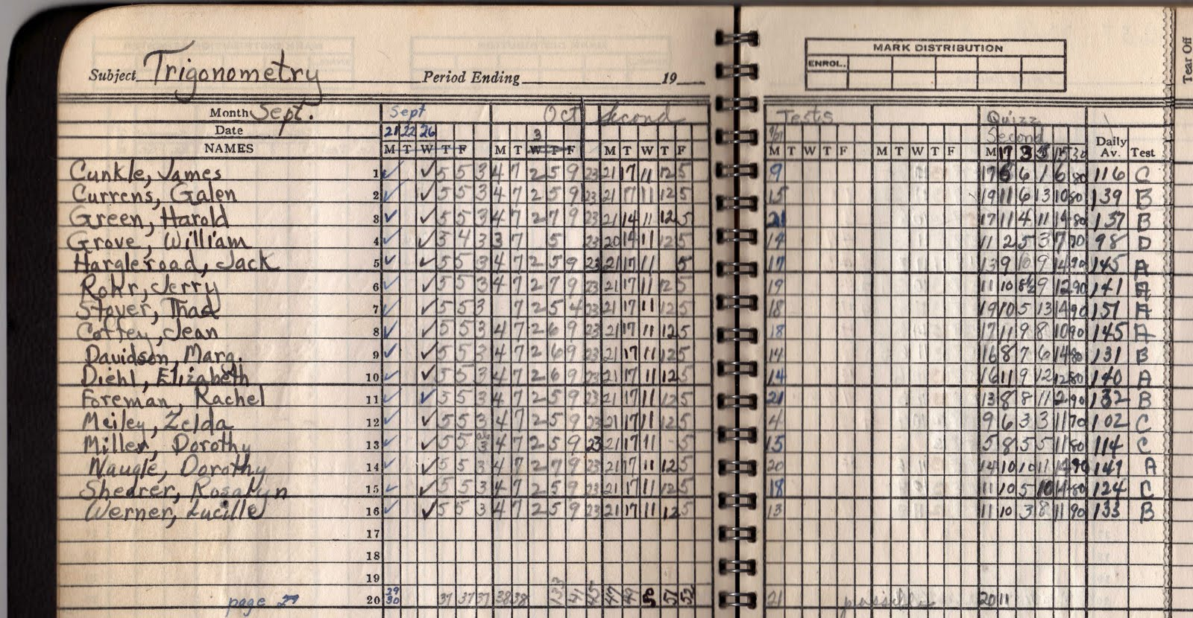
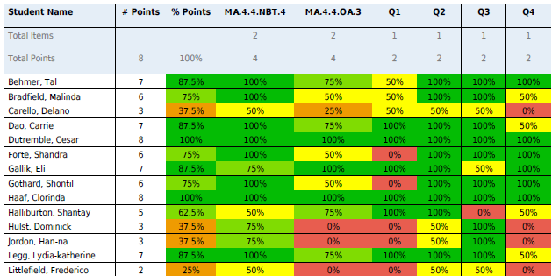

Slide 6

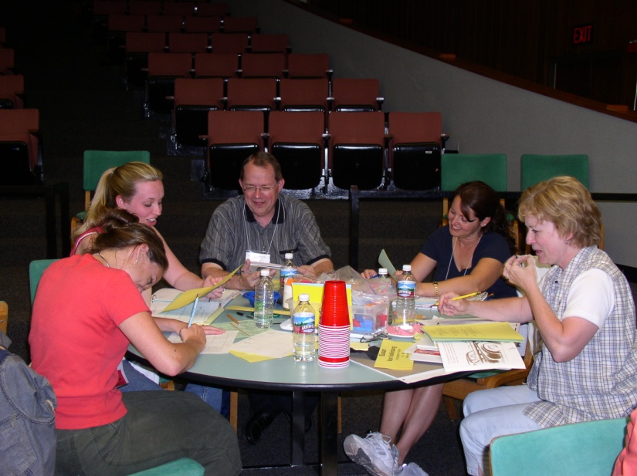

Slide 7
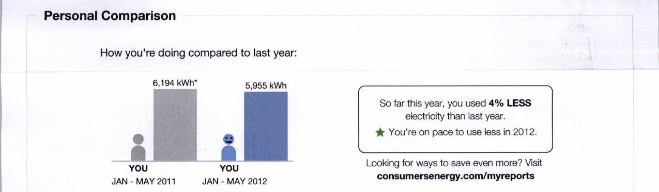

Slide 8
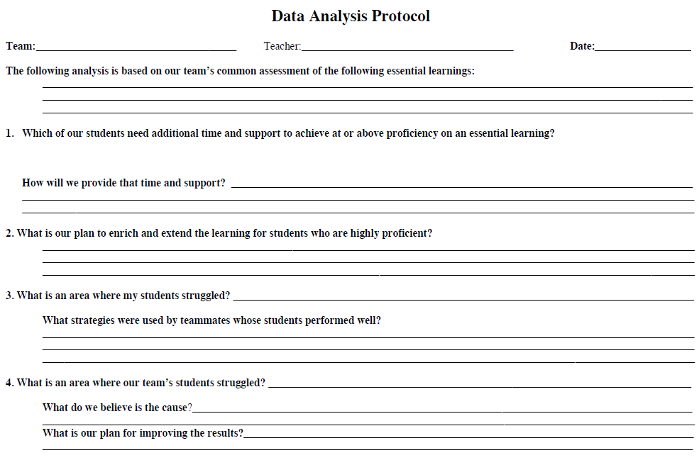

Slide 9
What common assessments exist at Urbandale?
How do we determine the “essential learnings”?

Slide 11
Additional Support / Extensions

Slide 12
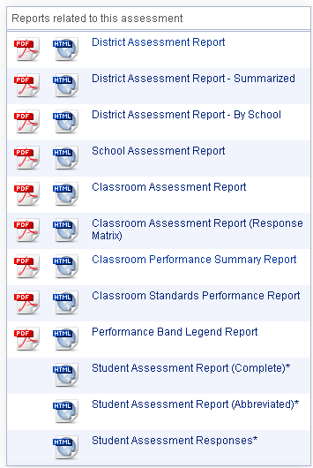

Slide 14
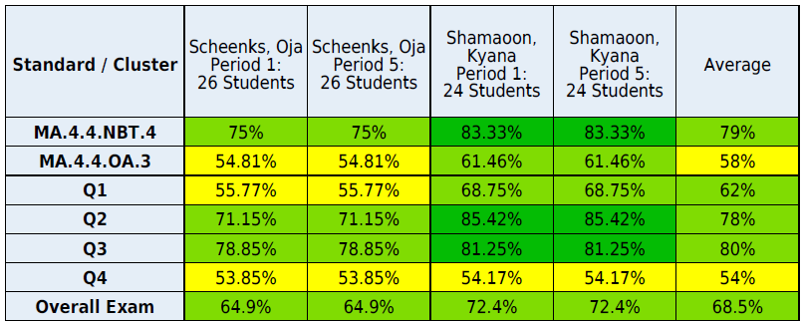
Mitch Fowler
Mitch Fowler

Slide 15
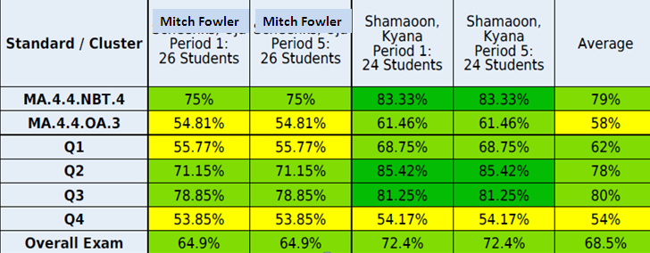

Slide 16
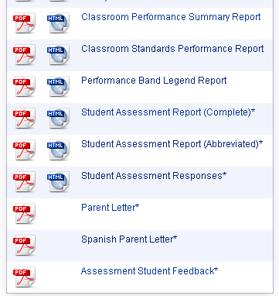
Communicating Data to Parents

Slide 17
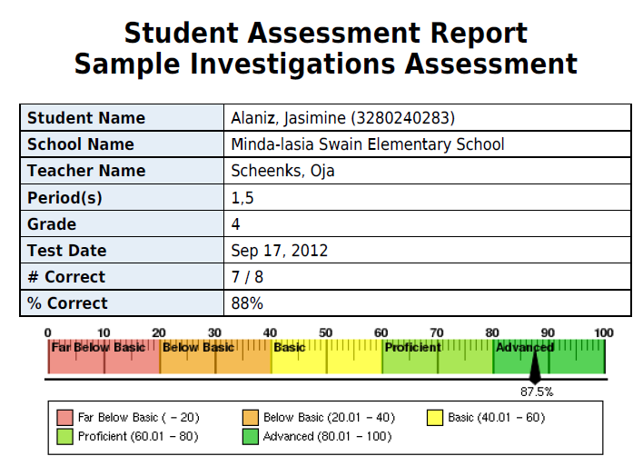
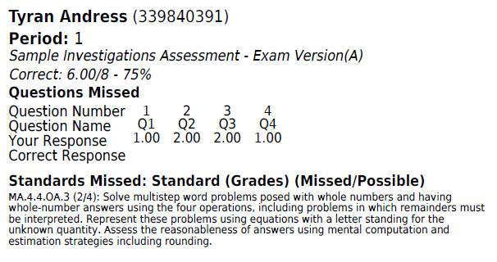

Slide 18
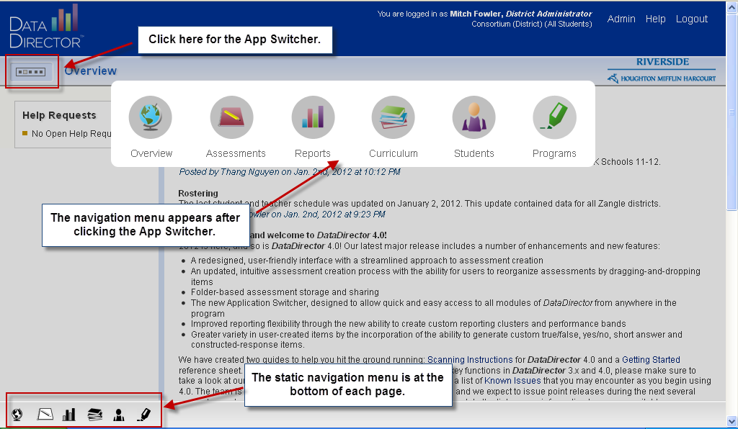
Navigation

Slide 19
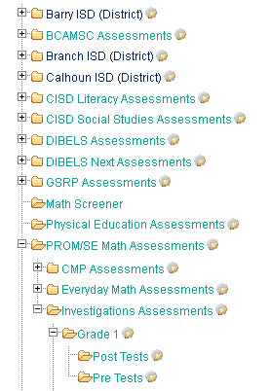
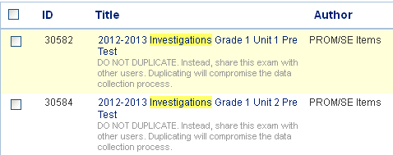
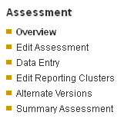
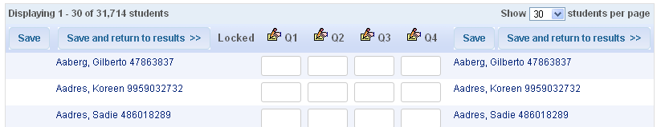

Slide 20
