Slide 1
DataDirector and Albion Schools: Collecting, Analyzing, and Acting on Data
Mitch Fowler
fowlerm@calhounisd.org

Slide 2
Agenda
Introductions
Lessons Learned / What is DataDirector?
Navigation and Menus
Displaying Student Growth
Structure of Ongoing Support
Questions

Slide 3
Lessons Learned…
“Bring some data…”
“This isn’t exactly what we’re looking for…”
“Do you have the colorful reports that Tim used in his conference?”

Slide 4
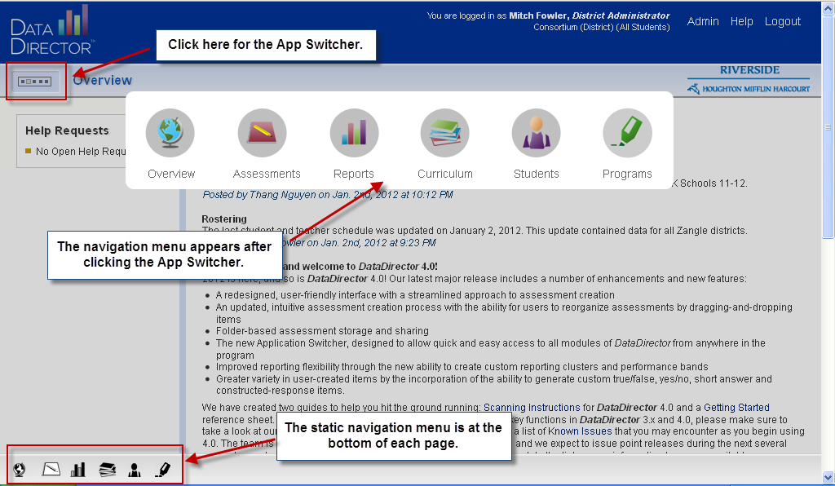
Navigation

Slide 5
Menus
Links to updates and information from DataDirector
View state and national standards
Access, edit, and create classroom assessments
Access district students with filters, create custom reports.
Access pre built MEAP, MME, and DIBELS reports
Create cohorts in order to efficiently track progress.

Slide 6
#1 – Seasonal Focus

Slide 7
Seasonal Growth II

Slide 8
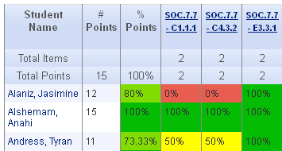
#2 – Standards Focus

Slide 9
#3 – Individually Defined Focus

Slide 10
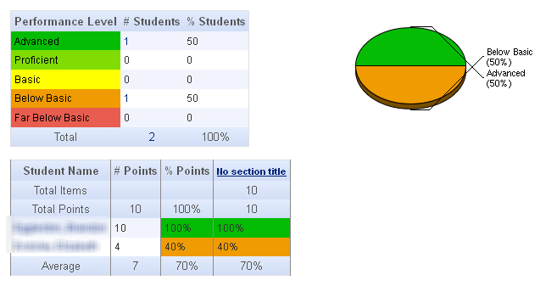
#4 – Overall % Correct Focus
Basic

Slide 11
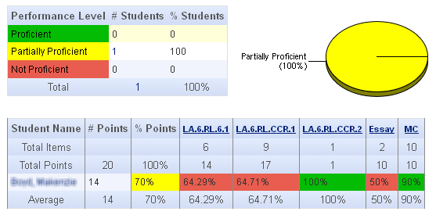
#5 – Standards and Section Focus
Intermediate

Slide 12
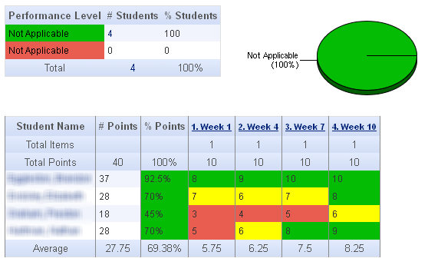
#6 - Progress Monitoring

Slide 13
Pre-Test / Post-Test Exams
Notes:
At the basic level, most reports in DD have a pie chart and performance level chart that will show how students performed using the default scoring bands. In this instance, teachers can point to groups of students who have physically moved proficiency levels.

Slide 14
Pre-Test/Post-Test Exams
Notes:
The Classroom Performance Summary Report can be used to discuss how individual students have made gains between the pre and post test. In this example, a student started the unit answering 0% of the questions related to MA.4.4.NBT.6 and finished the unit answering 87.5%.

Slide 15
Pre-Test/Post-Test Exams
Notes:
In the Classroom Exam Report the Response Frequency can also be used to show movement. Here students were given an exam with a rubric (0-5). The pre test shows most students on the left side of the rubric, whereas the post test shows students moving to the right side of the rubric.

Slide 16
Ongoing Support
Setting:
Whole Staff
Small Group
Individual
Topics:
Assessment Creation
Data Conference Prep
Student Growth Prep
Scanning Assistance
Times
Before School
After School
Planning
Lunch

Slide 17
Questions?
Web Resource: http://tinyurl.com/welcomebackalbion

