Slide 1
Organizing DataDirector for Data Collection and Conferencing
Mitch Fowler
fowlerm@calhounisd.org

Slide 2
Misc. Info
Online Resource:
http://tinyurl.com/organizedata

Slide 3
Agenda
Welcome / Lessons Learned
Structuring Answer Sheet Assessments
Columns and Colors
Sample Assessment Structures
Structuring Summary Assessments
Work Time

Slide 4
Outcomes
Today you will:
Understand the purpose and use of assessment sections and reporting clusters within DataDirector.
Determine which assessment structures fit your data needs.
Develop an assessment to use during the school year.

Slide 5
Lessons Learned…
“Bring some data…”
“This isn’t exactly what we’re looking for…”
“Do you have the colorful reports that Tim used in his conference?”

Slide 6
Structuring Assessments - Basics
Demo
Practice
Create your own assessment OR
Create an assessment with:
10 Multiple Choice Questions
2 Essay Questions
Align standards to each question
Select two “Power” standards

Slide 7
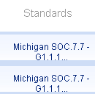
Structuring Assessments - Sections
Mommy, where do Sections come from?

Slide 8
Structuring Assessments - Sections
What do Sections look like when they grow up?

Slide 9
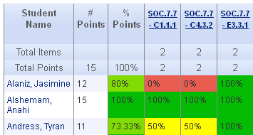
Structuring Assessments - Sections

Slide 10
Structuring Assessments - Sections

Slide 11
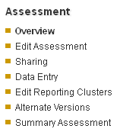
Structuring Assessments - Colors
Sections + Scoring Bands = Reporting Clusters

Slide 12
Structuring Assessments - Colors

Slide 13
Structuring Assessments - Colors

Slide 14
Structuring Assessments - Colors

Slide 15
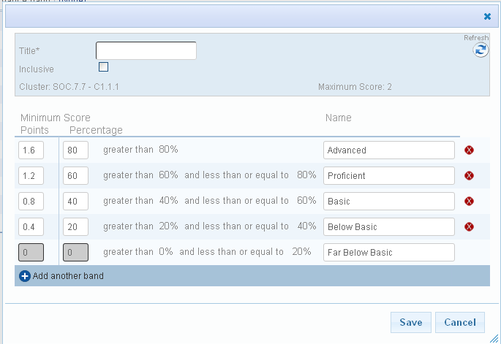
Structuring Assessments - Colors

Slide 16
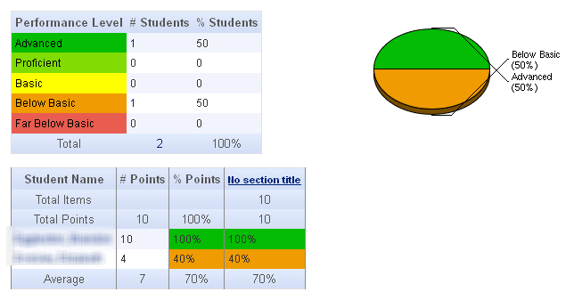
Sample Answer Sheet Assessment Structures
Basic

Slide 17
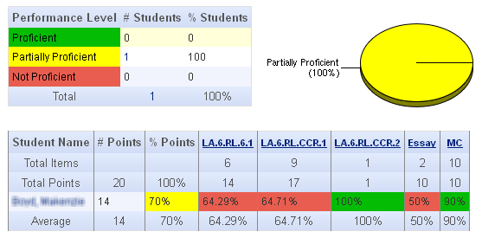
Sample Answer Sheet Assessment Structures
Intermediate

Slide 18
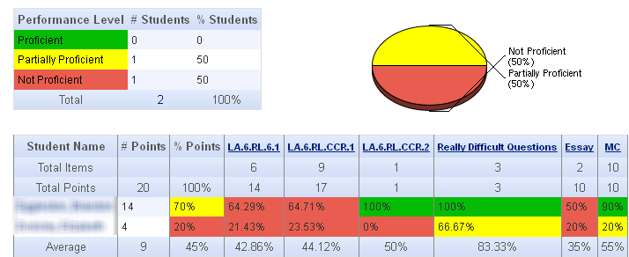
Sample Answer Sheet Assessment Structures
Advanced

Slide 19
Sample Answer Sheet Assessment Structures
Student Growth

Slide 20
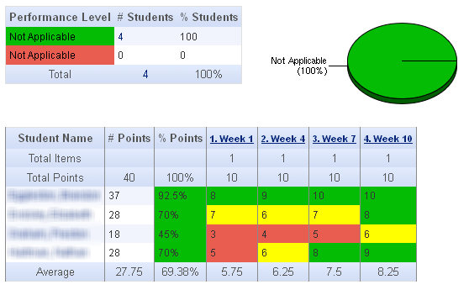
Sample Answer Sheet Assessment Structures
Progress Monitoring

Slide 21
Structuring Summary Assessments

