Slide 1
Elements of Quality Instruction and Data Use In Physical Education
Angela McDonald
mcdonala@calhounisd.org
Mitch Fowler
fowlerm@calhounisd.org

Slide 2
Agenda
Afternoon Outcomes
Using the AM Information – Activity
Backwards Report Design
Progress, Growth, Credit/No Credit
Assessment Design in DataDirector
Individual Practice

Slide 3
Using the AM Information - Activity
Using the information your learned this morning, identify the standards that are included in the first unit (or two) of the school year. What standards MUST students master by the end of the unit? What is your proficiency threshold?

Slide 4
Backwards Report Design
Identify Purpose:
Growth
Progress Monitoring
Credit/No Credit
Standards Based

Slide 5
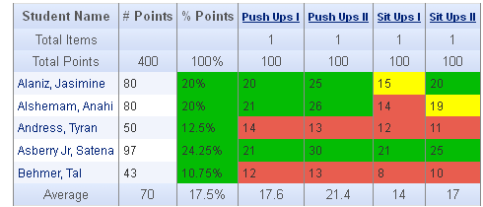
Backwards Report Design - Growth

Slide 6
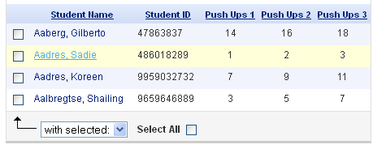
Backwards Report Design – Progress Monitoring

Slide 7
Backwards Report Design – Credit/No Credit

Slide 8
Backwards Report Design – Standards Based

Slide 9
Assessment Design in DataDirector
After reviewing the various report designs, which report structure would best fit your needs?
Tutorials
Questions?

Slide 10
Individual Practice

