Slide 1
NMU Action in Education Summer Institute DataDirector Training Day 1
Mitch Fowler
fowlerm@calhounisd.org

Slide 2
Day 1 Agenda
Introductions
Accessing Educational Data - Resources
Why DataDirector? / What is DataDirector?
Navigation and Menus
Assessments – Why?
Assessments – How?
Pre-Built Reports
Critical Data Needs

Slide 3
Day 2 Agenda
Participant Data Needs
Creating and Administering Assessments in DataDirector
Analyzing and Acting on Assessment Data
Prepping for a Data Conference to Show Student Growth

Slide 4
Online Resource
Moodle Page
http://tinyurl.com/NMUDDTraining

Slide 5
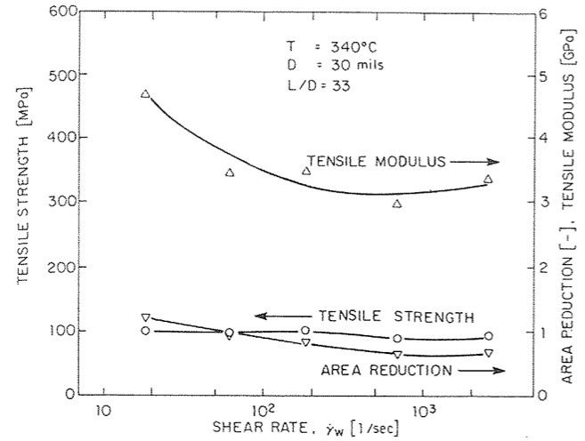
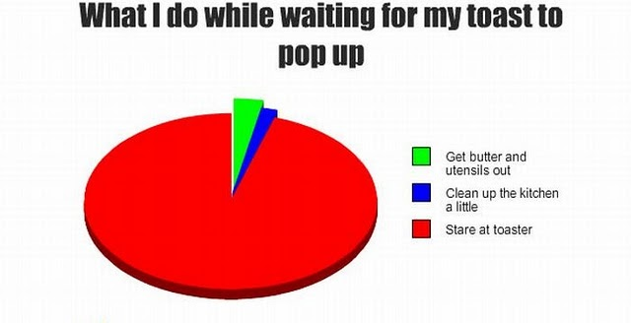
Why?
I believe…

Slide 6
Navigation

Slide 7
Menus
Links to updates and information from DataDirector
View state and national standards
Access, edit, and create classroom assessments
Access district students with filters, create custom reports.
Access pre built MEAP, MME, and DIBELS reports
Create cohorts in order to efficiently track progress.

Slide 8
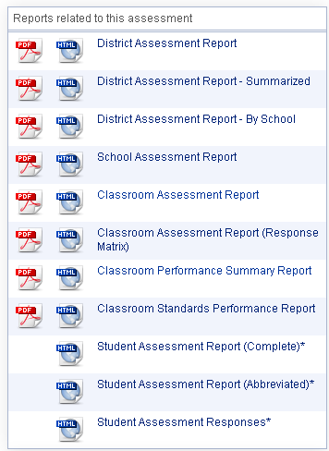
Available Reports
District Level
School Level
Classroom Level
Student Level

Slide 9
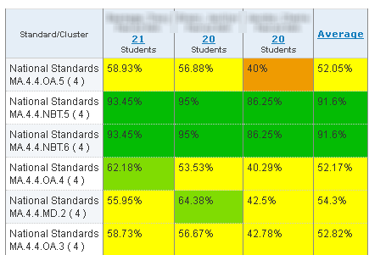
School Assessment Report
Teacher A
Teacher B
Teacher C

Slide 10
Classroom Assessment Report

Slide 11
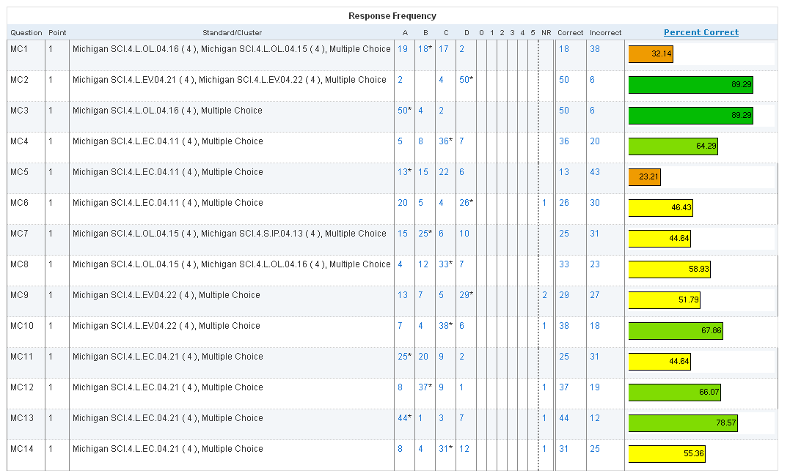
Classroom Assessment Report

Slide 12
Classroom Performance Summary Report

Slide 13
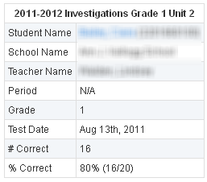
Student Assessment Report

Slide 14
Displaying Data for Growth
Notes:
At the basic level, most reports in DD have a pie chart and performance level chart that will show how students performed using the default scoring bands. In this instance, teachers can point to groups of students who have physically moved proficiency levels.

Slide 15
Displaying Data for Growth
Notes:
The Classroom Performance Summary Report can be used to discuss how individual students have made gains between the pre and post test. In this example, a student started the unit answering 0% of the questions related to MA.4.4.NBT.6 and finished the unit answering 87.5%.

Slide 16
Displaying Data for Growth
Notes:
In the Classroom Exam Report the Response Frequency can also be used to show movement. Here students were given an exam with a rubric (0-5). The pre test shows most students on the left side of the rubric, whereas the post test shows students moving to the right side of the rubric.

Slide 17
Debrief: How could you use DataDirector to monitor and report student growth?

Slide 18
Assessments
Creating
Adding Standards
Administering
Sharing

Slide 19
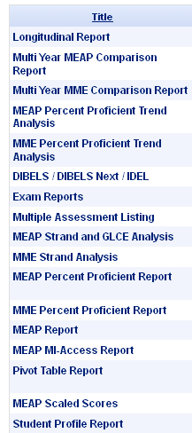
Pre Built Reports
Primary / K-8
Secondary/ 9-12

Slide 20
Percent Proficient Report

Slide 21
Percent Proficient Report

Slide 22
GLCE and Strand Analysis Report

Slide 23
GLCE and Strand Analysis Report

Slide 24
GLCE and Strand Analysis Report

Slide 25
GLCE and Strand Analysis Report

Slide 26
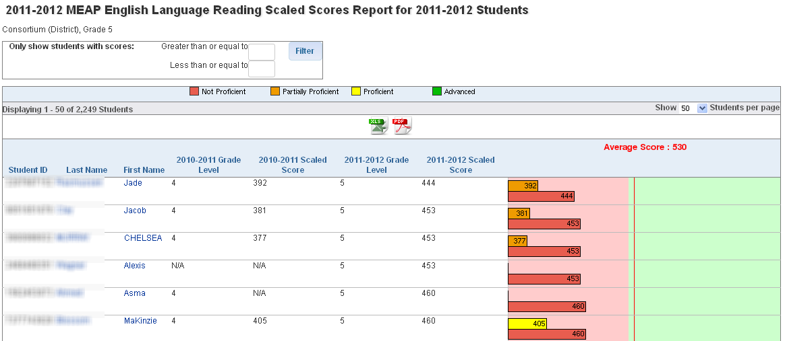
MEAP Scaled Score Report - NEW

Slide 27
Activity
According to your MEAP or MME data, what was the subject with the lowest percent proficient last year? What was the percent proficient?
Next, within the lowest subject, what was the lowest strand? If you are primary, what was the lowest GLCE within your lowest strand?

Slide 28
NMU Action in Education Summer Institute DataDirector Training Day 2
Mitch Fowler
fowlerm@calhounisd.org

Slide 29
Assessments
Creating
Adding Standards
Administering
Sharing

Slide 30
Analyzing and Acting on Assessment Data

Slide 31
Prepping for a Data Conference
Pre Test Classroom Performance Summary Report
Evidence of Changed Practice
Post Test Classroom Performance Summary Report
Jing

Slide 32
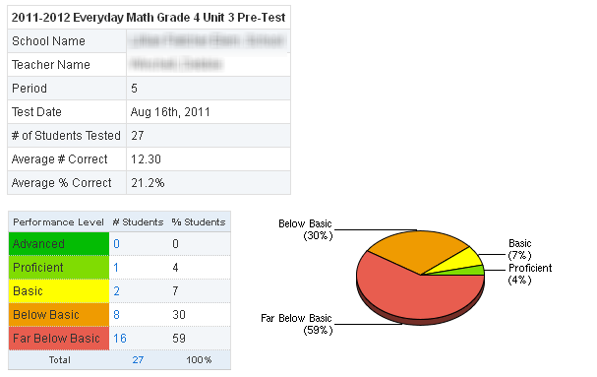
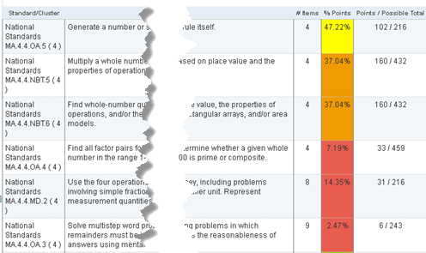
Ingredient #1 – Pre Test Data

Slide 33
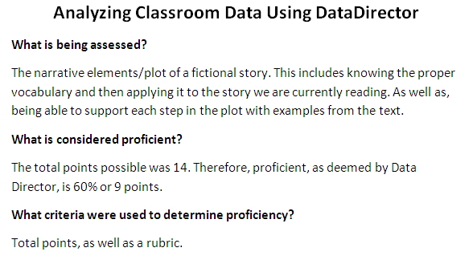
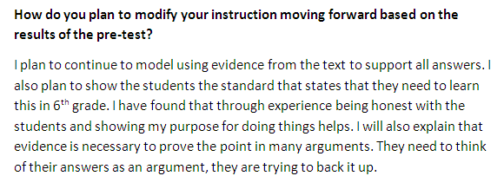
Ingredient #2 – Evidence of Changed Practice

Slide 34
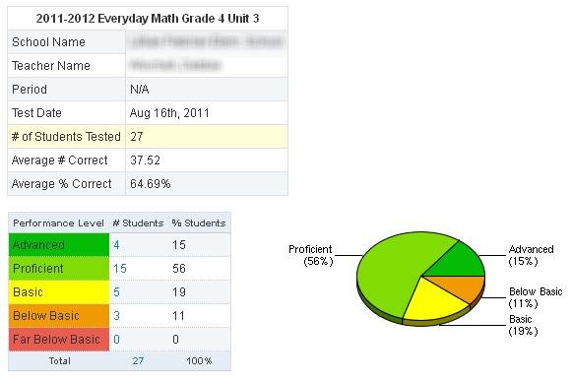
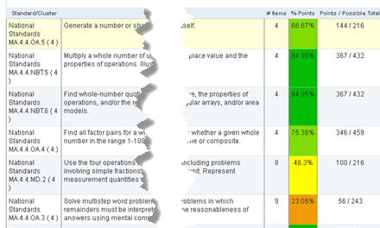
Ingredient #3 – Post Test Data

Slide 35
Ingredient #4 - Jing

