Slide 1
DB 101
Data Based instruction

Slide 2
Short story unit
The students read and studied 4 short stories to focus learning about the literary elements that make up plot in order to increase their ability to comprehend a story.
Students were assessed using four methods:
Filling out a story map applying the literary elements
Answering multiple choice comprehension questions
Writing their own short story
Writing an analysis of the various literary elements and how they enhance text throughout the unit

Slide 3
Merging the unit with db101
I had started this unit prior to DB101
Beginning of the unit – reviewed the basic meaning for the various elements of literature and created common language for each class (Cornell style).
Beginning of each story – previewed the text, discussed the vocabulary, etc.
During each story – students read along as they listened to the text on CD. The story was played on CD again as students worked on their comprehension questions to stimulate thinking.

Slide 4
More Merger
After reading each story – students completed a story map about the story and answered comprehension questions (both tasks were done independently at first).
The following class period students brought their practice to class as a launch pad for discussion – sometimes as a large group, other times in smaller groups or with partners (all integrating Kagan strategies).
These practice activities were only given credit/no credit and collectively weighed less than 3% in the overall student’s grade.

Slide 5
The end of the unit
At the end of the unit –
Students used clickers from Beyond Question to review the Elements of Literature basic terminology and vocabulary for the exam. (Students who scored 100% were excused from those correlating portions of the exam). Students were also given a review packet and other materials to aid them in studying for the exam.
Students completed a cold read of a new text while listening to the text on CD, completed a story map, answered multiple choice comprehension questions (similar in format to those on previous quizzes), and wrote an analysis of the various literary elements and how they had enhanced text throughout the unit.

Slide 6
Where did DB101 fit in?
I was able to create bubble sheets and use data director to see where students were struggling.
I gave three quizzes from this unit using bubble sheets.
I was able to use the School Assessment Report to see where my students needed the most help.

Slide 7
Data
Proficiency Scale (loosely based on our school’s grading scale):
Highly Proficient 90-100%
Proficient 73-89%
Partially Proficient 60-72%
59-0% Not Proficient

Slide 8
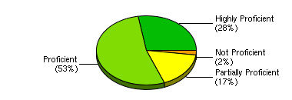
“The monkey’s paw”
Standard / Cluster | Hagelgans, Lesley Period 1 26 Students | Hagelgans, Lesley Period 3 29 Students | Hagelgans, Lesley Period 4 24 Students | Hagelgans, Lesley Period 5 7 Students | Hagelgans, Lesley Period 6 22 Students | Hagelgans, Lesley Period 7 19 Students | Average
LA.8.R.MT.08.01 | 69.23% | 69.46% | 70.24% | 61.22% | 68.83% | 71.43% | 69.29%
LA.8.R.NT.08.02 | 73.08% | 79.31% | 79.17% | 71.43% | 72.73% | 84.21% | 77.17%
LA.8.R.WS.08.04 | 97.69% | 97.24% | 99.17% | 97.14% | 91.82% | 98.95% | 97.01%
Comprehension | 81.54% | 82.76% | 81.67% | 68.57% | 75.45% | 83.16% | 80.31%
Literary Element | 73.08% | 79.31% | 79.17% | 71.43% | 72.73% | 84.21% | 77.17%
Reading Skills and Strategies | 38.46% | 36.21% | 41.67% | 42.86% | 52.27% | 42.11% | 41.73%
Vocabulary | 97.69% | 97.24% | 99.17% | 97.14% | 91.82% | 98.95% | 97.01%
Overall Exam | 80.47% | 80.9% | 82.05% | 75.82% | 77.97% | 83% | 80.56%
Analysis:
The section of the report called Response Frequency was most helpful for interpreting the data on the previous chart. From the response frequency I learned that only 1% of students got number 7 correct thus skewing the data in regards to Reading Skills and Strategies. This concept was tested using two items. I had put the wrong answer into data director, and that’s why so many students missed this question.
Once that anomaly was ruled out, the data revealed that students really needed more help in a different area. The area I needed to provide students with more help was implementing the strategies used by mature readers to increase comprehension including: predicting, constructing mental images, etc.

Slide 9
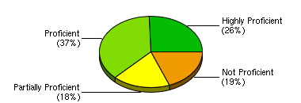
“The tell-tale heart”
Standard / Cluster | Hagelgans, Lesley Period 1 27 Students | Hagelgans, Lesley Period 3 29 Students | Hagelgans, Lesley Period 4 23 Students | Hagelgans, Lesley Period 5 7 Students | Hagelgans, Lesley Period 6 22 Students | Hagelgans, Lesley Period 7 20 Students | Average
Comprehension | 88.15% | 94.48% | 93.91% | 94.29% | 89.09% | 88% | 91.09%
Literary Element: Narrator | 72.22% | 65.52% | 69.57% | 78.57% | 72.73% | 72.5% | 70.7%
Reading Skills and Strategies | 94.44% | 89.66% | 95.65% | 92.86% | 86.36% | 87.5% | 91.02%
Vocabulary | 67.04% | 60% | 65.22% | 51.43% | 66.82% | 70.5% | 64.77%
Overall Exam | 76.02% | 72.78% | 76.43% | 69.93% | 75.36% | 77.1% | 75.08%
Analysis:
The graph was originally alarming to see 19% of students were not proficient. Then I looked at the table that broke the data down by strand and class. I noticed that Data Director was including students from my 5th hour yearbook class that had not taken the assessment (as they have LA with a different teacher).
Once that was ruled out, I determined that problematic area on the last story/quiz had greatly improved (to the 90% percentile), but the role of the narrator as a literary element was problematic as well as vocabulary.

Slide 10
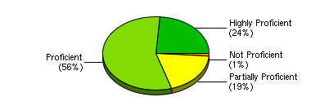
“There will come soft rains”
Standard / Cluster | Hagelgans, Lesley Period 1 26 Students | Hagelgans, Lesley Period 3 25 Students | Hagelgans, Lesley Period 4 22 Students | Hagelgans, Lesley Period 5 6 Students | Hagelgans, Lesley Period 6 20 Students | Hagelgans, Lesley Period 7 17 Students | Average
No section title | 81.79% | 76.8% | 81.82% | 73.33% | 82.33% | 82.35% | 80.46%
Overall Exam | 81.79% | 76.8% | 81.82% | 73.33% | 82.33% | 82.35% | 80.46%
Analysis:
First alarm bell was that in the insanity of my schedule, I didn’t take the time to put in the details about the strands.
The good news was my data binder was at home so I could compare the quiz questions with the data.
The data showed a greater improvement in the literary elements (understanding and application) but the questions that proved to be troublesome (much like the first quiz) were those that required students to make inferences about the text.
The bright spot – students had maintained a high level of proficiency (80%) despite reduced scaffolding by the teacher.

Slide 11
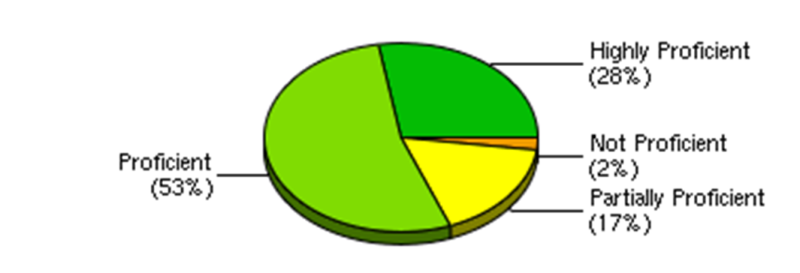
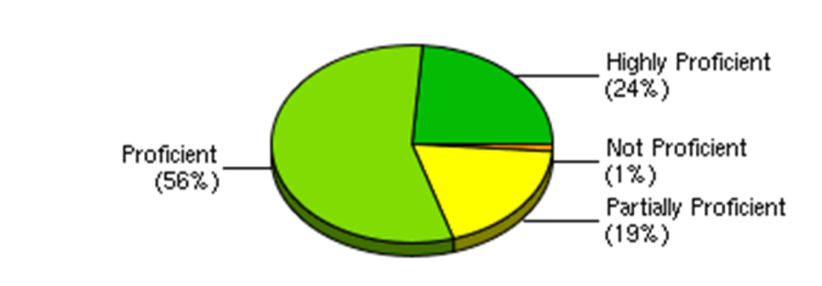
Side by side
At first glance, it appears that not much had changed from the first quiz to the last quiz. What is interesting is how the method for teaching changed:
In the first story, the follow-up discussion of the homework was teacher directed.
In the second story, the discussion was carried out in groups of 4-5.
In the third story, the discussion was carried out with a partner – thus continuing the transfer of ownership from the teacher to the students.
“The Monkey’s Paw”
“The Tell-Tale Heart”
“There Will Come Soft Rains”

Slide 12
Interventions
Students participated in prereading activities, listened to the stories on CD, completed questions to stimulate thinking for comprehension and vocabulary retention, the practice assignments were discussed in various ways (large group, small group, structured partners – Kagan), and students completed a study guide and participated in a review game (The Clickers!) before the final exam.
Students seem to retain the most information when they are working with a partner in a structured activity.
Students who performed well on the in class review (clicker game) did not have to take those correlating sections of the test.
After the final exam, students could retake any part of the final they wanted after they had a discussion with the teacher. Retake requirements: identify what went wrong, create a plan to study differently next time, consult with parent and teacher at least three days prior to the retake.

Slide 13
Now what?
This year we began the work of answering “How does this show growth?” content vs. skill
This year we revised 2/3 of our units (and correlating assessments) to put more emphasis on skill growth instead of content mastery.
Next year the other units need to be revised in the same manner.
This year data was reported in a different manner – instead of Short Story Exam 85% (B), the test was broken down into 5 parts Comprehension, Literary Elements, Vocabulary, Story Map and Essay Questions.

Slide 14
What role will DD play?
Data director is like an IRA – it’s going to take some time to set up initially, but the dividends could be huge in the end.
I need to get all of the assessments into Data Director (multiple choice and other – written pieces could also be integrated since they are graded using a rubric).
Hopefully we can use the Turning Technologies clickers in place of the bubble sheets for even greater efficiency.
I need more PD for how I could use Data Director to show student growth across an entire year through multiple units.

