Slide 1
Taming Wild Running Records – Using DataDirector to Progress Monitor Literacy Achievement
Mitch Fowler
School Data Consultant
fowlerm@calhounisd.org

Slide 2
Participant Outcomes
Participants will:
understand options for structuring running record data within a data warehouse.
understand how to assist teachers in analyzing conditionally formatted data to assist in making instructional decisions.

Slide 3
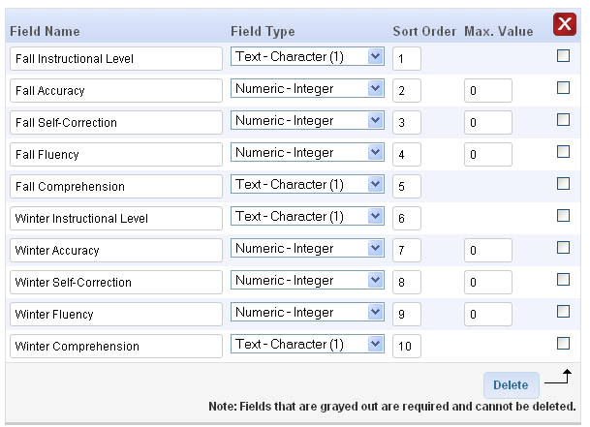
Summary Assessment Structure

Slide 4
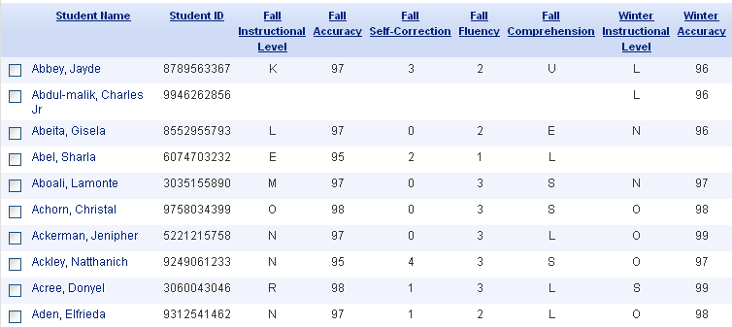
Once data is entered…

Slide 5
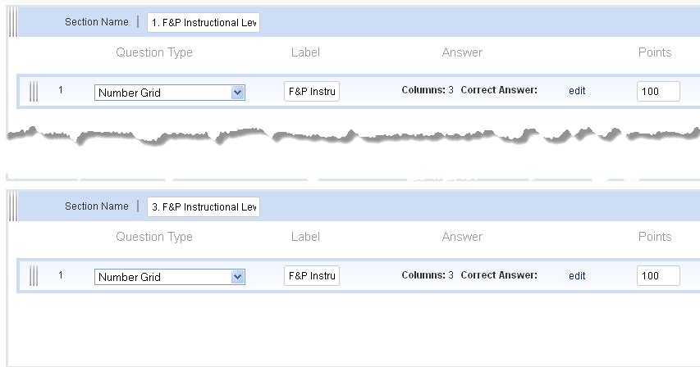
Answer Sheet Assessment Structure
Notes:
Pic of Answer Sheet Assessment

Slide 6
Once data is entered…
Notes:
Pic of Classroom Performance Summary Report

Slide 7
What next?
What interventions are in place for our red students?
How are the students responding to these interventions?
What data/evidence are we collecting on these students?
What is the correlation between MEAP scores and reading levels?

Slide 8
What next?
Questions to Consider:
Possible Next Steps:
How are the students responding to these interventions?
What data/evidence are we collecting on these students?
What is the correlation between MEAP scores and reading levels?
Create summary assessment to track interventions and progress monitoring data.
Create literacy data profile to triangulate data. DIBELS, STARR, MEAP, etc.
Create custom report that incorporates MEAP reading and reading levels in order to determine if additional training is necessary for staff.

Slide 9
Lessons Learned
Identify Purpose
Admin only or Teacher?
Provide Clear Data Input Instructions
Utilize the Description Box
Provide Teachers with Data Analysis Templates

