Slide 1
DataDirector for Teachers - Beginner
Mitch Fowler
fowlerm@calhounisd.org

Slide 2
Agenda
Introductions
Why DataDirector? / What is DataDirector?
Navigation and Menus
Assessments – Why?
Break
Assessments – How?

Slide 3
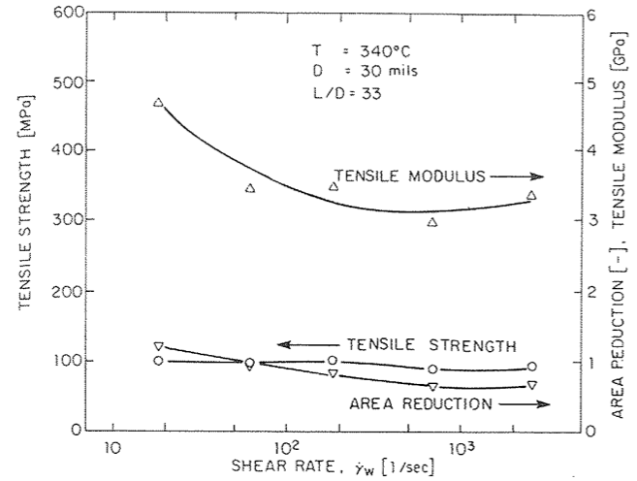
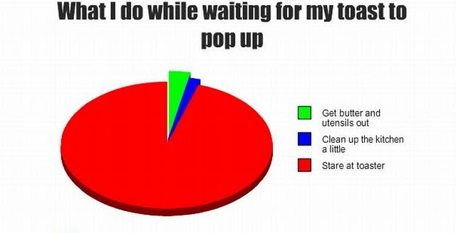
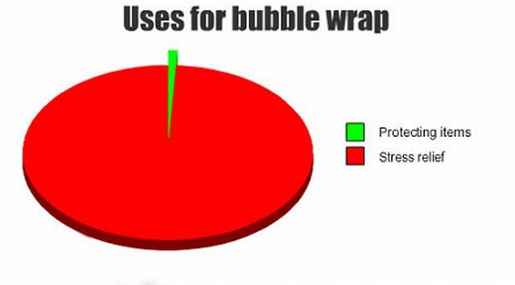
Why?
I believe…

Slide 4
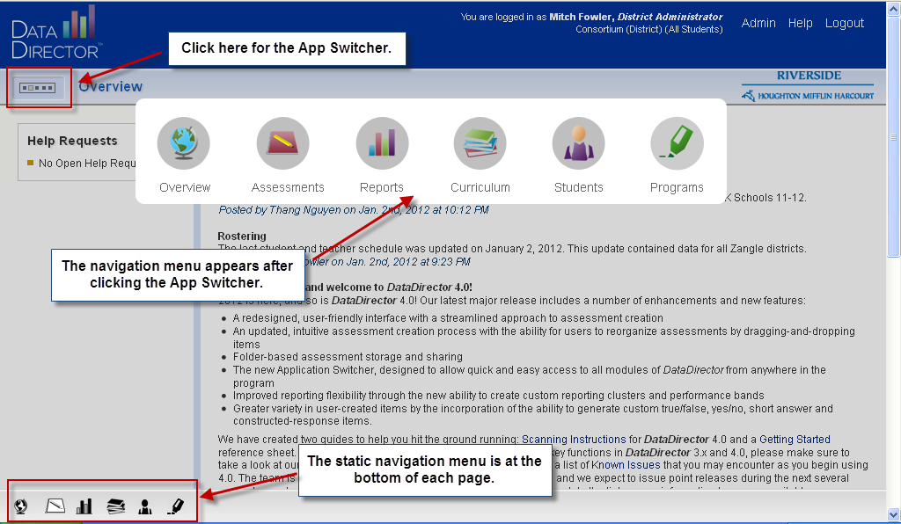
Navigation

Slide 5
Menus
Links to updates and information from DataDirector
View state and national standards
Access, edit, and create classroom assessments
Access district students with filters, create custom reports.
Access pre built MEAP, MME, and DIBELS reports
Create cohorts in order to efficiently track progress.

Slide 6
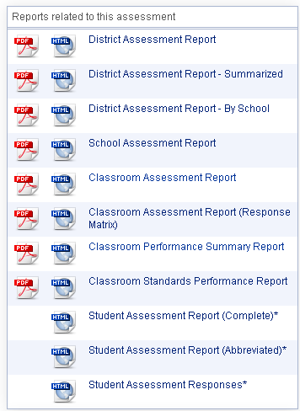
Available Reports
District Level
School Level
Classroom Level
Student Level

Slide 7
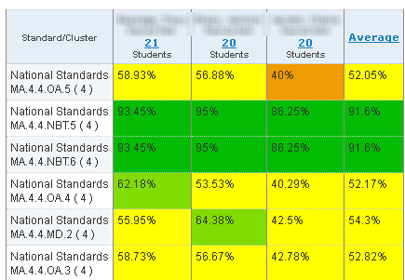
School Assessment Report
Teacher A
Teacher B
Teacher C

Slide 8
Classroom Assessment Report

Slide 9
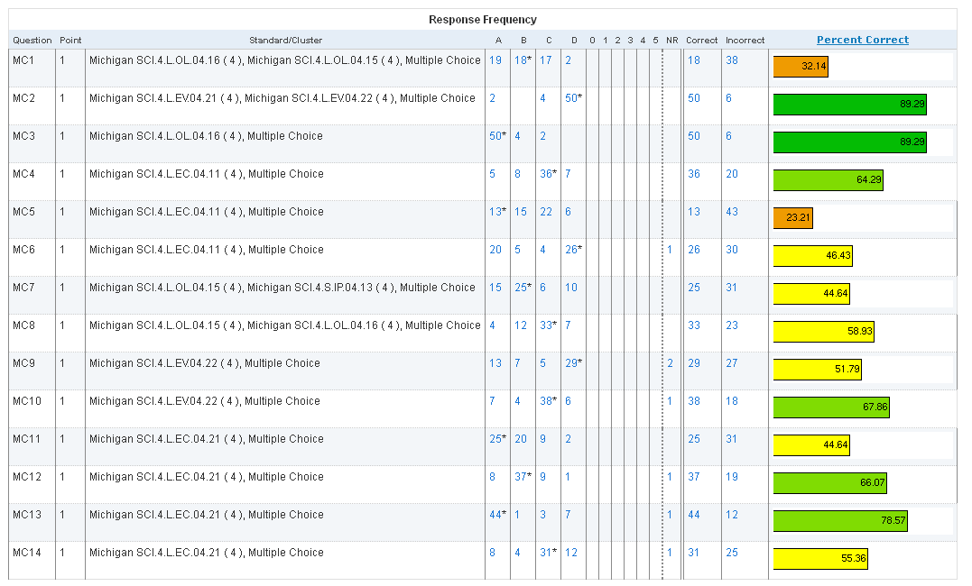
Classroom Assessment Report

Slide 10
Classroom Performance Summary Report

Slide 11
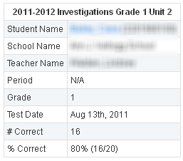
Student Assessment Report

Slide 12
Activity
Access any assessment you wish. Review the Classroom Assessment Report.
Which standards or areas were a success for most students?
Which standards or areas were a challenge for most students?

Slide 13
Assessments
Create
Administer
Share

Slide 14
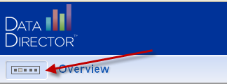
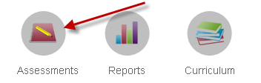
Accessing Assessments

Slide 15
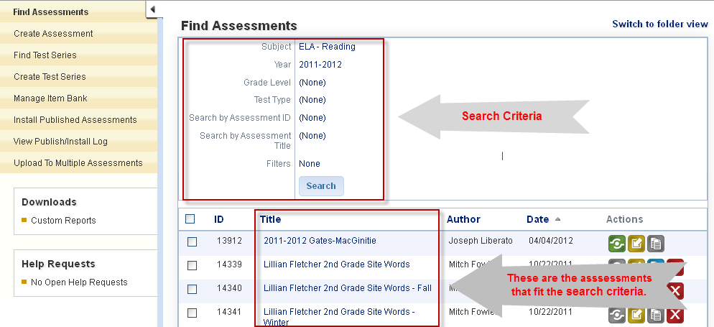
Accessing Assessments

