Slide 1
There’s an Assessment for That! MACUL 2012
Mitch Fowler – fowlerm@calhounisd.org
Calhoun ISD

Slide 2
Participant Outcomes
Participants will:
explore mobile friendly features of DataDirector.
understand how to integrate rubric scoring on performance tasks and mobile devices to save time.
understand how to capture mobile monitoring notes on DataDirector.
create mobile friendly assessments.

Slide 3
Presentation Resources
Creating Assessments with Analytic Rubrics Tutorial
Creating a Summary Assessment Tutorial
Sample Performance Assessment Rubric
Sample Monitoring Notes
These resources are available on:
Moodle
MACUL Space

Slide 4
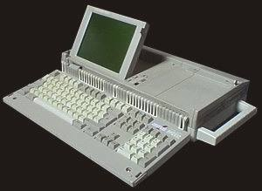
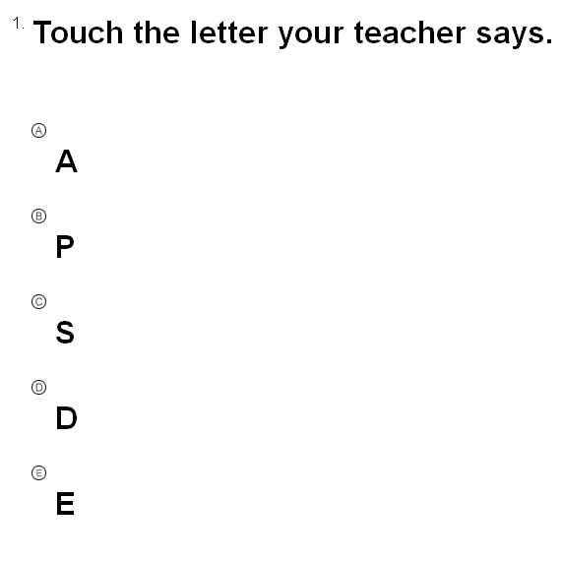
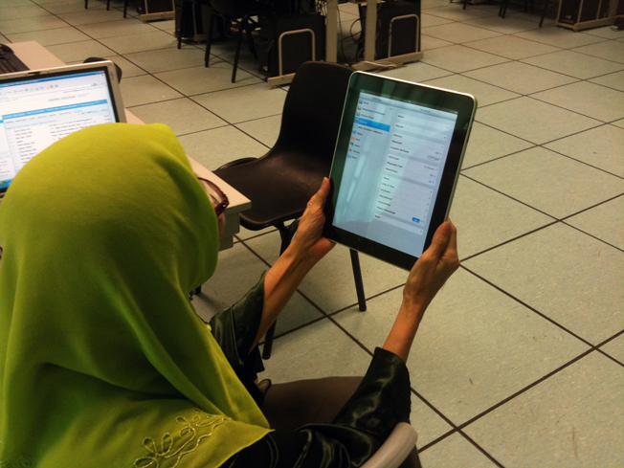
Why mobile devices?
Notes:
Why Mobile Devices?
Portable for on site assessment with field reps and teachers (Maureen)
Potential to involve students with online testing (Mitch)
Less invasive that laptop (Maureen)

Slide 5
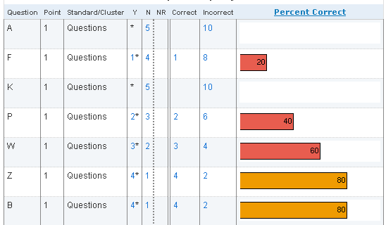
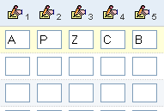
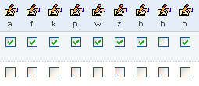
My Mobile Collection Story…
Assessments – Making it Work in DataDirector

Slide 6
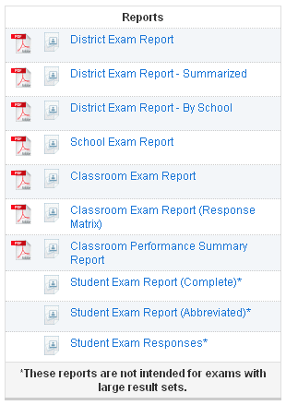
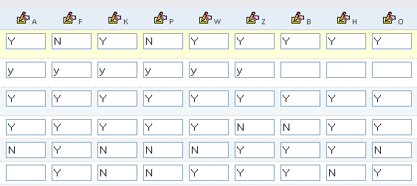
Building the exam…

Slide 7
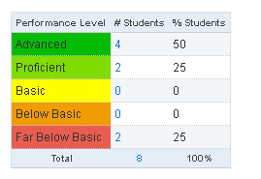
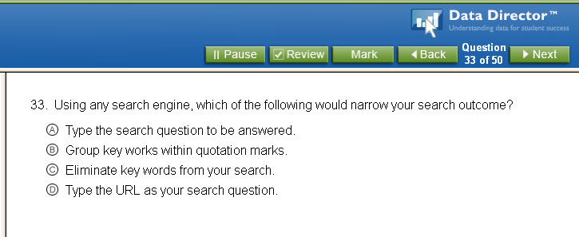
Mobile friendly DataDirector features…

Slide 8
Turn to someone next to you…
What assessments do you have in place currently that could be adjusted to maximize the features of mobile devices?
What other features of DataDirector could be used easily with mobile devices?

Slide 9
Assessment Examples
Examples:
Rubric Scored Performance Assessments
Monitoring Notes
PE Observations
Vocal Music Observations
Band Observations

