Slide 1
DataDirector for Teachers - Beginner
Mitch Fowler
fowlerm@calhounisd.org

Slide 2
Agenda
Introductions
Why DataDirector? / What is DataDirector?
Navigation and Menus
Assessments – Why?
Break
Assessments – How?
Pre-Built Reports
Reflections and Next Steps

Slide 3
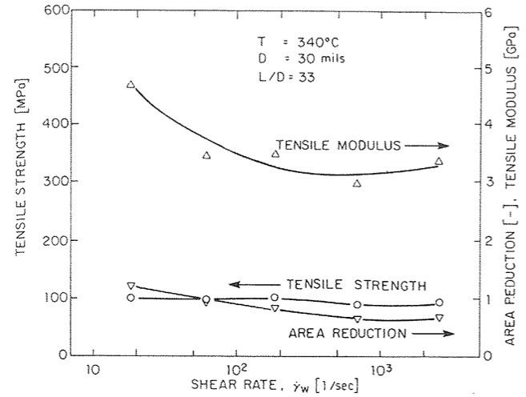
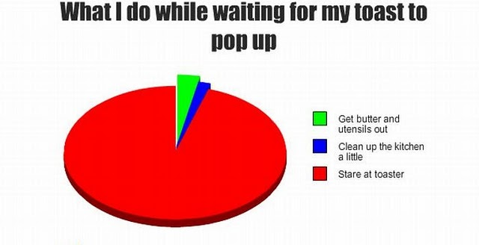
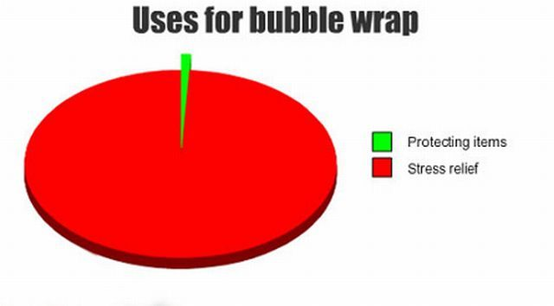
Why?
I believe…

Slide 4
Navigation

Slide 5
Menus
Links to updates and information from DataDirector
View state and national standards
Access, edit, and create classroom assessments
Access district students with filters, create custom reports.
Access pre built MEAP, MME, and DIBELS reports
Create cohorts in order to efficiently track progress.

Slide 6
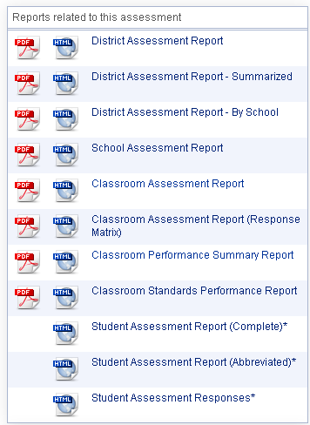
Available Reports
District Level
School Level
Classroom Level
Student Level

Slide 7
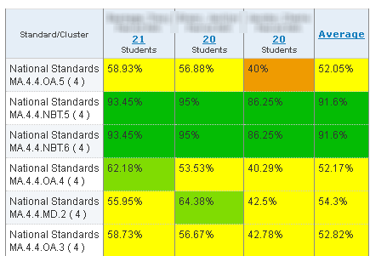
School Assessment Report
Teacher A
Teacher B
Teacher C

Slide 8
Classroom Assessment Report

Slide 9
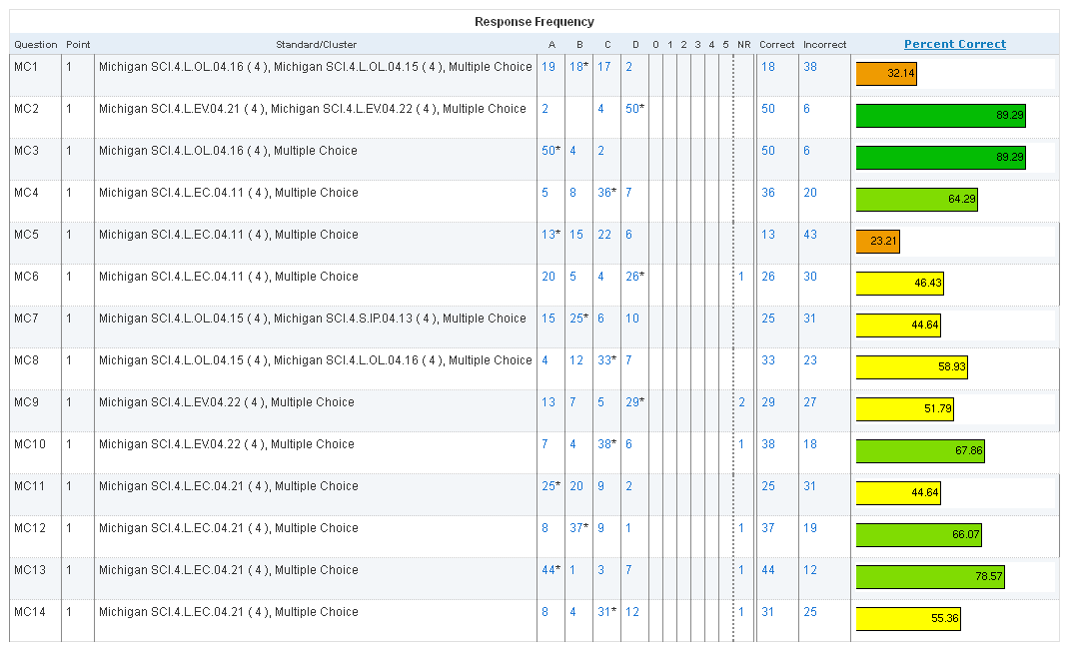
Classroom Assessment Report

Slide 10
Classroom Performance Summary Report

Slide 11
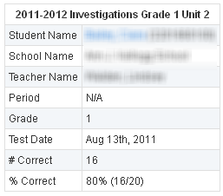
Student Assessment Report

Slide 12
Activity
Access any assessment you wish. Review the Classroom Assessment Report.
Which standards or areas were a success for most students?
Which standards or areas were a challenge for most students?

Slide 13
Using Reports with Teachers
PLC
School Assessment Report
District Assessment Report
Individual
Classroom Assessment Report
Classroom Performance Summary Report
Moodle Resource

Slide 14
Using Reports with Teachers
Components:
Pre/Post Test
Classroom Exam Report
Classroom Performance Summary Report
Data Conference Planning Form

Slide 15
Pre-Test / Post-Test Exams
Notes:
At the basic level, most reports in DD have a pie chart and performance level chart that will show how students performed using the default scoring bands. In this instance, teachers can point to groups of students who have physically moved proficiency levels.

Slide 16
Pre-Test/Post-Test Exams
Notes:
The Classroom Performance Summary Report can be used to discuss how individual students have made gains between the pre and post test. In this example, a student started the unit answering 0% of the questions related to MA.4.4.NBT.6 and finished the unit answering 87.5%.

Slide 17
Pre-Test/Post-Test Exams
Notes:
In the Classroom Exam Report the Response Frequency can also be used to show movement. Here students were given an exam with a rubric (0-5). The pre test shows most students on the left side of the rubric, whereas the post test shows students moving to the right side of the rubric.

Slide 18
Break

Slide 19
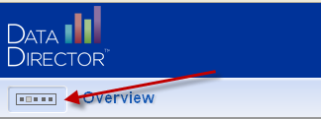
Accessing Assessments

Slide 20
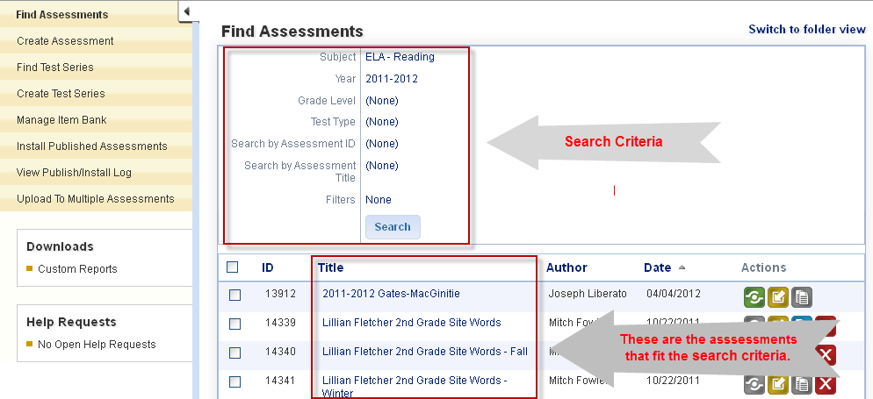
Accessing Assessments

Slide 21
Activity
I have shared an assessment called “DataDirector for Teachers – Beginner” with you. It is in the 2011-2012 school year and the subject is “Other”. Please access this assessment.

Slide 22
Assessments
Creating
Adding Standards
Administering
Sharing

Slide 23
Activity
Consider any upcoming assessment you may be administering soon. Take some time and create an Answer Sheet Assessment for this assessment.
If you do not have one in mind, create one matching the description I have provided.

Slide 24
Pre Built Reports
Primary / K-8
Secondary/ 9-12

Slide 25
Percent Proficient Report

Slide 26
Percent Proficient Report

Slide 27
GLCE and Strand Analysis Report

Slide 28
GLCE and Strand Analysis Report

Slide 29
GLCE and Strand Analysis Report

Slide 30
GLCE and Strand Analysis Report

Slide 31
Activity
According to your MEAP or MME data, what was the subject with the lowest percent proficient last year? What was the percent proficient?
Next, within the lowest subject, what was the lowest strand? If you are primary, what was the lowest GLCE within your lowest strand?

Slide 32
Sample Expectations for Assessment Reports
Assessment | Report | Question
Pre Test | Classroom Assessment Report | What topics do students know a lot about? A little? How will you change your pacing based on the results?
Pre Test | Classroom Performance Summary Report | What students are demonstrating proficiency? How will the pacing and delivery of content change for these students?
Post Test | Classroom Assessment Report | What topics were a strength for all students? A challenge? Why do you believe this was the case?
Post Test | Classroom Performance Summary Report | What students did not meet minimum proficiency? How will these students receive the content they did not master during this unit?

