Slide 1
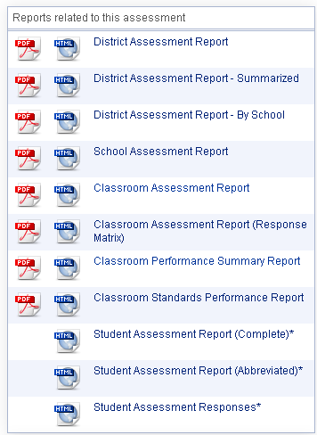
Available Reports
District Level
School Level
Classroom Level
Student Level

Slide 2
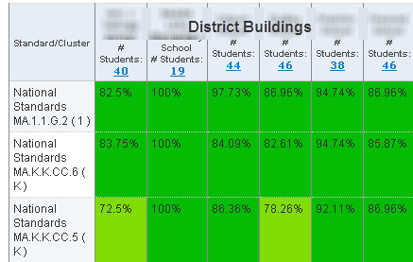
District Assessment Report

Slide 3
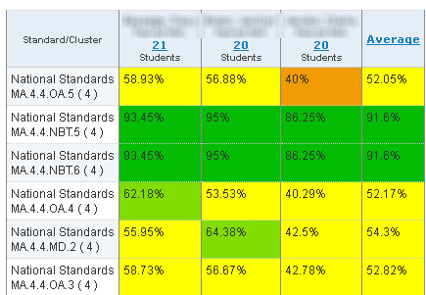
School Assessment Report
Teacher A
Teacher B
Teacher C

Slide 4
Classroom Assessment Report

Slide 5
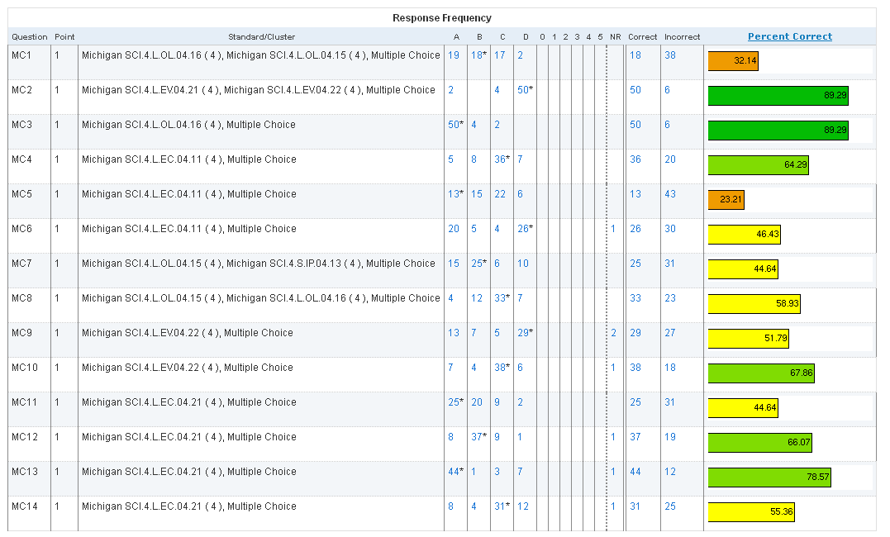
Classroom Assessment Report

Slide 6
Classroom Performance Summary Report

Slide 7
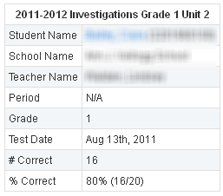
Student Assessment Report

