Slide 1
PROM/SE Assessments Administrators
Mitch Fowler
Calhoun ISD
fowlerm@calhounisd.org

Slide 2
Agenda
Teacher’s Perspective
Exam Reports Overview
Reports for PLCs
Reports for Data Conferences
Preparing Teachers for Data Conferences

Slide 3
Teacher’s Perspective
Accessing Pre/Post Tests
Data Entry
Bubble Sheets and Scanning
Manual Entry

Slide 4
Available Reports
District Level
School Level
Classroom Level
Student Level

Slide 5
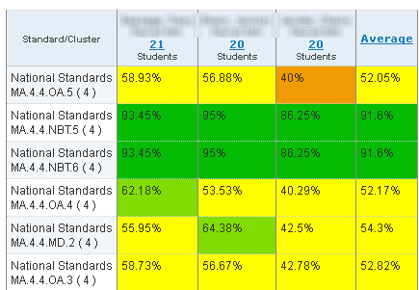
School Exam Report
Teacher A
Teacher B
Teacher C

Slide 6
Classroom Exam Report

Slide 7
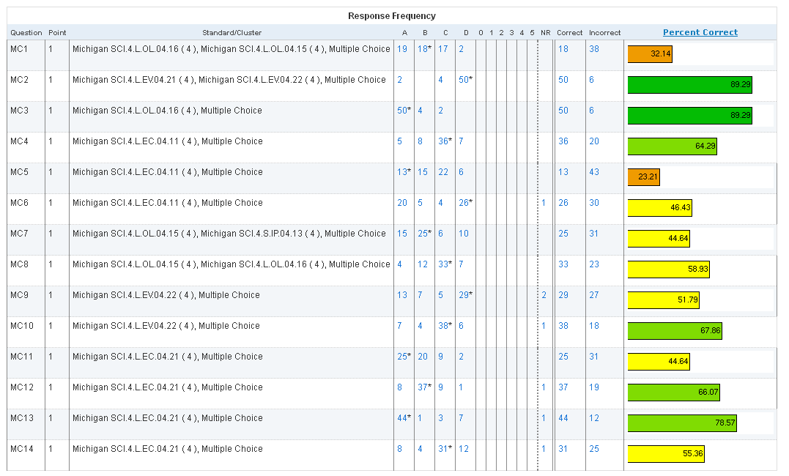
Classroom Exam Report

Slide 8
Reports for Specific Situations
PLC
School Exam Report
Individual Data Conference
Classroom Exam Report
Classroom Performance Summary Report
Tutorials
http://goo.gl/TMSR5

Slide 9
Classroom Performance Summary Report

